Slide 1
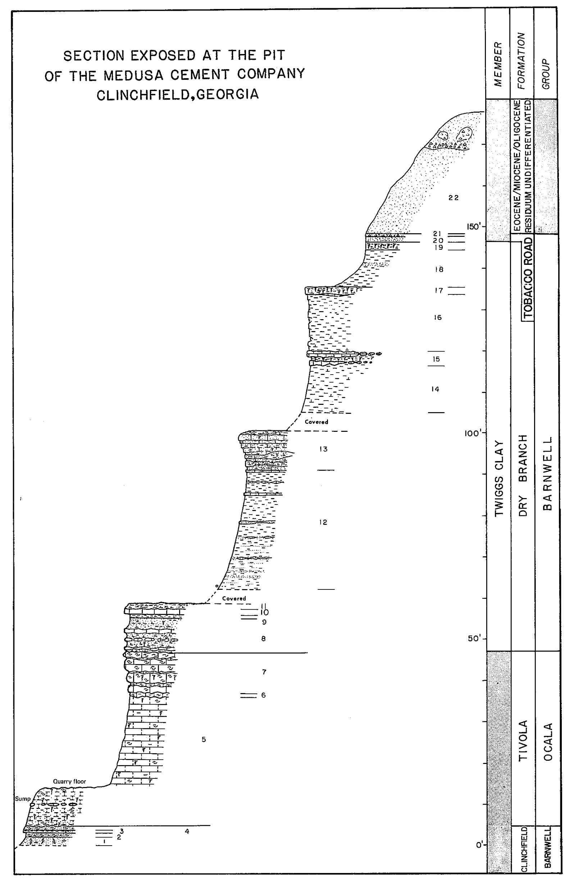
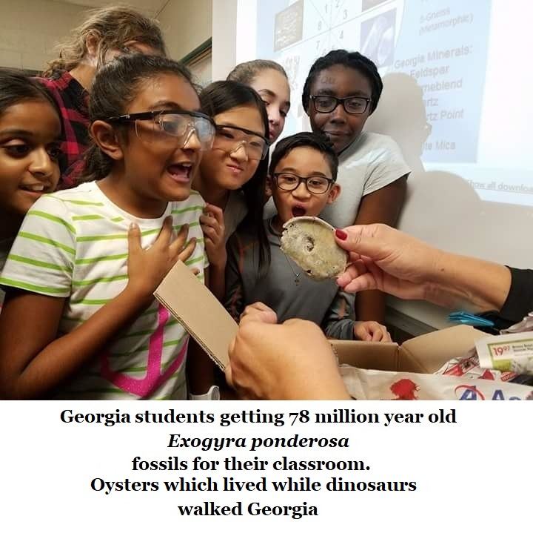

A Glimpse into the
Natural History of
Houston County, Georgia
Medusa Cement Company
is now
Cemex
By
Thomas Thurman
Creator, Owner, &
Lead Author of
GeorgiasFossils.com

Slide 2
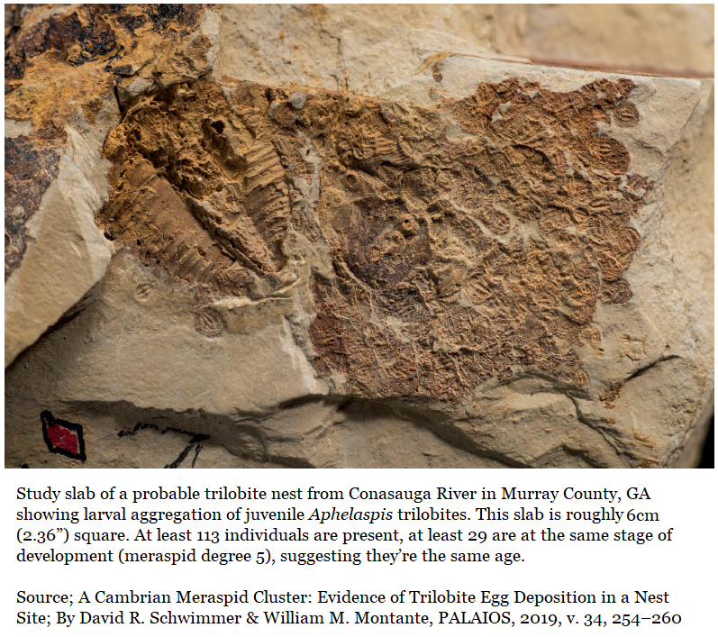
Georgia’s
500 Million Year Fossil Record
One of Georgia’s many contributions to science is the earliest known nest homing behavior; similar as that seen in modern salmon.
A small, three-inch square slab, form Murray County in NW Georgia shows Earth’s oldest known record of offspring returning to their nest.
29 adolescent juveniles are preserved near a shed adult trilobite skin.

Slide 3
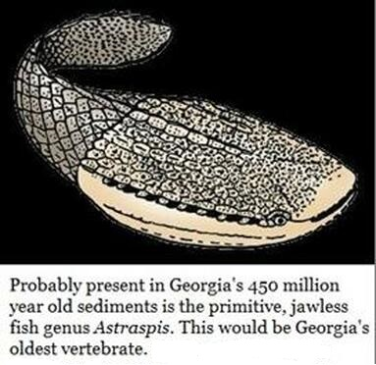
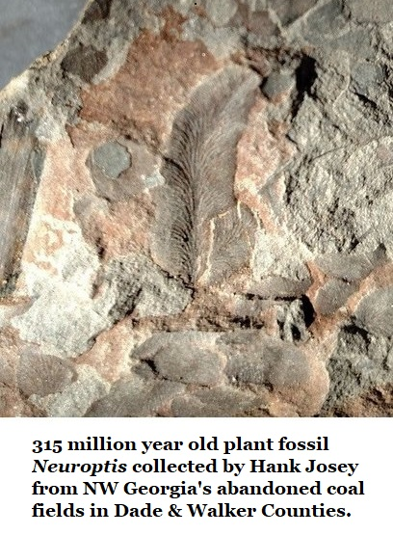
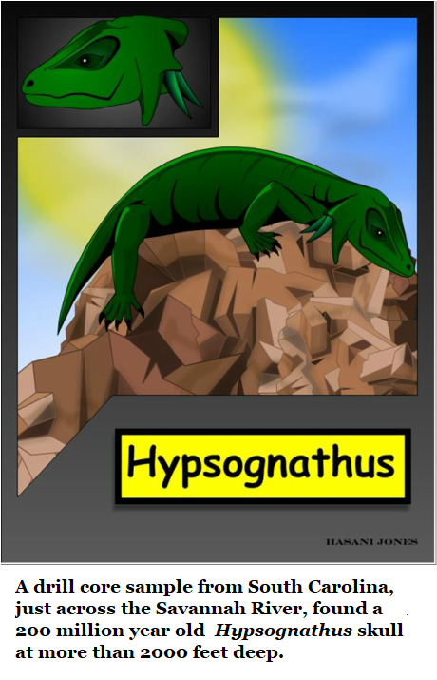
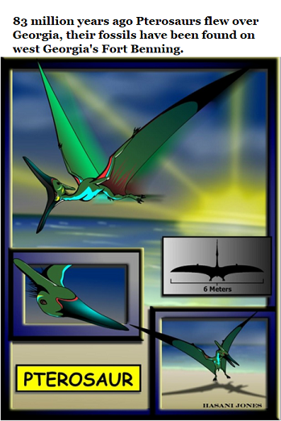
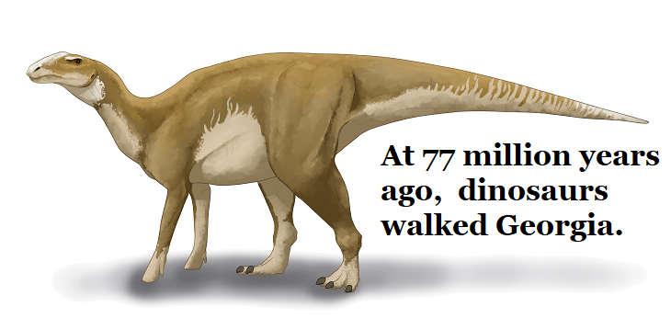
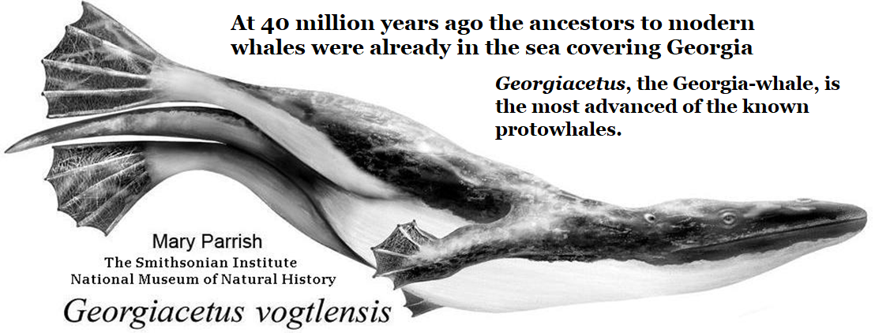
Georgia’s fossil record clearly illustrates the continuous evolution of life and an ever-changing Earth.

Slide 4
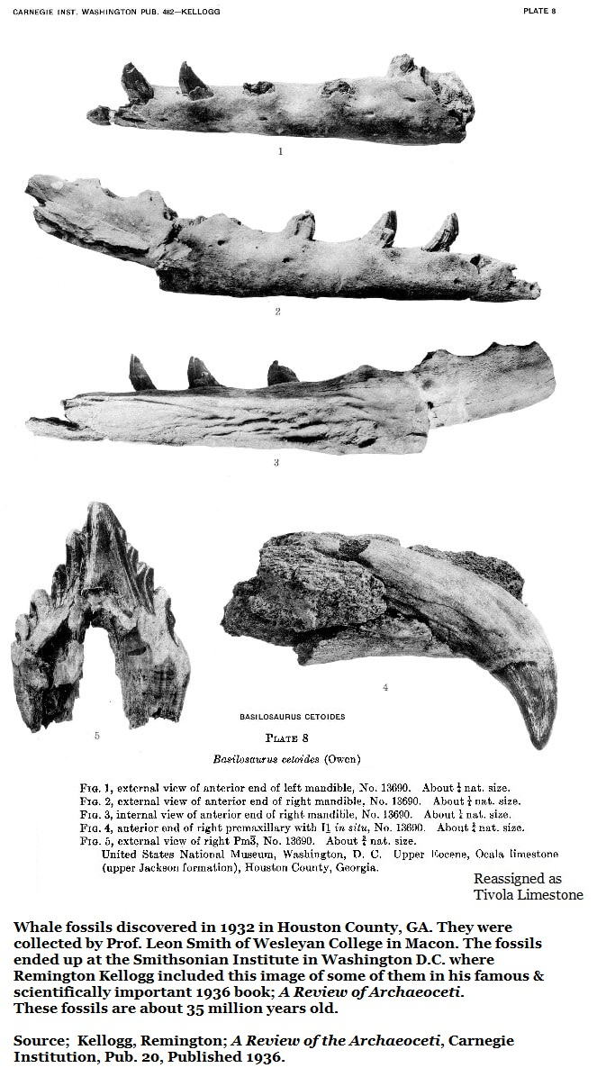
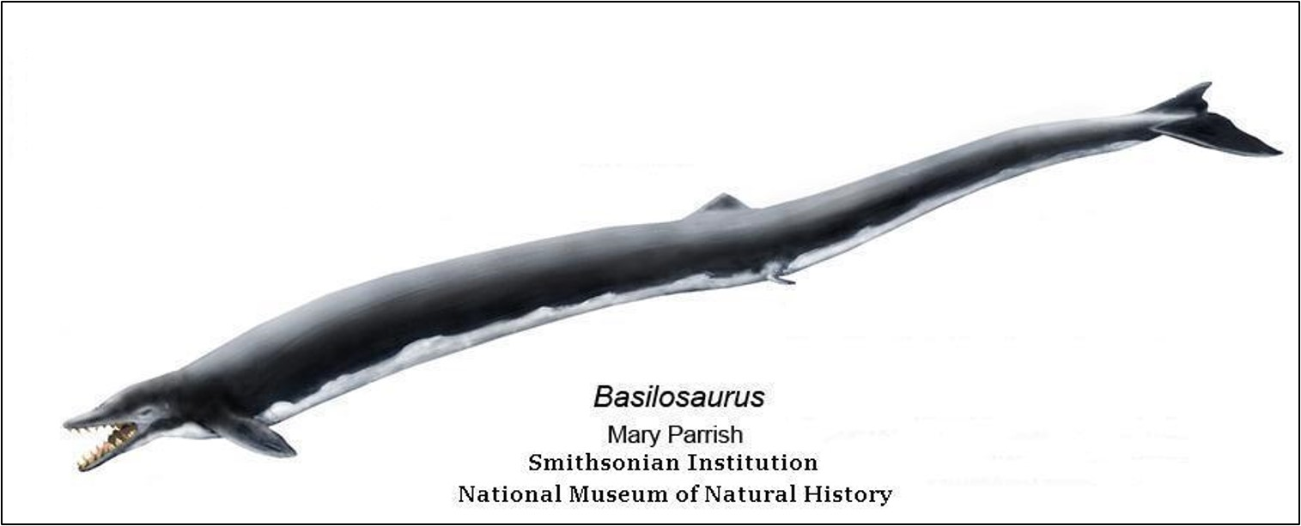

Diver, roughly 7ft long with fins, shown for scale.
Humans, of course, were still 33+ million years in the future.
From 37 to 34 million years ago the basilosaurids, the first great whales, populated the sea typically covering Georgia’s Coastal Plain.
Basilosaurus cetoides was present and reached 60+ feet, fossils recovered from Houston County in 1932 are on display at the Smithsonian.
In 1925 six vertebra of the slightly smaller Cynthiacetus maxwelli (about 40 feet) were reported from Crisp County, near Cordele.
In 1973 the twenty-foot Durodon serratus at Macon’s Museum of Arts & Sciences, was collected from Twiggs County.

Slide 5
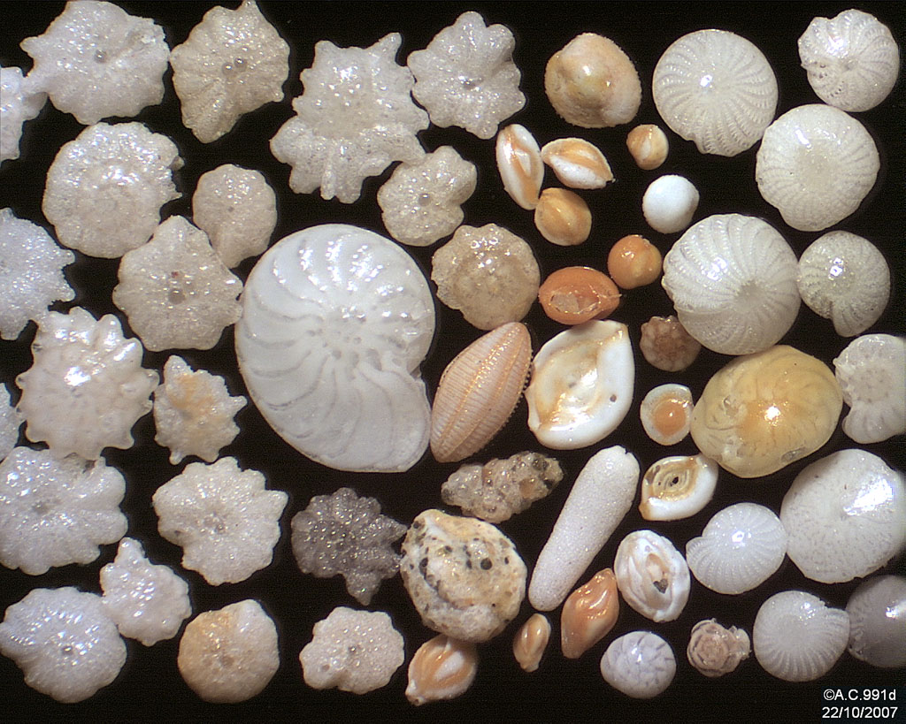
How do we know the age? Foraminifera.
Forams, for short.
The oil exploration requires the ability to date sediments.
Microscopic forams are essentially ameba which create easily preserved shells.
40,000 species occur in a fossil record stretching back 150 million years.
Thanks to heavy financial investment by the oil industry the evolution of forams is well understood.
A timeline has been assembled for the emergence and extinction of many foram species; this creates the ability to date sediments.
Foraminifera or forams for short
You need only collect a sample and identify the species present.
Look up the emergence and extinction of each.
The more species you identify, the greater accuracy you can achieve in dating.

Slide 6
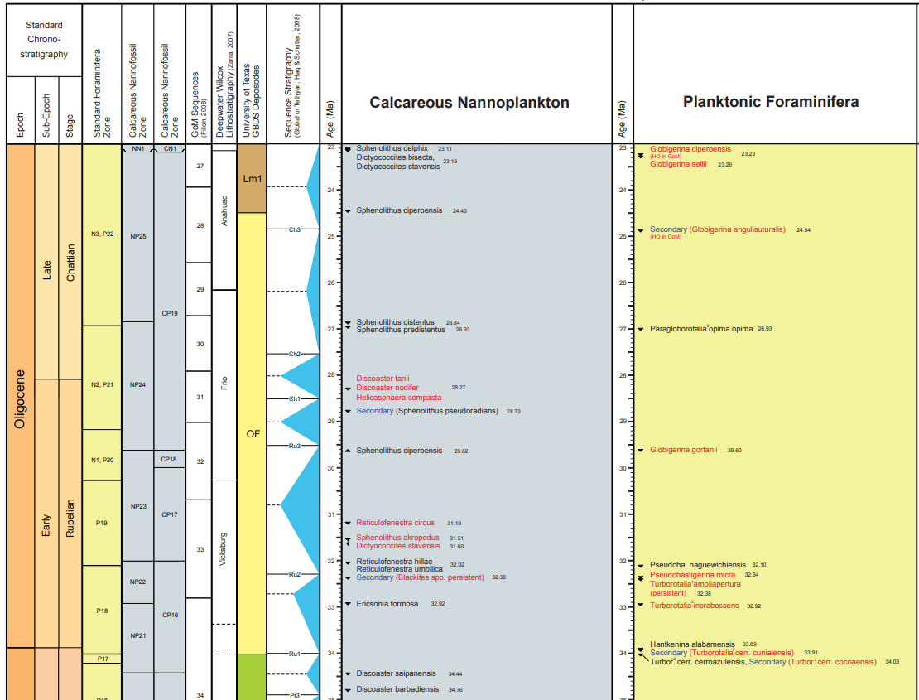

Paleodata.com
Paleo-Data
Oilfield Biostratigraphy
in New Orleans is the Southeastern company maintaining foram dating.
It is a small enough company that Ryan Weber, the President, has personally assisted me, several times, with identifying specimens & dating sediments.

Slide 7
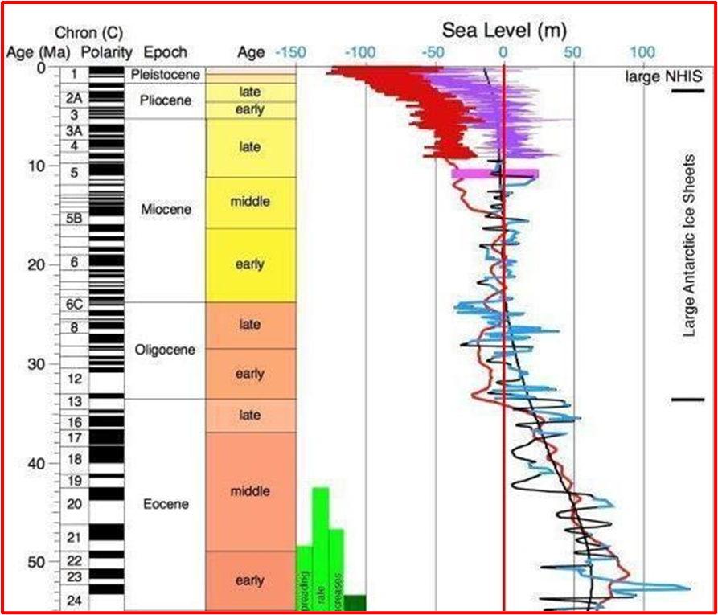
Global sea level change in the last
50 million years
The red line from zero down represents modern coastlines.
Numbers to the right are above modern levels
Numbers to the left are below modern levels.
The numbers are in meters, 50 meters equals 164 feet.

Slide 8
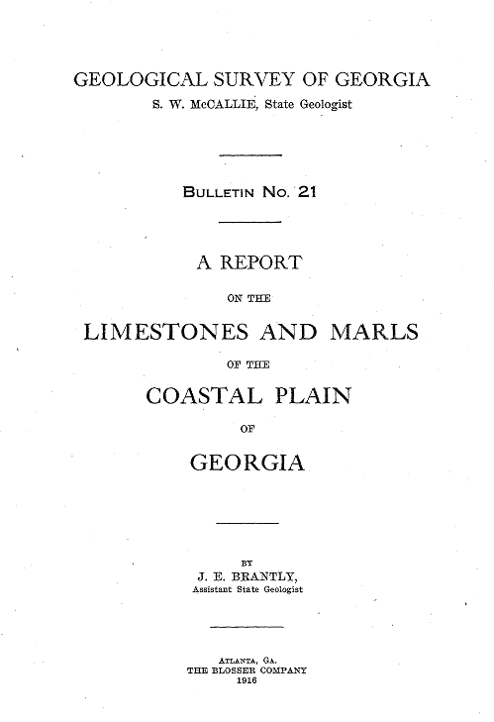
In 1918 The Geological Survey of Georgia published a report on the varied limestones which occur on Georgia’s Coastal Plain.

Slide 9
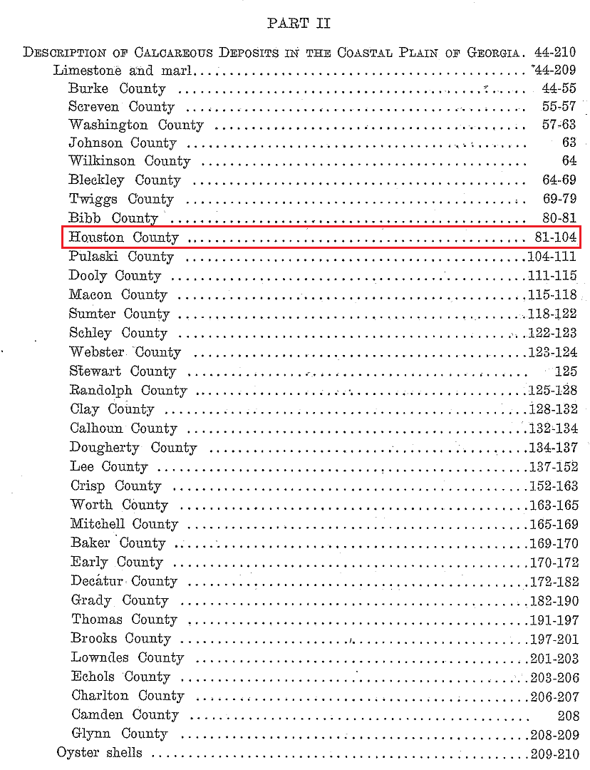
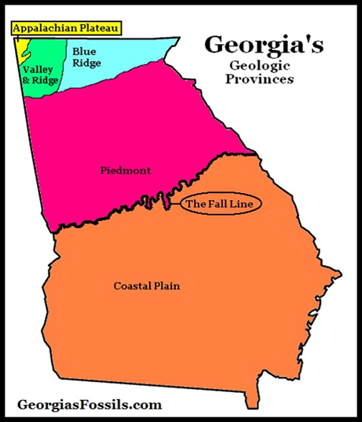
At 23 pages Houston County entry is the longest in that 1918 report.
Burke County
in east Georgia is the next longest at 11 pages.

Slide 10
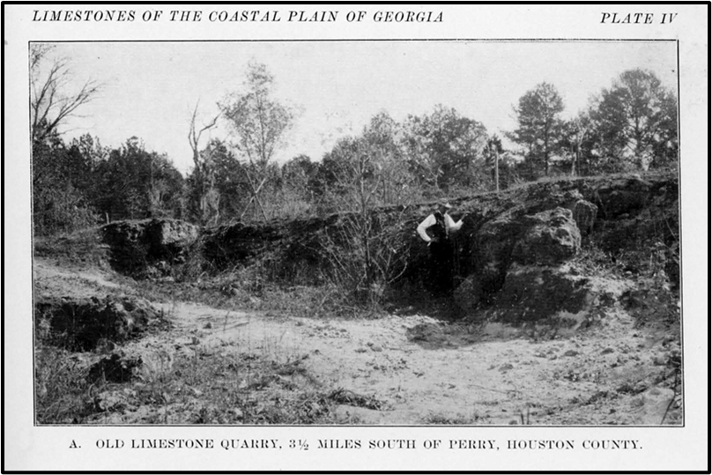
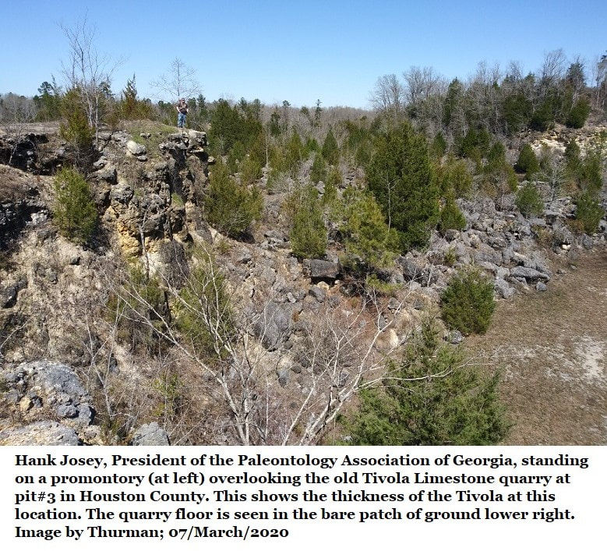
The Tivola Limestone has been continuously mined in Houston County for more than a century.
These two pics are of the same quarry from 1918 & 2020.
In 1911 it was called the “Old Limestone Quarry”.
Here’s Hank
This Elko Road quarry has been silent for 50+ years.
The Tivola Limestone is still actively mined from the same bed about three miles to the southeast.

Slide 11
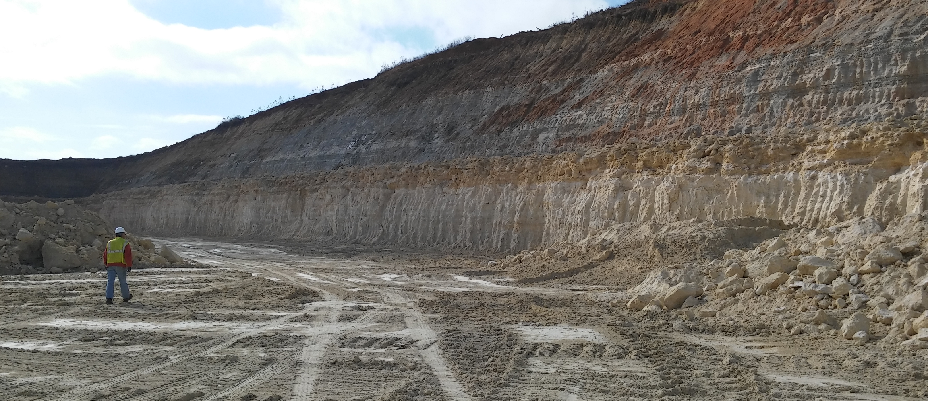
The quarry is about 150ft deep.
A view of the current quarry wall of the Tivola Limestone pit of Clinchfield.
Notice the stratigraphy.
That’s Dr. Burt Carter walking the quarry wall.

Slide 12

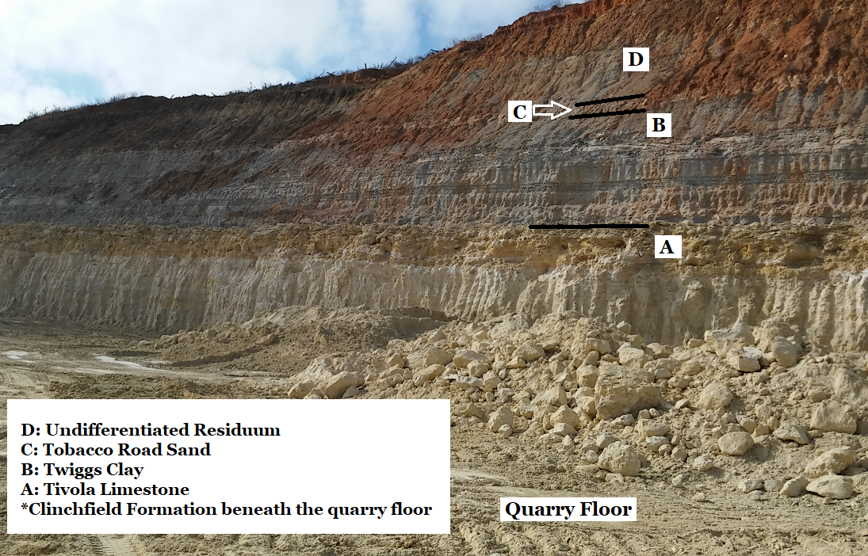
The 1986 drawing to the right shows the stratigraphy of the various beds.
Ocean seashells are abundant in Houston County 150 miles inland from the nearest coastline, they tell the story of repeated climate change.

Slide 13
The Clinchfield Formation
Just beneath the quarry floor the Clinchfield Formation occurs sporadically.
It is Georgia’s single richest source of vertebrate fossils.
9,700 scientifically reported vertebrate fossils have been reported including 50+ species of sharks, reptiles, marine mammals, terrestrial mammals & one bird.
Crassostrea gigantissima oysters were recovered and forams from inside them were used to date the formation to 35.4 million years old, or Upper Eocene in age.
These oysters lived in the intertidal zone. They were submerged at high tide and exposed at low tide.
Those oysters prove that when they lived, the coast was in Houston County.

Slide 14
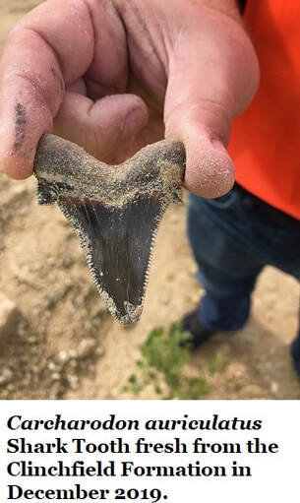
Partial List of Vertebrate Fossils from the Clinchfield Formation
The list does not include the more than 35 species of rays and sharks nor the many species of bony fish
Mammals
Basilosaurus (sp) Great Whale Rare Pickering
Basilosaurus cetoides First great whale 18 vertebral frags Westgate
Brontotheriid Titanothere (Rhino-like) Very Rare Parmley
Brontotheriid Titanothere (Rhino-like) 1 tooth frag. Westgate
Brontotheriid Titanothere (Rhino-like) Tooth frag (2019) Rhinehart
Durodon serratus Whale (Orca sized) 4 teeth/1 cervical Westgate
Daphoenus (sp) Bear-dog Very rare (2019) Rhinehart
Eosiren (sp) Manatee Common Pickering
Hyracodon (sp) Hornless rhino Very rare (2019) Rhinehart
Megacerops (sp) Rhino-like animal Very rare (2019) Rhinehart
Palaeolagus temnodon Rabbit or hare Very rare (2019) Rhinehart
Reptiles
Family: Cheloniidae Sea Turtles Rare Parmley
Family: Trionychinae Soft Shelled Turtles Rare Parmley
Crocodylid Crocodile 25 teeth & 10 bone frags Westgate
Dermochelydidae (sp) Leather Back Turtles Rare Parmley
Nebraskophis (sp) Colubrid Snake Very Rare Parmley
Palaeophis (sp) Palaeophid Snake Rare Parmley
Palaeophis africanus Constrictor Snake Very Rare Parmley
Pterosphenus (sp) Pterosphenus Snake Very Rare Parmley
Pterosphenus schucherti Constrictor Snake Very Rare Parmley
Pterosphenus schucherti Giant aquatic snake 14 vertebrae Westgate
Trionyx (sp) Softshell turtle 17 shell frags Westgate

Slide 15
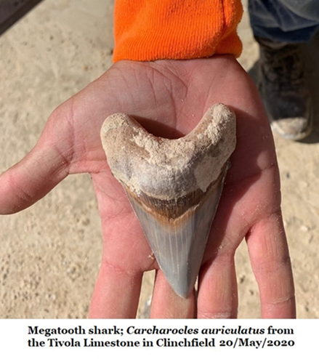
The 35-Million-year-old Tivola Limestone
The quarry is mining the Tivola Limestone, which was formed by a strong current.
Sea levels had risen dramatically. Sea water depth was about 100 ft when the limestone was deposited.
Houston County is submerged and the shoreline is probably north of Macon.
Fossils are often broken and seen in all orientations; this shows that they “settled out” of a strong current.

Slide 16
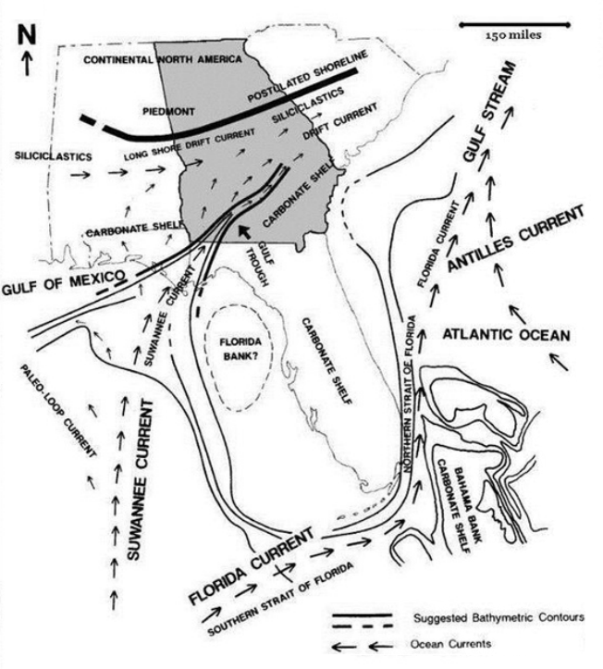
Coastline @
High stand of sea levels
High Sea Levels & Some Fossils of the Tivola Limestone
Vertebrates
Genus & Species Common name Frequency
Lamna apppendiculata Mackerel Shark Rare
Carcharias cuspidate Great White Rare
Galeocerdo latidens Tiger Shark Rare
Myliobatis (species?) Eagle Ray Common
Basilosaurus cetoides Early whale Very Rare
Siren (species?) Manatee (rib frags) Rare
Entelodont (Genus?) Terminator pig Very Rare
Carcharocles auriculatus Megatooth shark Rare
Carcharhinus (species?) Requiem shark Rare
Cretolamna (species?) Mackerel shark Rare
Galeorhinus (species?) Hound shark Rare
Hemipristis (species?) Snaggletooth shark Rare
Odontaspis (species?) Sand Shark Rare
Sphyraena (species?) Barracuda Rare
Invertebrates
Genus & Species Common name Frequency
Phyllacanthus mortoni Sea urchin Common
Oligopygus wetherbyi Sea biscuit Very rare
Periarchus lyelli Sand dollar Rare
Periarchus pileussinensis Sand dollar Abundant
Durhamella ocalanum Sand dollar Common
Durhamella ocalanum Sand dollar Common
Wythella eldridgei Sand dollar Very rare
Paraster armiger Heart urchin Very rare
Macropnuestes martini Sea biscuit Rare
Perry

Slide 17
The Twiggs Clay Member
of the Dry Branch Formation
The Twiggs Clay is a thick bedded, very fine-grained, grey clay. It’s approximately 34.35 million years old.
Sea levels were still very high, but conditions had changed.
This was a quiet sea; clay particles the last thing to settle out of river deposits.
The Twiggs is not rich in fossils but there are fossil bearing beds scattered through it which can be fossil rich.
Red sandy-clay fossil beds bearing terrestrial vertebrates have also been reported in Twiggs County.
A fossil-rich tempest-deposit limestone bed can be seen in Houston County’s Oaky Woods WMA.

Slide 18
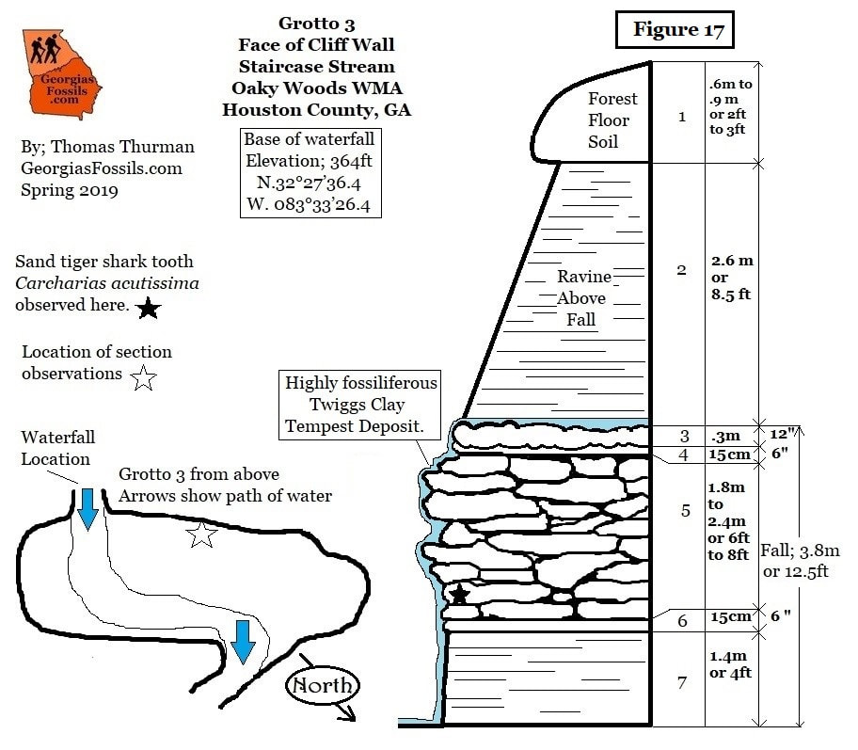
34-Million-Year-Old
Super Typhoon Deposit
This is a diagram of a 25-foot cliff wall along an Oaky Woods stream.
The whole wall is Twiggs Clay.
Section 5 is an 8-foot, fossil rich, limestone bed in Twiggs Clay interpreted as a super storm event and a large storm surge.
Both sections 3 & 6 are sandy limestone beds which bracket the storm deposit.

Slide 19
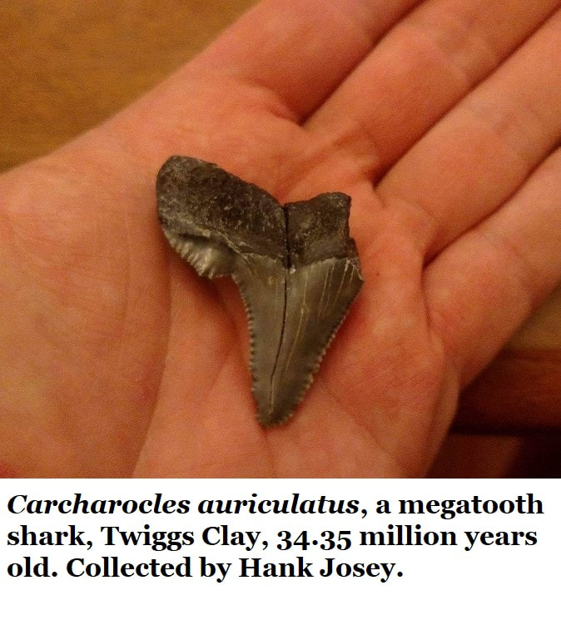
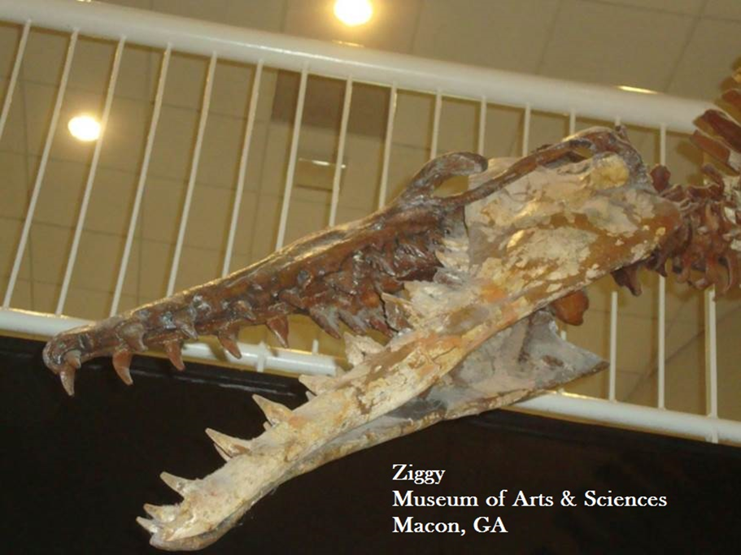
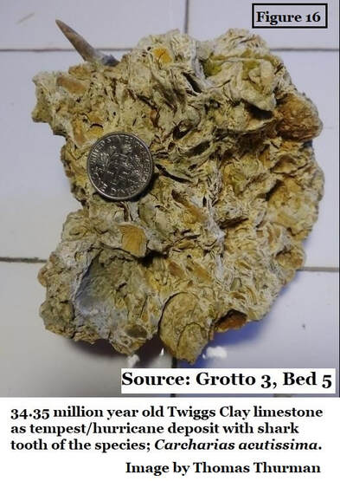
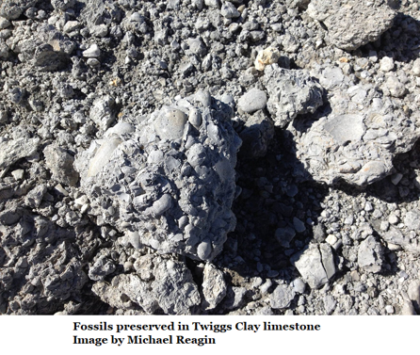
Some Twiggs Clay
Fossils
Ziggy…
The Durdon serratus on display at the Museum of Arts & Sciences in Macon, Georgia was discovered and recovered from the Twiggs Clay in 1974.

Slide 20
The Tobacco Road Sand, 33.9 Million Years Ago
Houston County is again coastal with our hills are forming barrier islands.
The rust-stained deposit is just 9 inches thick in Clinchfield while a few miles north in Houston County’s Oaky Woods, its 10 feet thick.
This is a near-shore, river borne sand deposit, fossils are present but not in great numbers; sand dollars and sea snails dominate.
The long warm-earth period is ending.
For 30 million years sea levels had been higher than they are today, peaking more than 450 feet above today’s shoreline.
Now, the world was cooling, large glaciers were beginning to build at the poles and sea levels are falling as this formation was being laid down.

Slide 21
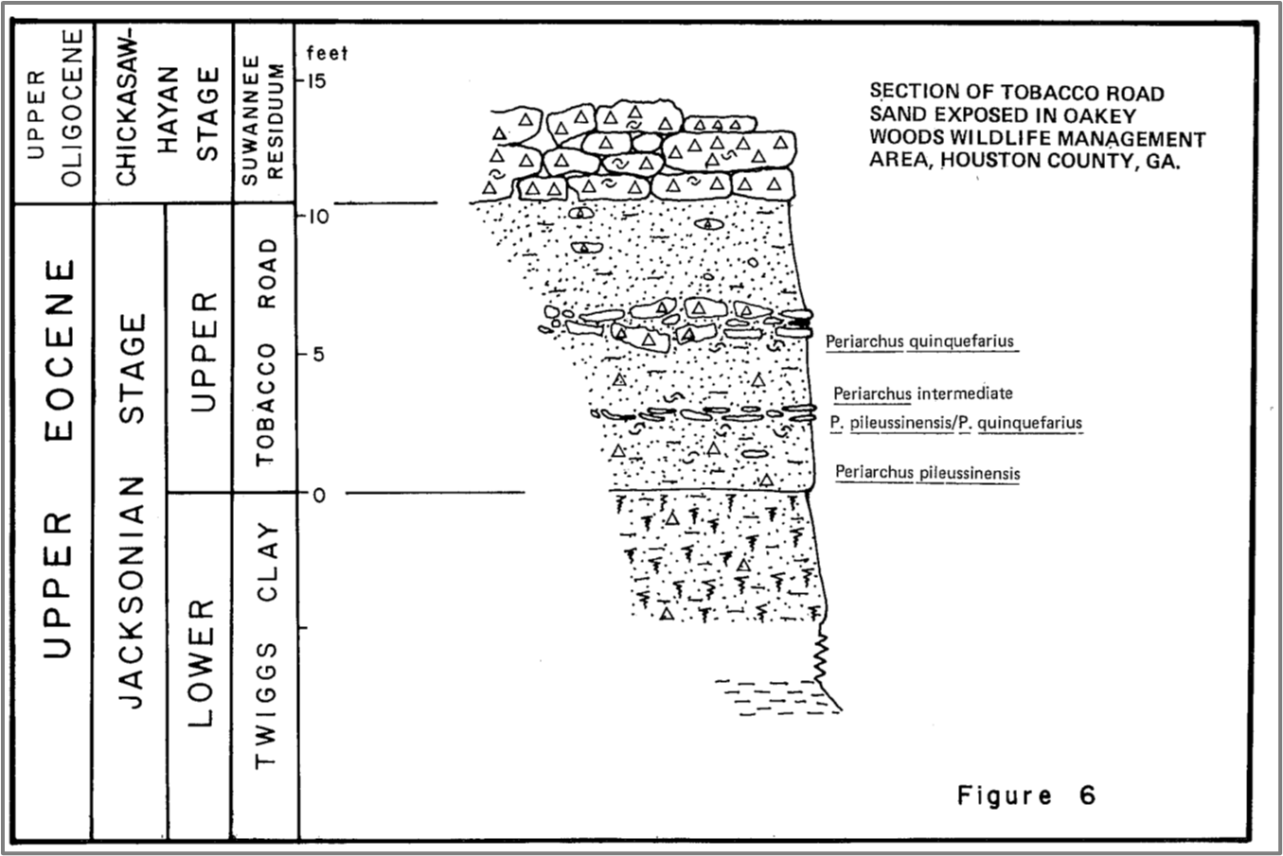
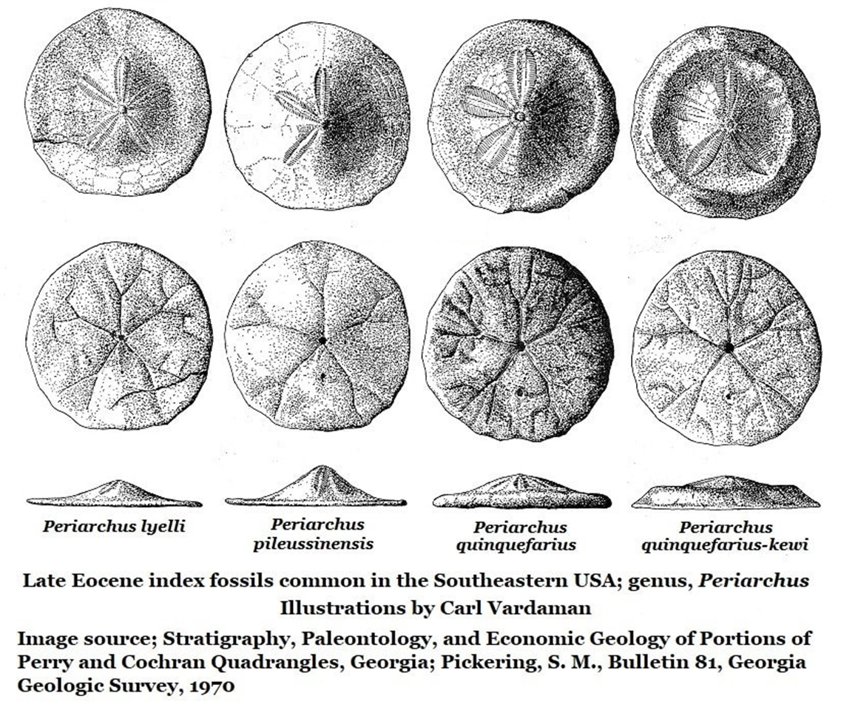
The Tobacco Road Sand
& Ocmulgee Formation
meet in
Oaky Woods
Wildlife Management Area
Also in Houston County is the Ocmulgee Formation, a marine limestone deposit with very little sand or clay.
The Tobacco Road Sand and Ocmulgee Formation are the same age, they occur side by side in Oaky Woods.

Slide 22
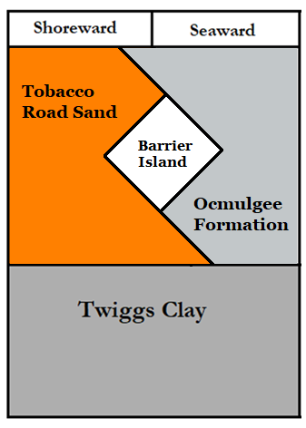
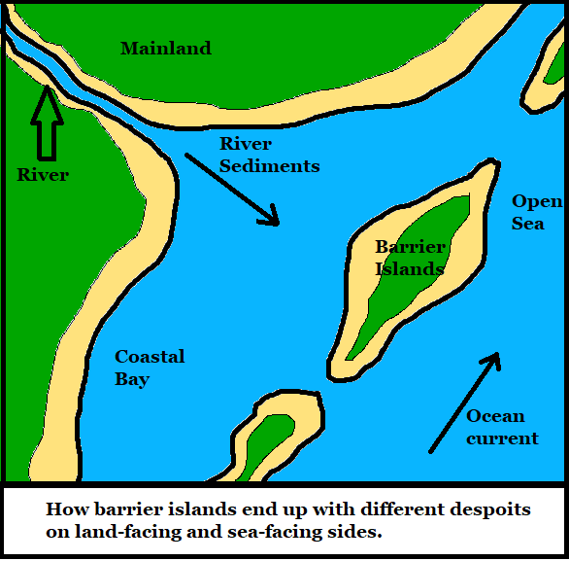
Barrier Island Environment
There’s a hilltop in Oaky Woods
which was a barrier island 34 million years ago.
On the Northeast flank of this hill there’s a marine limestone deposit of the Ocmulgee Formation. #1
On the Southwest flank, there are the, river borne sand deposits of the Tobacco Road Sand. #2
#1
#2

Slide 23
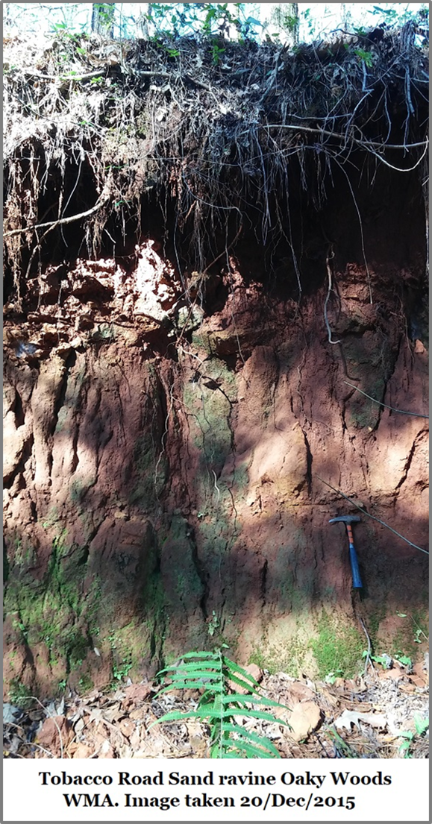
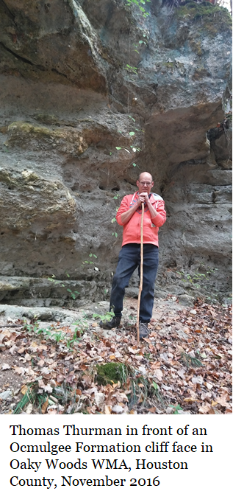
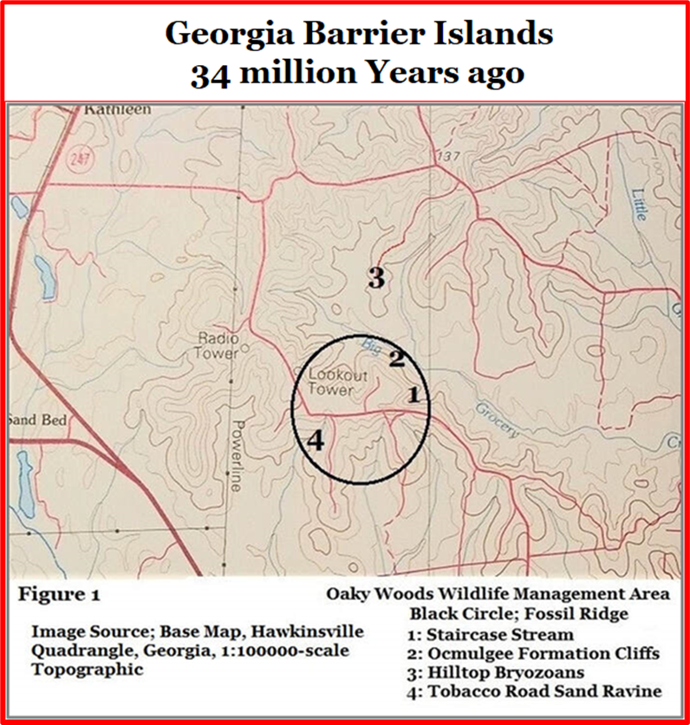
These two very different formations, occur on opposite sides of the same Oaky Woods hill.
Evidence of a hill
That was once an island.
Location 2
Tobacco Road Sand
Ocmulgee Formation
Location 4

Slide 24
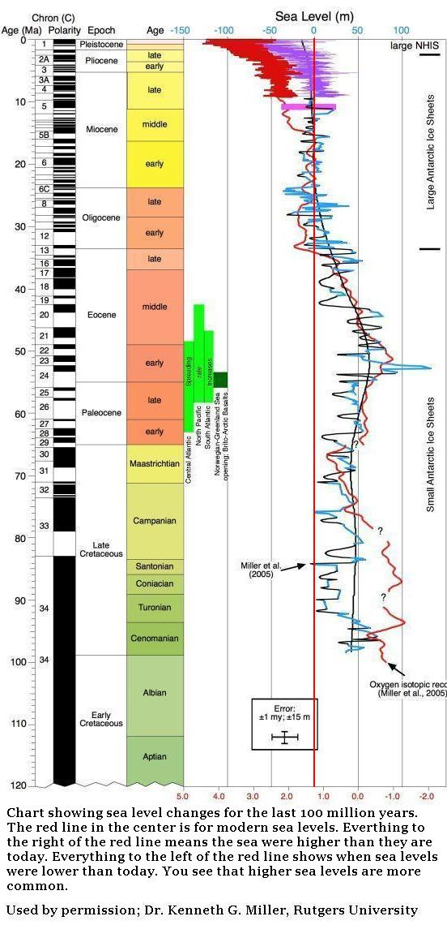

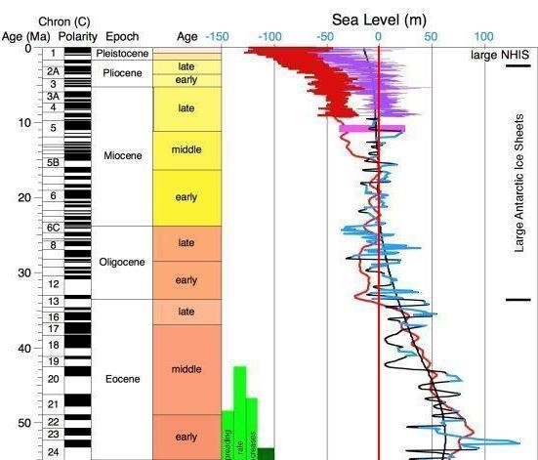
The Eocene Epoch ended with the first major glacial event in more than 30 million years.
Glaciers grew until coastlines retreated far below modern shorelines.
Houston County was again dry and cold.
A global extinction event occurred.
Then the climate reverses again and warms, opening the Oligocene Epoch.
Sea levels rose and Houston County was again submerged.
New fossil beds were laid down.
The Oligocene
Glaciers Grow & Sea Levels Fall.
Glacier Melt & Sea Levels Rise.
Fluctuating sea levels of the last 100 million years

Slide 25
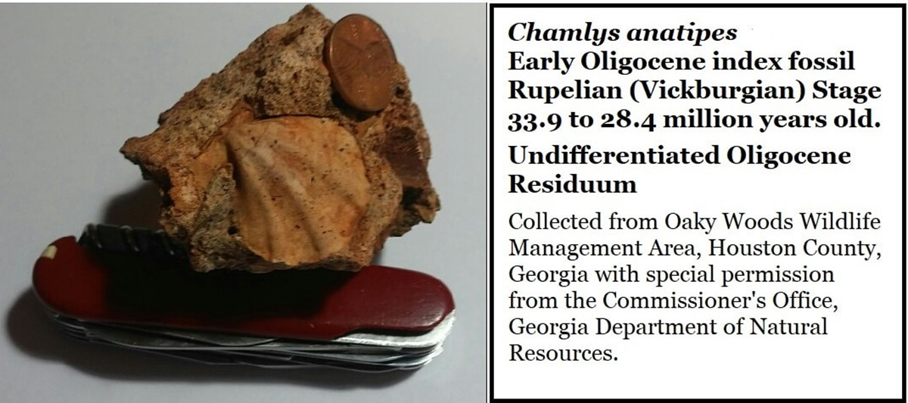
Early Oligocene
Undifferentiated Residuum
Began as fossil-rich limestone 33 million years ago, after the extinction event.
Now it is a sandy red clay with fossil bearing boulders, dornicks, & pebbles.

Slide 26
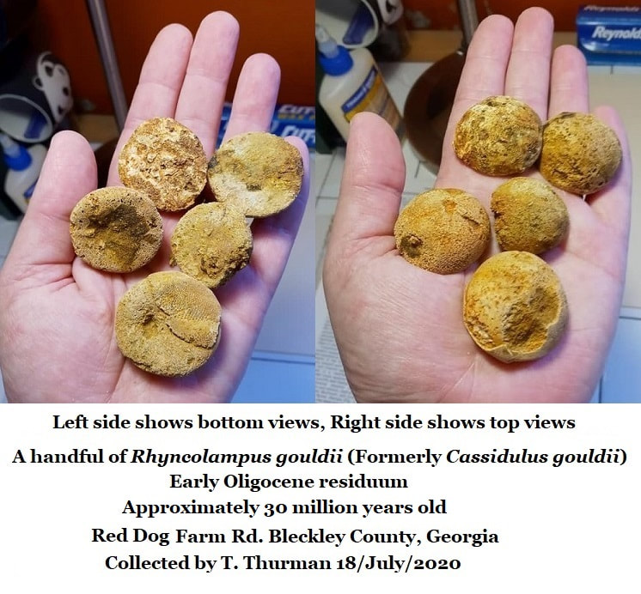
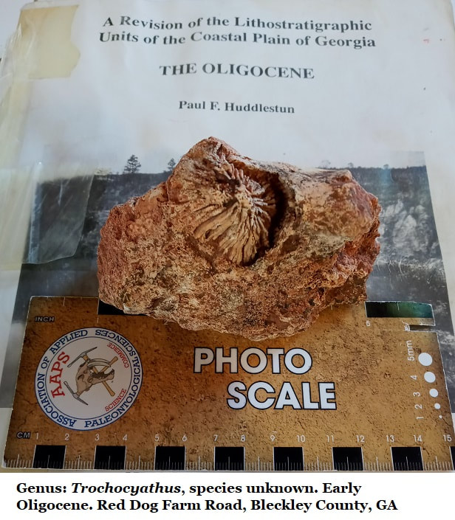
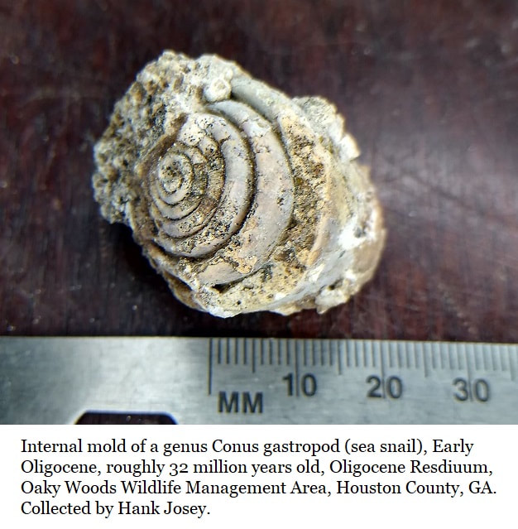
How does soft limestone become hard chert?
Sea levels were high, Houston County was submerged and the limestone formed.
The climate shifted again, the glaciers return, sea levels fell, & Houston County is again high and dry.
The limestone, now far inland, is buried by later sediments.
It absorbed fresh groundwater rich in silica, this changes some of the soft limestone into hard chert.
When the silica became exhausted, the groundwater became acidic.
Acidic groundwater slowly dissolves limestone.
Chert is unaffected by the acid.
The limestone dissolved & weathered away leaving the chert behind.
Early Oligocene Fossils in chert,
30 million years old.

Slide 27


We have loose boulders & dornicks of fossil rich chert.
The fossils are about 33 million years old.
They red clay holding the chert is younger
  We just don’t know how much younger.
We know that in the last 25 million years there’s been a vast amounts of erosion.
13 million years ago small primitive horses, beavers, rhinos, and a canid (distant relative of dogs) roamed Georgia, their fossils have been found in south Georgia’s Echols County.
5 to 7 million years ago different primitive horses roamed Taylor County, their fossils were reported from Reynolds in 1974.

Slide 28
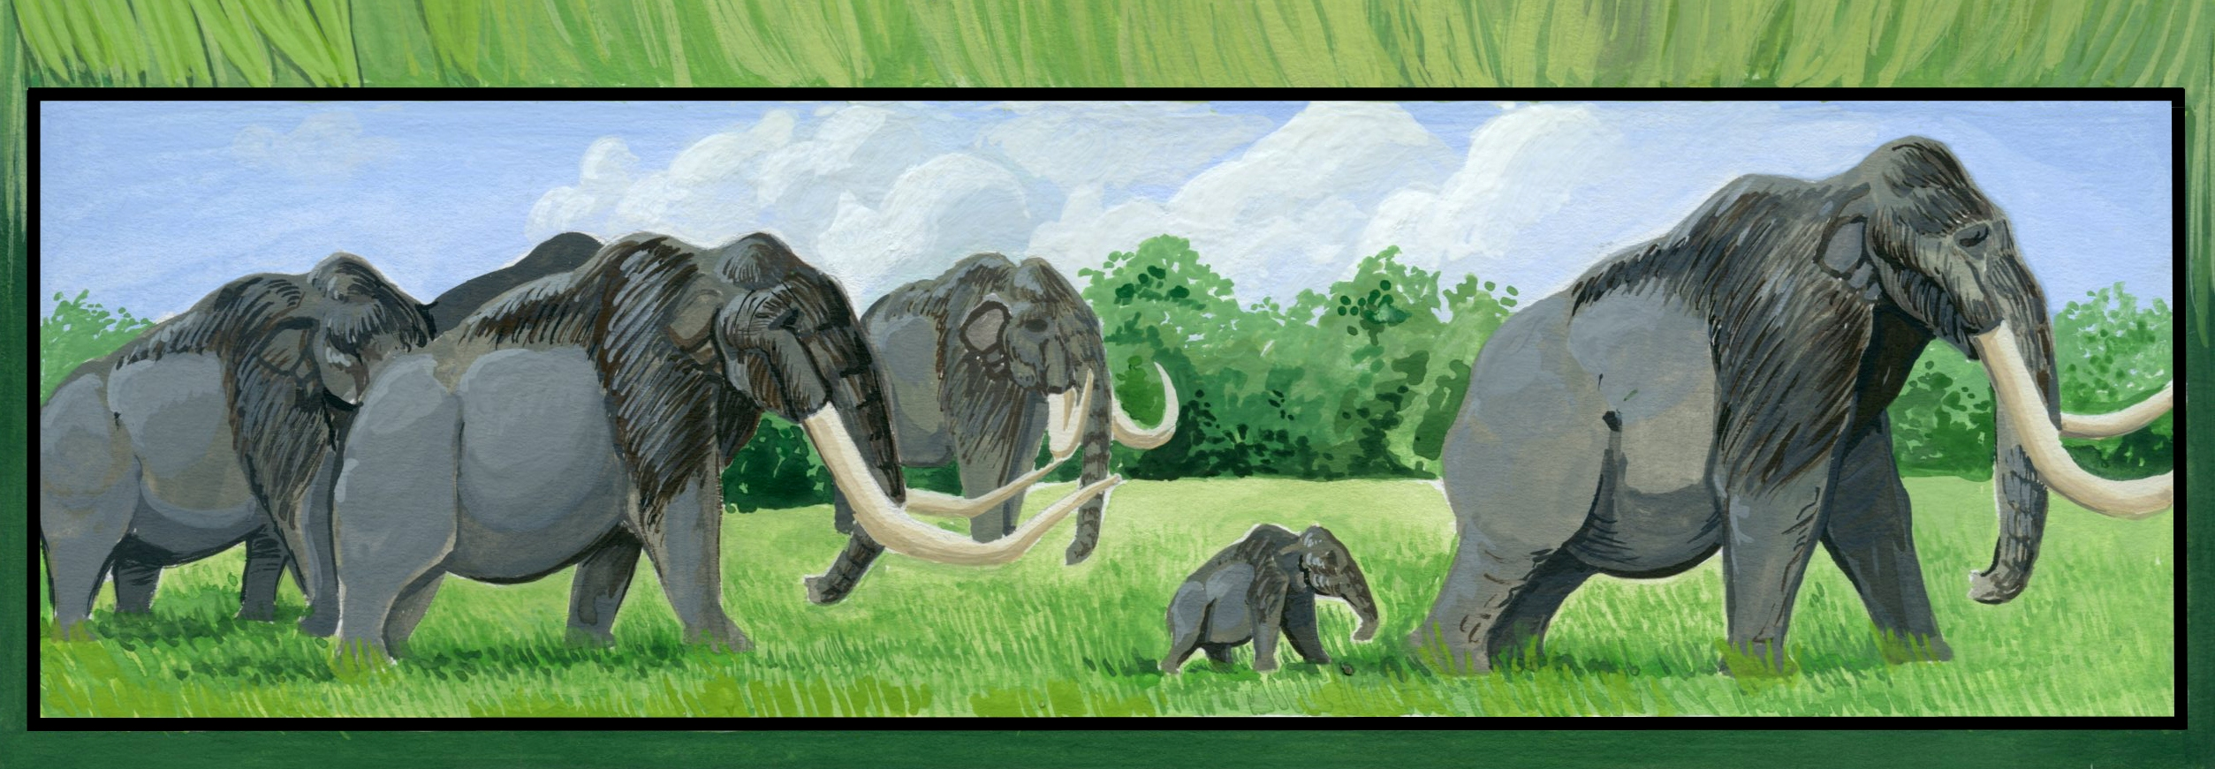
10 million years ago
The tempo of glacial advance and retreat
dramatically increased.
Sea levels rose and fell with much greater frequency.
This has been attributed to Antarctica moving into its current position and a circum-polar current becoming established, permanently freezing Antarctica.
These are the “Ice Ages”
Mastodons & Mammoths walked Georgia.

Slide 29
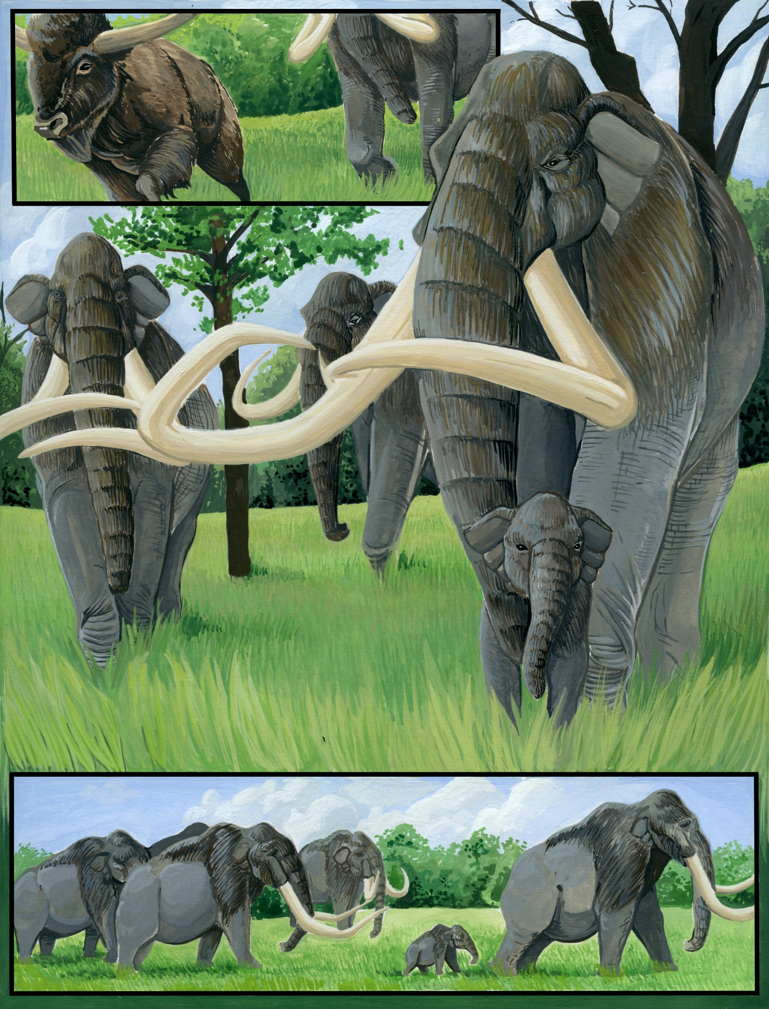
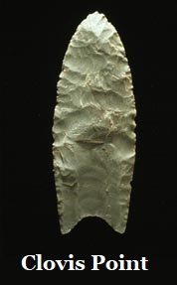
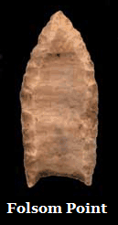

Mastodons & Mammoths
are known throughout Georgia.
Ocmulgee Indian Mounds in Macon reports continuous human habitation for 17,000 years.
The Clovis point emerged at least 13,000 years ago and endured until 10,000 when the Folsom point appeared.
A Clovis point was recovered from Houston County’s Oaky Woods WMA.
The Columbian Mammoth, largest member of the elephant family, went extinct 11,500 years ago.
The Clovis are known to have hunted mammoths in other parts of the USA.
It is probable that the Clovis people hunted mammoths in Georgia too.
Columbian Mammoths
Were described from a Georgia Fossil

