Slide 1
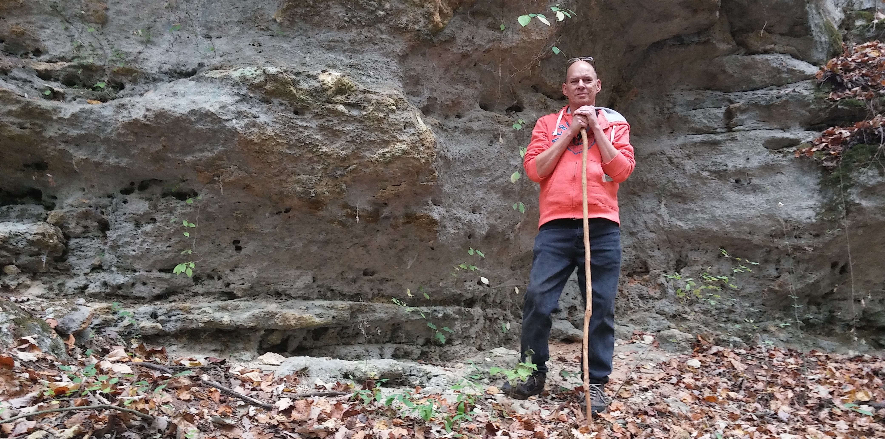
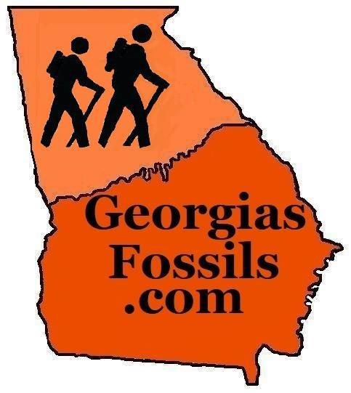

THE
STRATIGRAPHY
OF
OAKY WOODS
WILDLIFE MANAGEMENT
AREA
Georgia DNR requests that anyone using the state’s Wildlife Management Areas (WMA) purchase a Hunting License, Fishing License or a Land Pass.
Proceeds support wildlife management.
It is illegal to collect fossils in WMAs without written permission from the Commissioner’s Office; collection by photography only please.

Slide 2
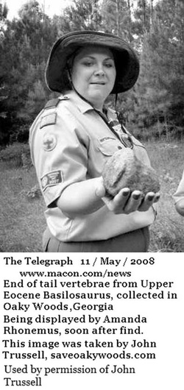
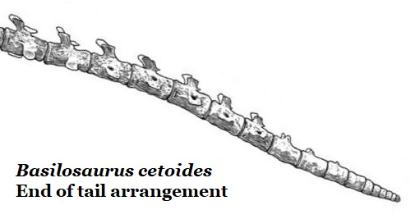
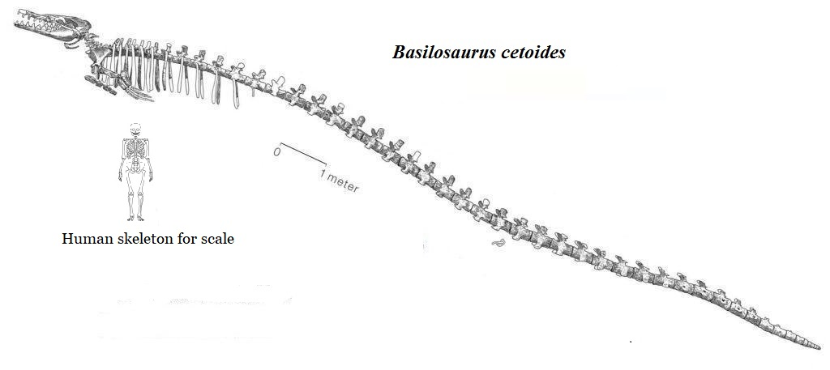
In 2008 John Trussell of Save-Oaky-Woods asked for help in identifying a fossil that Boy Scouts found during a hike.
It was an end-of-tail vertebrae from a large basilosaurid whale.
So I asked; “Where’d it come from?”

Slide 3

To be fair…
I’d been warned about delving into the complexities of
Georgia’s Coastal Plain stratigraphy.
Yet, aren’t such complexities resolved by performing detailed field observations
& reporting your findings?

Slide 4
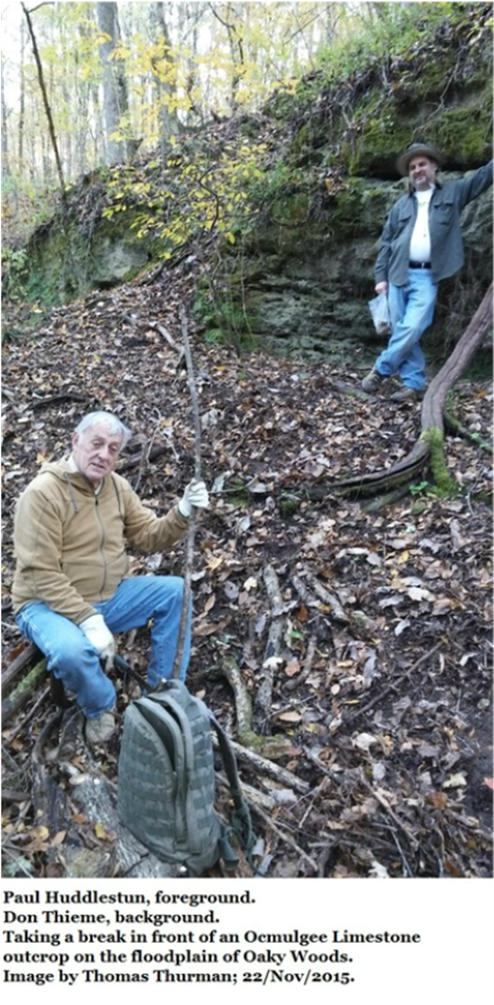
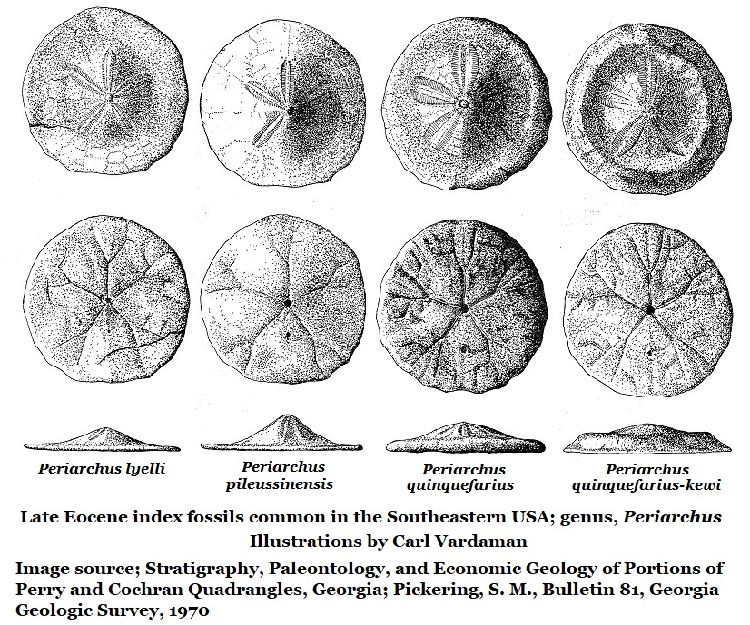
Trussell guided me to a previously unidentified Ocmulgee Formation cliff face.
The Ocmulgee Formation had never been reported so far north in Georgia.
This new site is important because a series of cliffs is present.
  These are the only known large, publicly accessible outcrop of the formation.
The type locality is at Taylors Bluff and is only accessible from the Ocmulgee River.
Periarchus sand dollars are present in Oaky Woods and Taylors Bluff, confirming a late Eocene age.
Red dots mark species observed at both the Oaky Wood’s cliffs & Taylor’s Bluff
Image at right;
2015 Paul F. Huddlestun, confirmed the Ocmulgee Forfmation in Oaky Woods.
Don Thieme from Valdosta State University advised us.

Slide 5
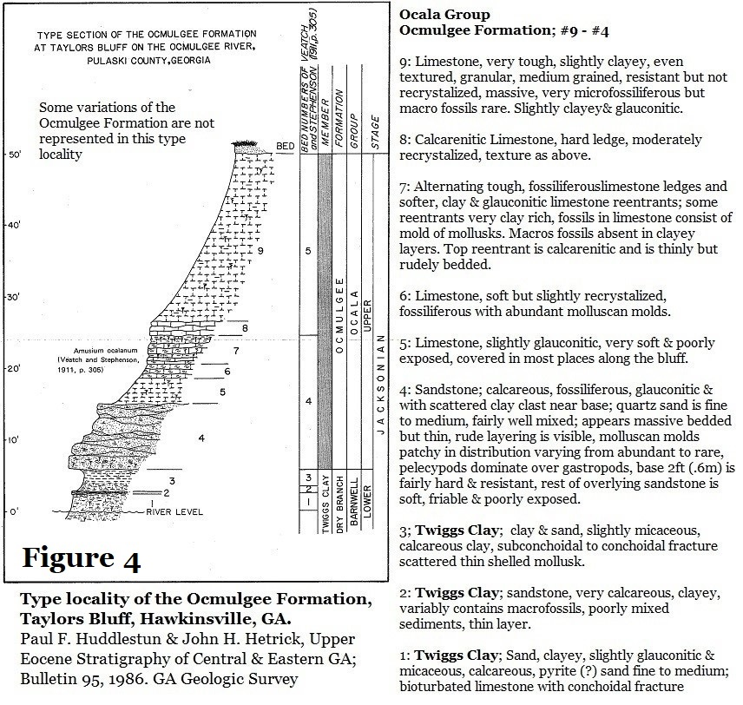
By way of definition;
The Ocmulgee Formation
34 million years old.
Latest Eocene
Priabonian Stage
Late Jacksonian
Named by Huddlestun & Hetrick in 1986.
A marine limestone formation rich in fossils & composed primarily of calcium carbonate from the skeletons of microscopic marine life. It will react vigorously to acids.
Bryozoans populations can be dense enough to give the limestone a rough texture.
It is considered a nearshore deposit.
It is overlain by Early Oligocene residuum.
It is underlain by the Twiggs Clay.

Slide 6
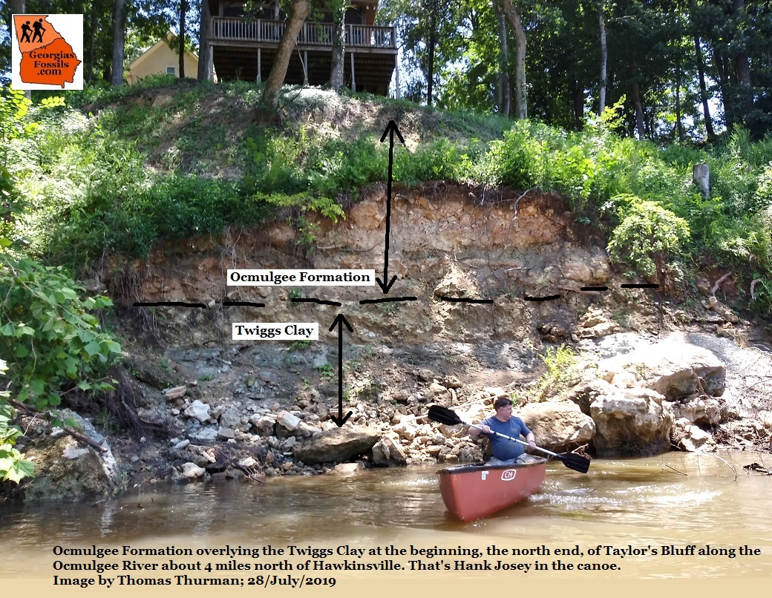
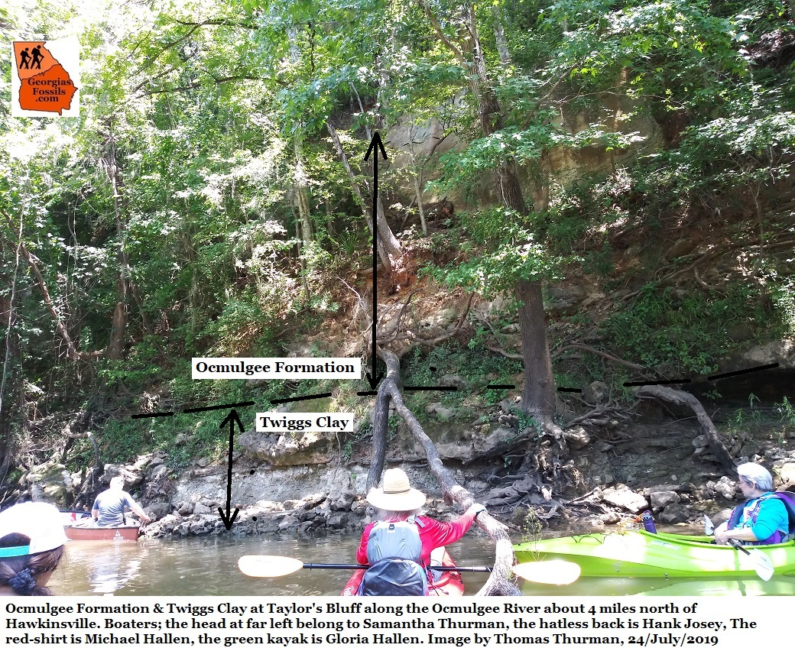
Taylor’s Bluff; is only accessible from the Ocmulgee River.
On 28/July/2019 Mike & Gloria Hallen, Hank Josey, Samantha Thurman and myself visited Taylor’s Bluff, the Ocmulgee Formation type locality.

Slide 7
Also in Oaky Woods…The Tobacco Road Sand
The Tobacco Road Sand occurs in a ravine found in the southwest of Oaky Woods WMA.
Here, researchers reported a possible new transitional species of sand dollar, Periarchus intermediate, between the established species.
Contradictions existed in the published stratigraphy.
  The 1978 report (seen here) states the Tobacco Road Sand is overlain by Suwannee Residuum (Aka; Early Oligocene residuum)
  The 1993 report states is it overlain by the Early Oligocene Shellstone Creek Beds.
The Twiggs Clay occurs beneath the Tobacco Road Sand

Slide 8
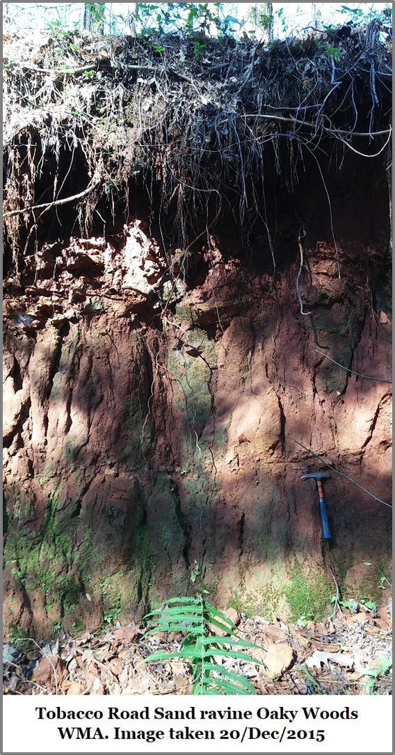
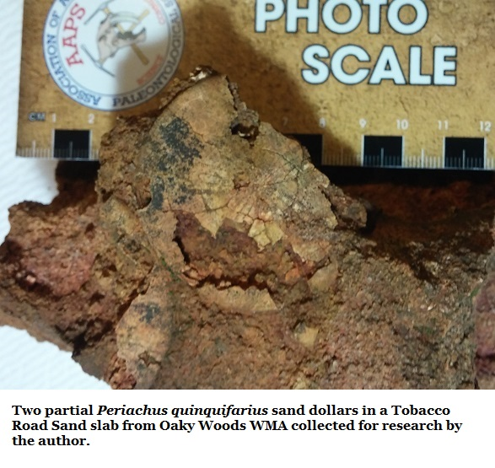
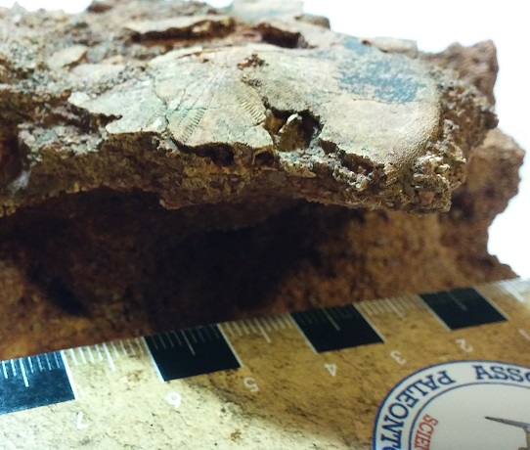
By way of definition;
The Tobacco Road Sand is made up of alternating beds of clay-coated quartz sand stained by iron oxidation. Between these are beds of silicified sandstone slabs.
  These sandstone slabs represent bottom conditions at the end of the Eocene, sand dollars often occur in living positions.
  They show post-mortem damage from ostracod feeding.
  Both Periarchus pileussinensis & Periarchus quinquefarius are present.
  Complete individuals have not been observed at this location.
  One bed shows an abundance of loose Periarchus pileussinensis fragments.
  The Tobacco Road Sand does not react to acid.

Slide 9
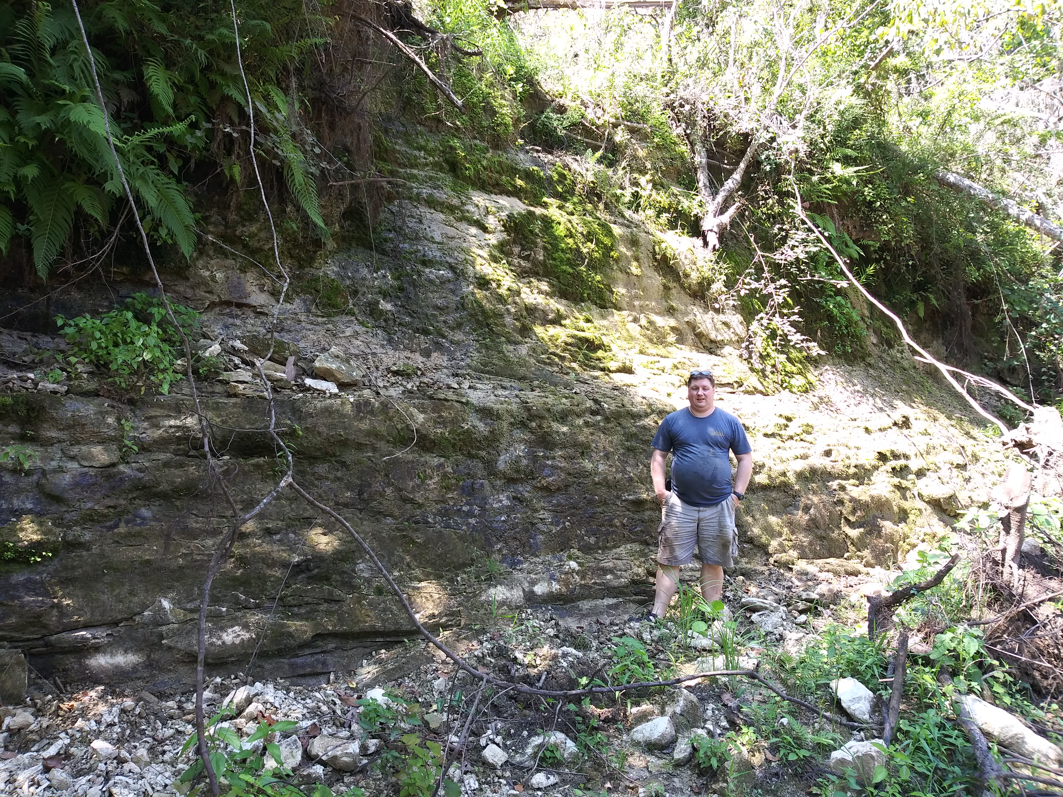
The Twiggs Clay Member of the Dry Branch Formation
While not generally fossiliferous beyond a microscopic scale, beds of limestone occur rarely which can be fossils rich, and lenses/localities occur which are rich in vertebrate fossils.
By Way of Definition; In Oaky Wood the Twiggs Clay underlies both the Ocmulgee Formation and Tobacco Road Sand.
Early researchers believed the Twiggs Clay was volcanic in origin, but in 1970 Sam Pickering showed that it contained no glass and was composed of terrestrially sourced clays.
To quote Pickering’s 1970 report.
“The principal clay mineral is montmorillonite, and at fresh exposures there is usually enough calcium carbonate present as microfossils and silt to clay sized particles to effervesce with 10% hydrochloric acid.”
The Twiggs Clay was deposited somewhat off the shoreline in a very quite environment.
Very fine grains of clay are the last things to settle out of river borne sediments when rivers empty into the sea.
Hank Josey at the Twiggs Clay of Prichards Bluff along the Ocmulgee River July/2019

Slide 10
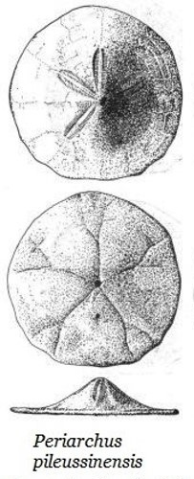
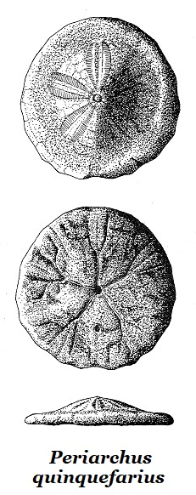
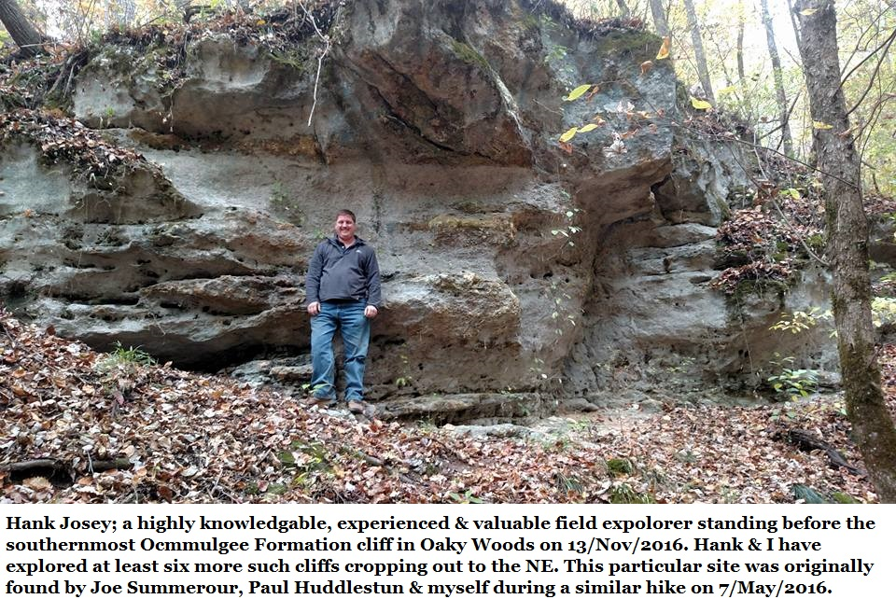

Was there value to an amateur Oaky Woods research project?
There was an unreported, extensive & accessible exposure of the rarely studied end of Eocene Ocmulgee Formation.
There was a potential new species of sand dollar in the Tobacco Road Sand Formation.
There were contradictions in the literature about what sediments occurred above the Tobacco Road Sand.
None of this had been reported in the state’s literature.
?
I soon learned that collecting research samples required the support of professionals & written permission from the GA DNR Commissioner Mark Williams.

Slide 11
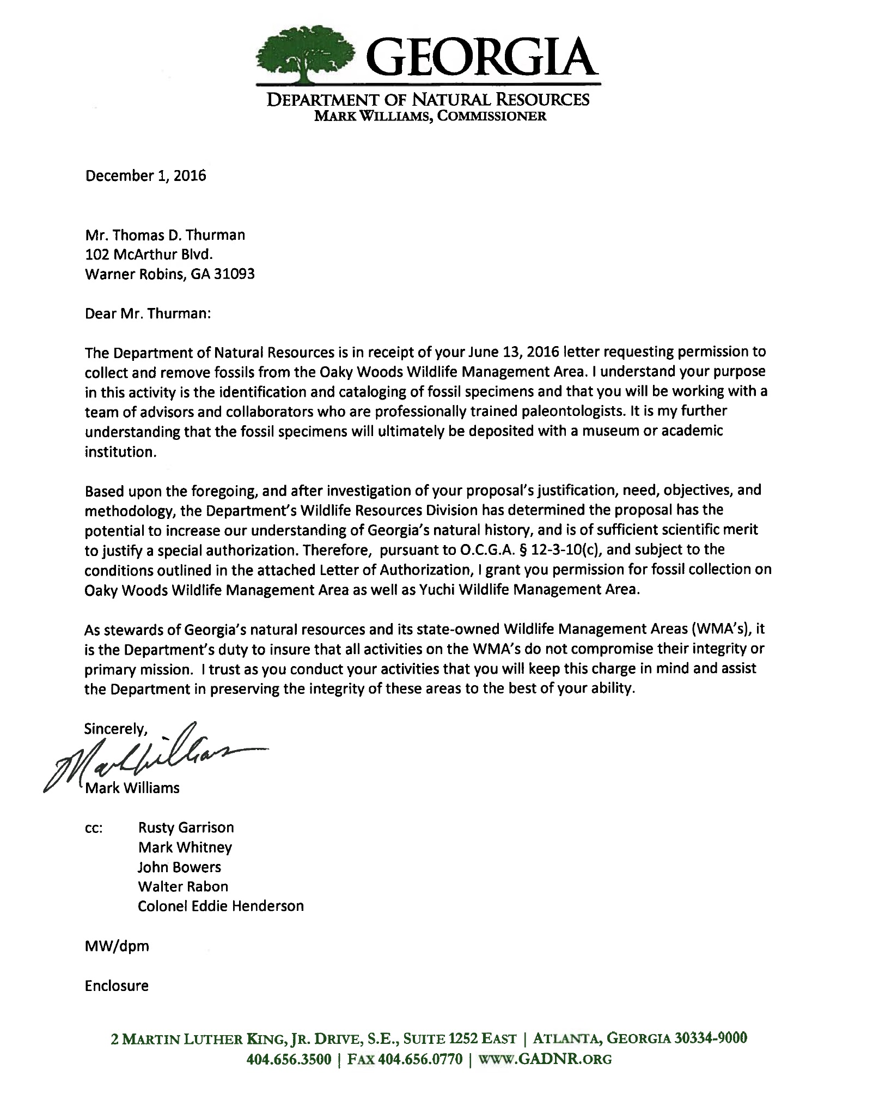
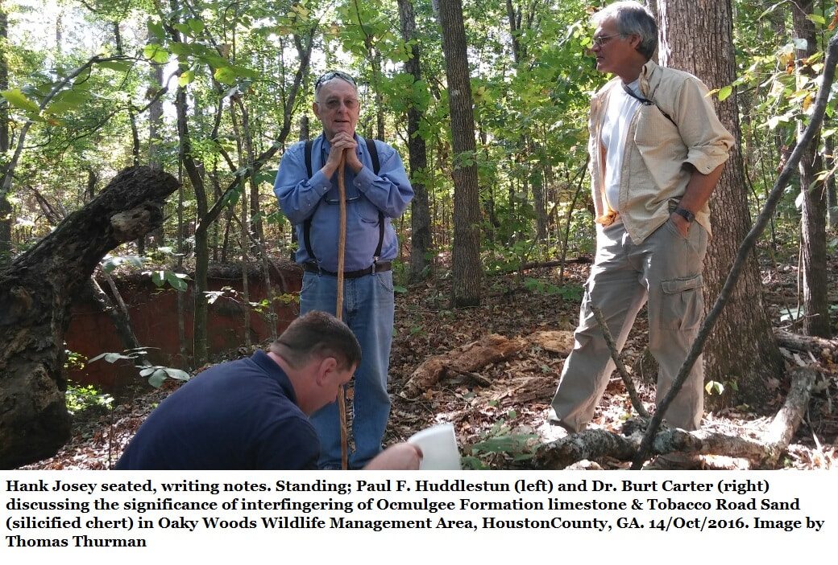
Under the advice & assistance of Don McGowan, the Regional Manager of Game Management for the Wildlife Resource Division of the GA DNR, a team was assembled & permission was granted.
The team included
Paul F. Huddlestun
Burt Carter of GA Southwestern
Don Thieme, Valdosta State University
Roger Portell of the Florida Museum of Natural History
Hank Josey, field researcher and amateur paleontologist.

Slide 12

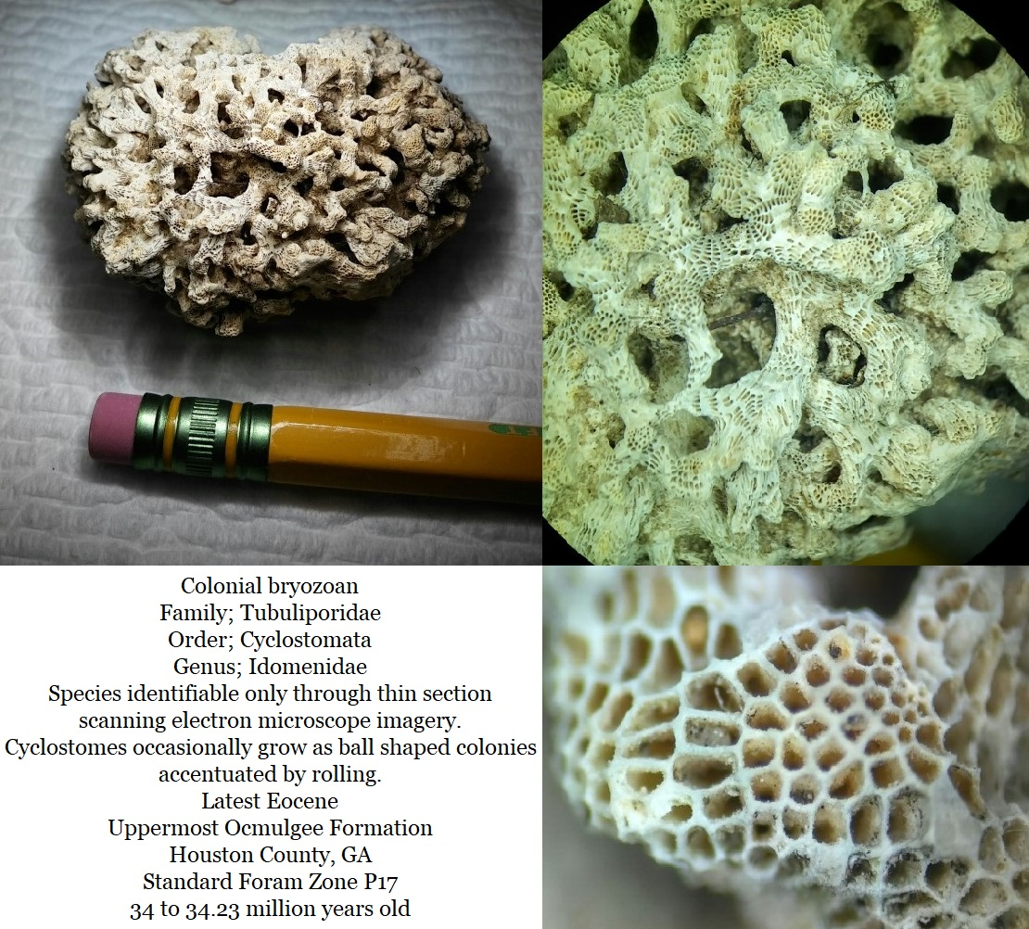
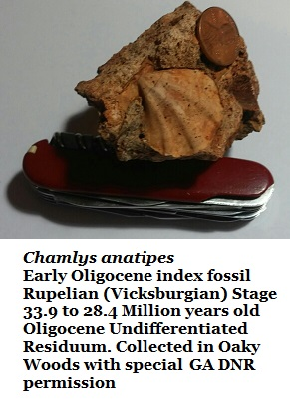
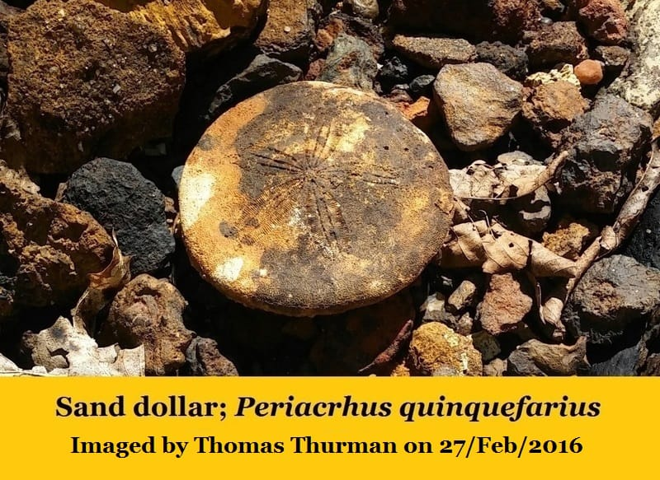
From 2016 to 2019 I enjoyed written permission from the Georgia Department of Natural Resources to conduct paleontological research in Oaky Woods Wildlife Management Area.
Permission to collect samples was included.
Conditions applied.
I was informed by GA DNR that I was the first person to receive such permission.
Some things we found.

Slide 13

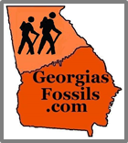
First Scientific Results
Fieldwork could not confirm the Early Oligocene,
Shellstone Creek Beds Formation in any reported location,
it is therefore abandoned.
In 1993 Huddlestun erected the informal Early Oligocene formation Shellstone Creek Beds and assigned three localities.
Reported just north of the intersection of Red Dog Farm Rd and Magnolia Road in Bleckley County.
  Field research could not locate the described outcrop.
Reported as overlaying the Tobacco Road Sand in the Oaky Woods ravine.
  Early Oligocene residuum, widespread & typical of the area, overlies the Tobacco Road Sand at this locality.
Reported as sand only in a ravine in the northwest of Oaky Woods. Neither sand bed nor fossils could be located, cannot confirm age location’s sediments.
Locality of Tobacco Road Sand ravine in Oaky Woods.

Slide 14

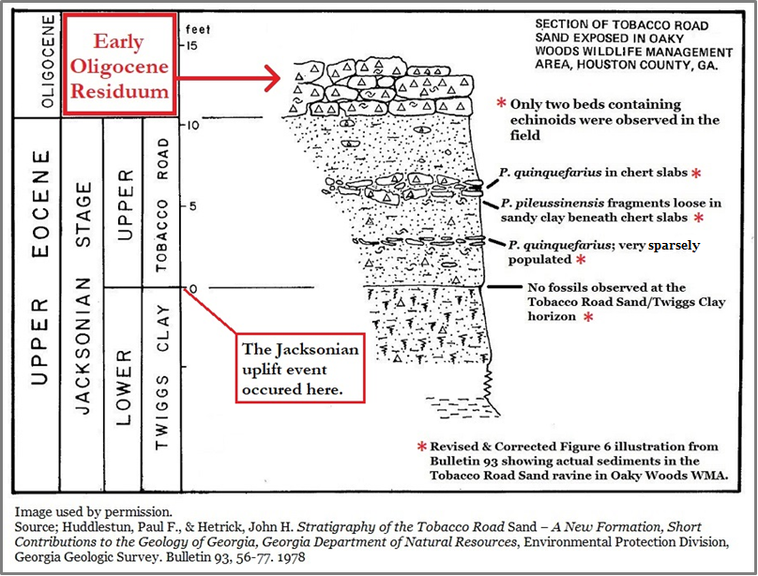
Second Scientific Results
We could not confirm or locate a “Periarchus intermediate” echinoid and while two beds of echinoids do indeed occur in the Tobacco Road Sand ravine, they are not as described in the literature.
Field research shows the Early Oligocene residuum, as dornicks & boulders overlying the ravine.

Slide 15
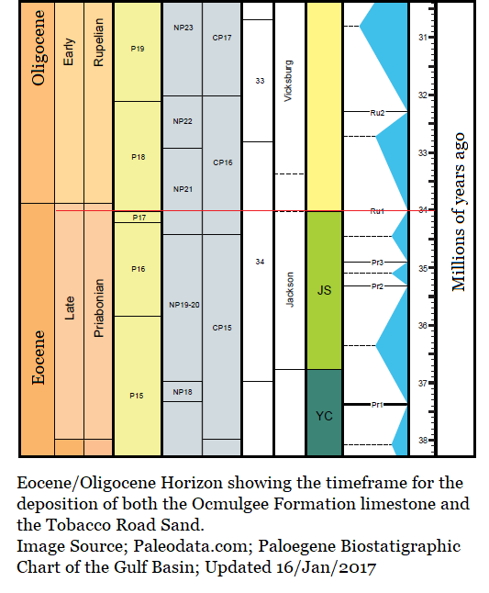
Returning to the Late Eocene…
Just what is the Jacksonian Stage?
The Eocene Epoch?
A period in Earth’s history which spanned from; 33.9 to 55.8 mya (million years ago) and saw the diversification of the mammals.
The Eocene is divided into 4 stages, with the most recent being the Priabonian.
  Priabonian; 33.9 to 37.2 mya
  Bartonian; 37.2 to 40.4 mya
  Lutetain; 40.4 to 48.6 mya
  Ypresian; 48.6 to 55.8 mya
What is the Jacksonian?
The Jacksonian Stage is a subdivision of the Priabonian marking a geologic event, the Jacksonian spans from 33.6 to 36.7 mya and is restricted to the Southeastern USA.
It was named for Jackson, Mississippi in Hind County.
It is subdivided into early & late Jacksonian.
  At approximately 35.3 mya there was an uplift event (Epeirogenic Movement) modestly lifting the Southeastern Piedmont Plateau and causing a sea level shift which is revealed in the stratigraphy.
    Late Jacksonian refers to post uplift conditions.
    Early Jacksonian refers to conditions before the uplift.

Slide 16

A line of flat, rounded quartz pebbles…
In 1978 Huddlestun & Hetrick reported a line of flat quartz pebbles often (not always) marks the base of the Tobacco Road Sand. In a recent conversation with Huddlestun further explained these were possibly beach pebbles slowly rounded and sorted by surf action.
This bed does not occur in Oaky Woods.
*
To paraphrase Huddlestun & Hetrick’s 1978 report.
“Regional uplift in Alabama has caused the outcrop belt of the Tobacco Road Sand to grade westwardly into its offshore equivalent the Ocmulgee Formation.”
Huddlestun & Hetrick explain;
“The basal bed of the Tobacco Road Sand in the nearshore facies commonly consists of a coarse, poorly sorted, pebbly sand that contains flattened beach pebbles that may be as much as 2 inches (5 em) in diameter.”
*
*
*

Slide 17
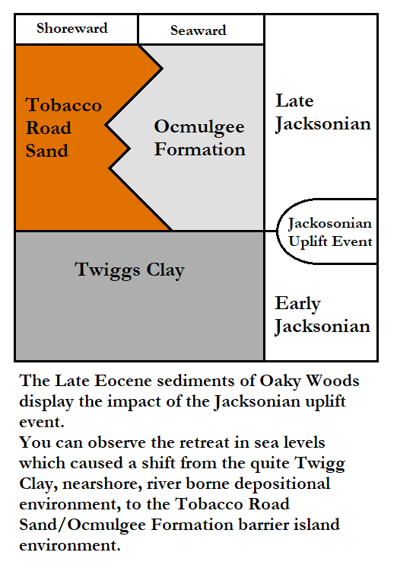
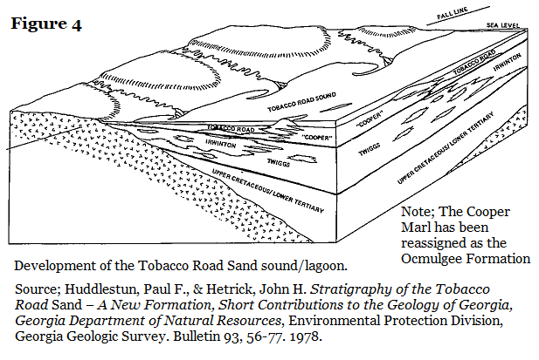
In 1978 Huddlestun & Hetrick understood that the Tobacco Road Sand and Ocmulgee Formation represented a barrier island, sound/lagoonal environment in the late Jacksonian.
This environment didn’t exist at this location in the early Jacksonian when the Twiggs Clay was being deposited.

Slide 18
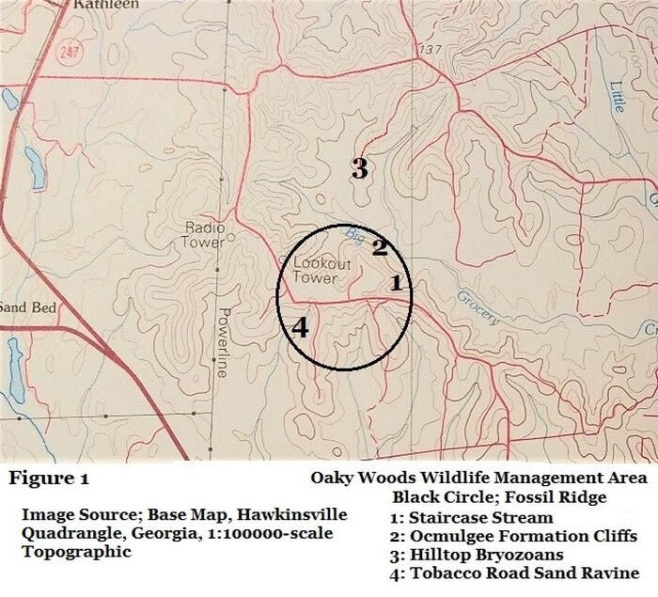
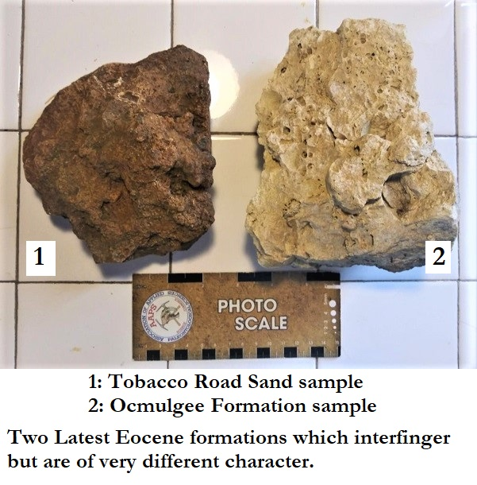
Oaky Woods, Fossil Ridge
Within the circle of the map at left is a ridge in Oaky Woods which shows a barrier island environment during the Late Eocene.
Locations 1 & 4 reveal the Tobacco Road Sand underlain by the Twiggs Clay.
Location 2 & 3 (North of the circle) show the Ocmulgee Formation outcrops, also underlain by the Twiggs Clay.
Locations 1 & 4 show shoreward sediments.
Locations 2 & 3 show seaward sediments.

Slide 19
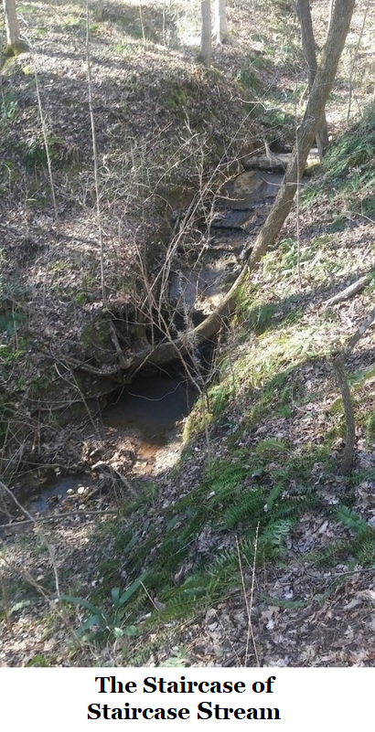
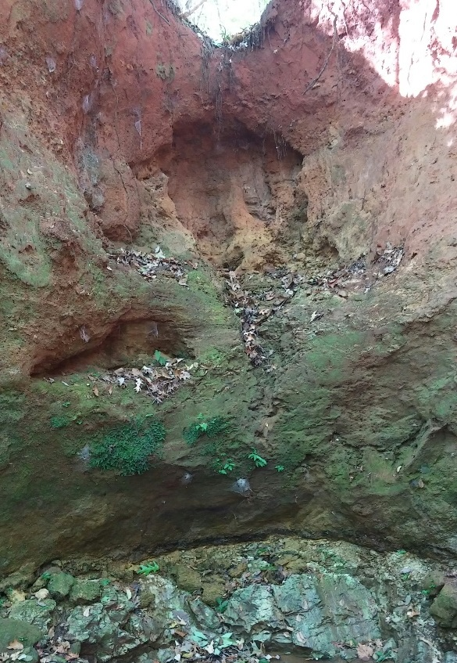
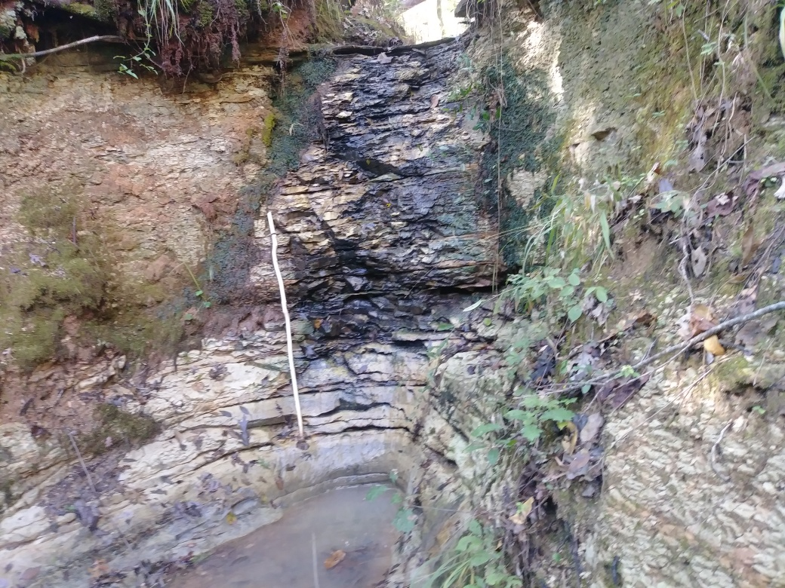
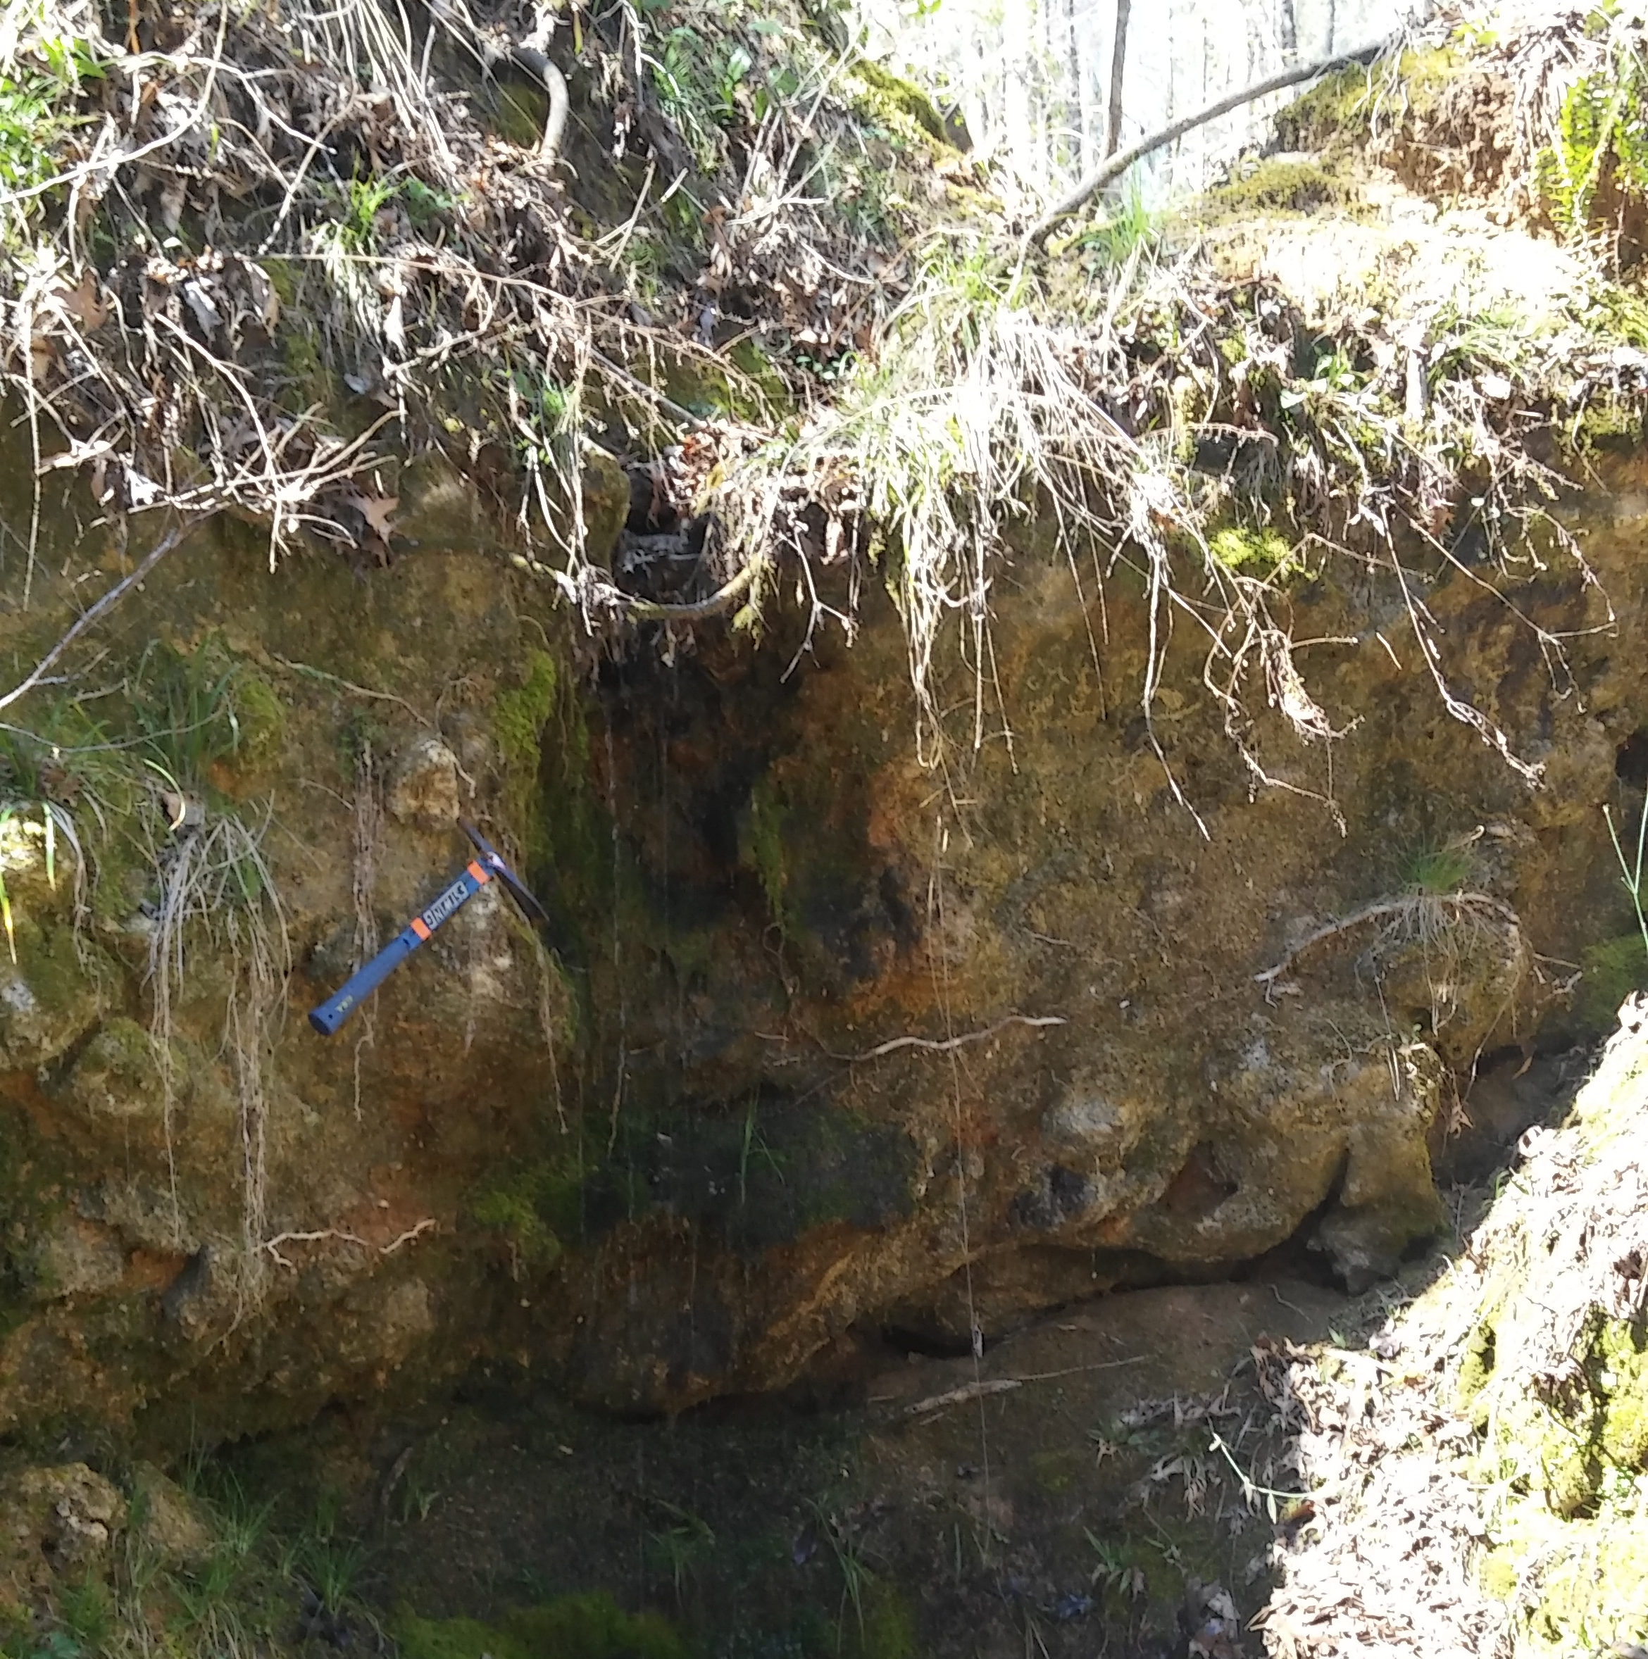
Staircase Stream:
A rainfed erosional stream on the northeast side of Fossil Ridge in Oaky woods. The stream has carved a series of features and grottos which reveal the stratigraphy of the ridge.
Grotto 2
Grotto 1
Grotto 3

Slide 20
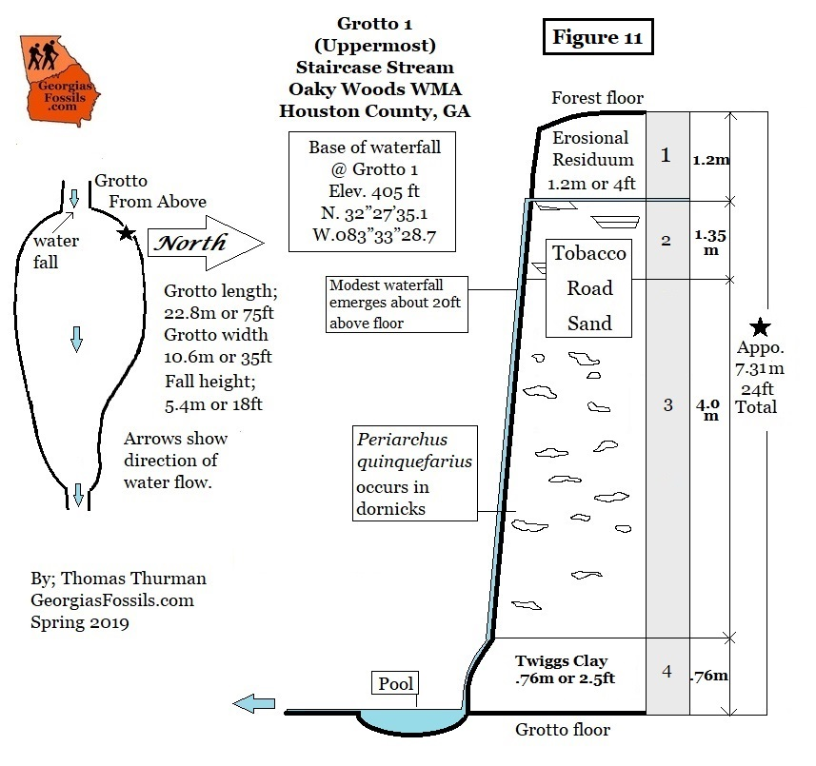
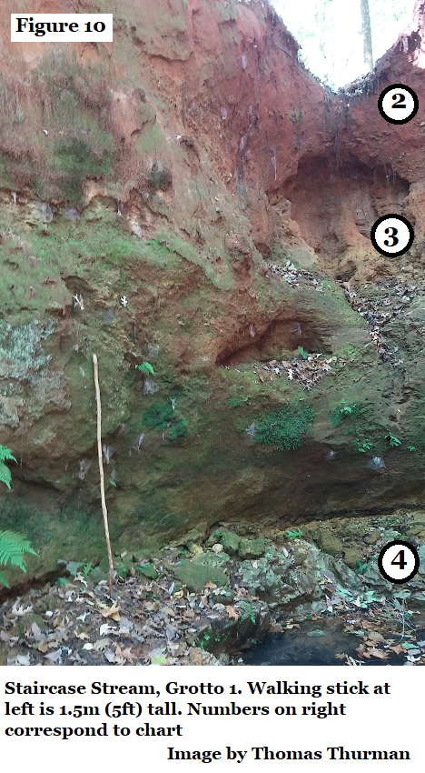
Staircase Stream; Grotto 1
In Grotto 1 the Tobacco Road Sand/ Twiggs Clay Horizon is between bed 3 & 4.
This is also the early/late Jacksonian horizon.
It’s interesting to see how the normally consistent Twiggs Clay shows many changes as we continue down the facie.
early/late
Jacksonian horizon

Slide 21
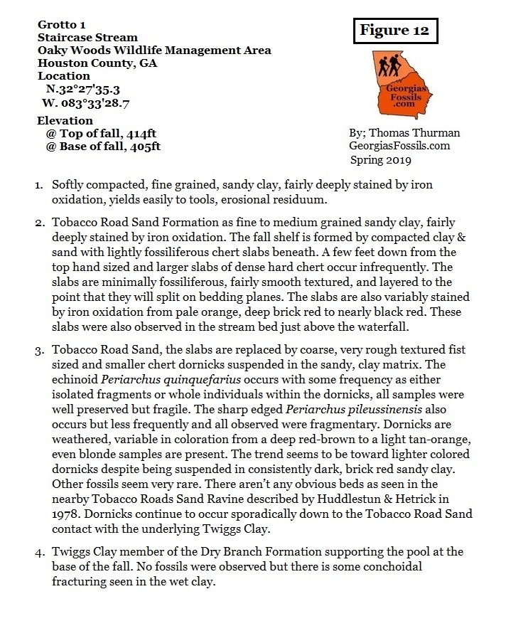
Grotto 1

Slide 22
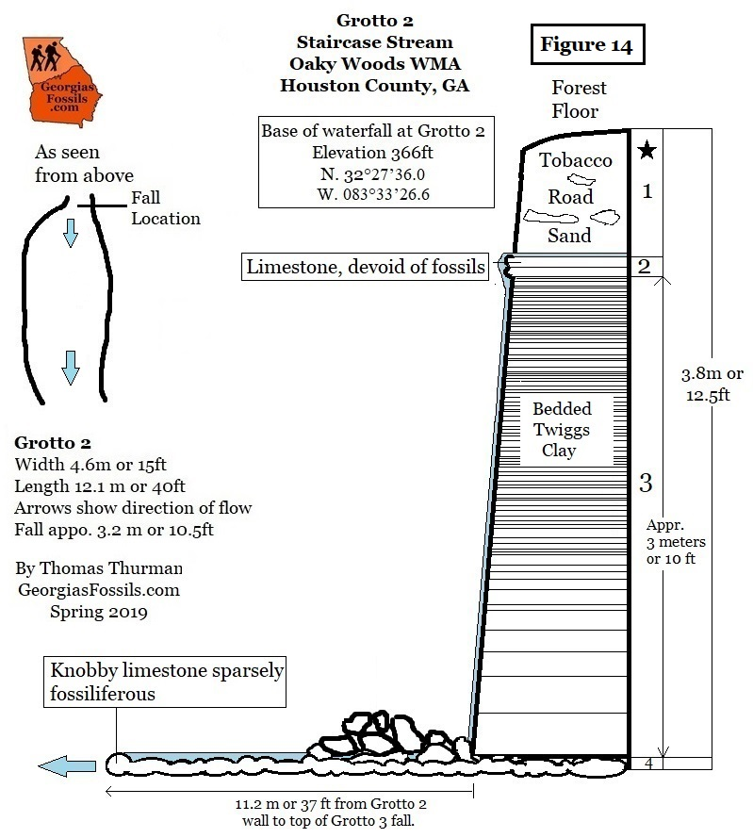
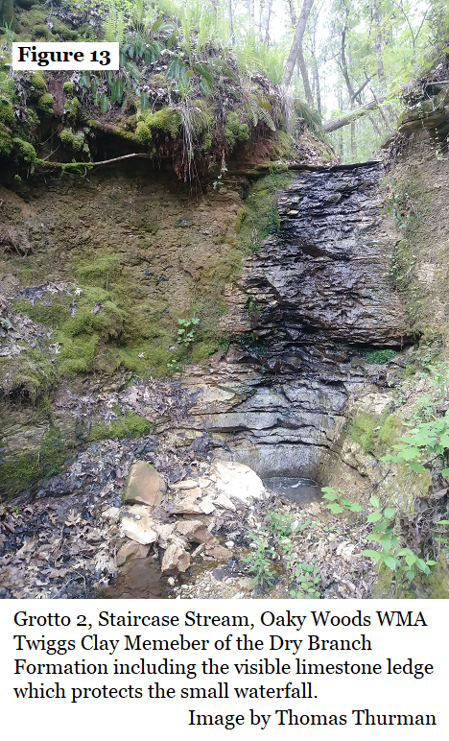
Staircase Stream, Grotto 2
Grotto 2 shows the shift from the Late Jacksonian Tobacco Road Sand to early Jacksonian Twiggs Clay.
Here the Twiggs Clay is seen in its most typical form…Very fine grains of clay as the last things to settle out of river borne sediments where the paleo- Ocmulgee River emptied into the sea somewhat off the shoreline in a very quite environment.

Slide 23
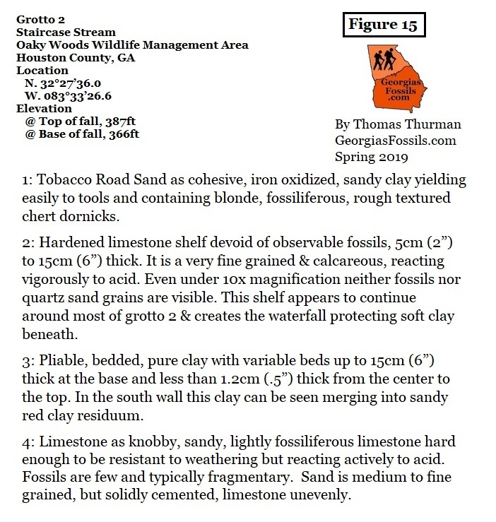
Grotto 2

Slide 24
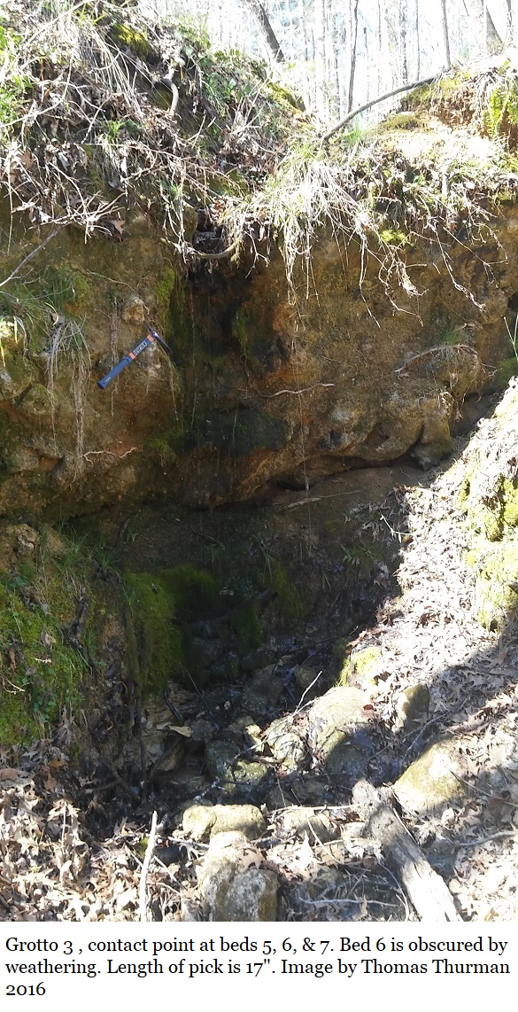
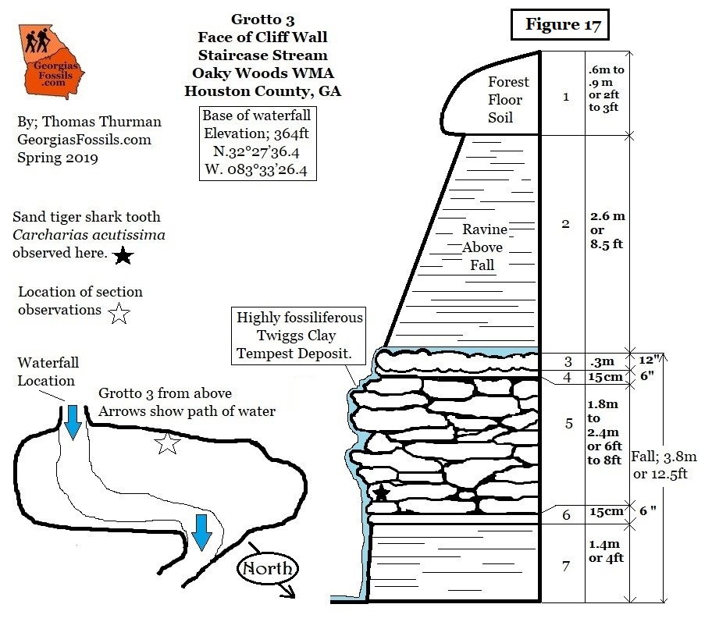
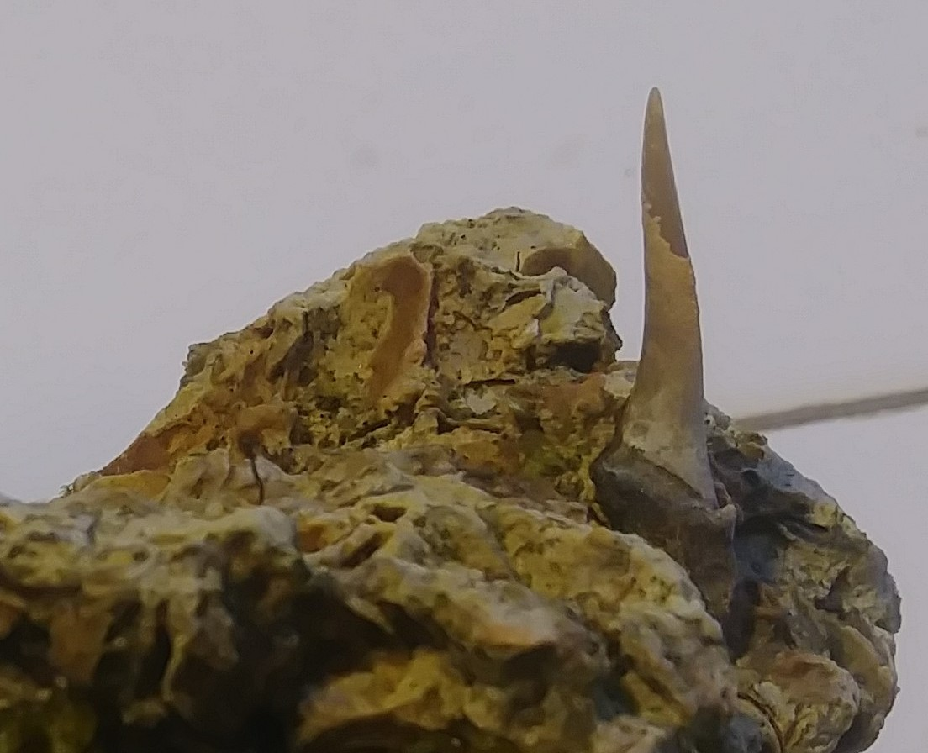
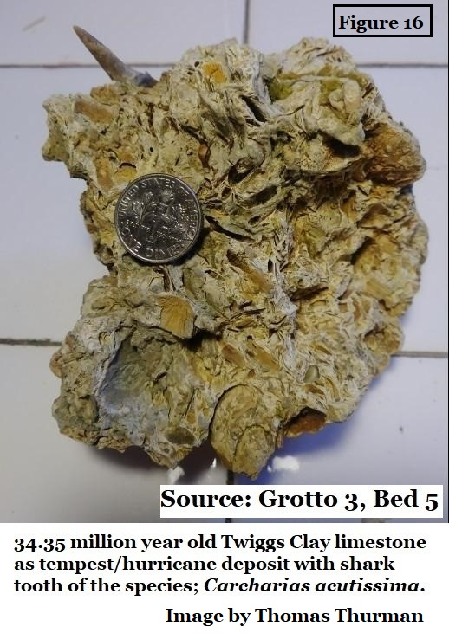
Grotto 3
Bed 5, is likely a tempest (hurricane) deposit.

Slide 25
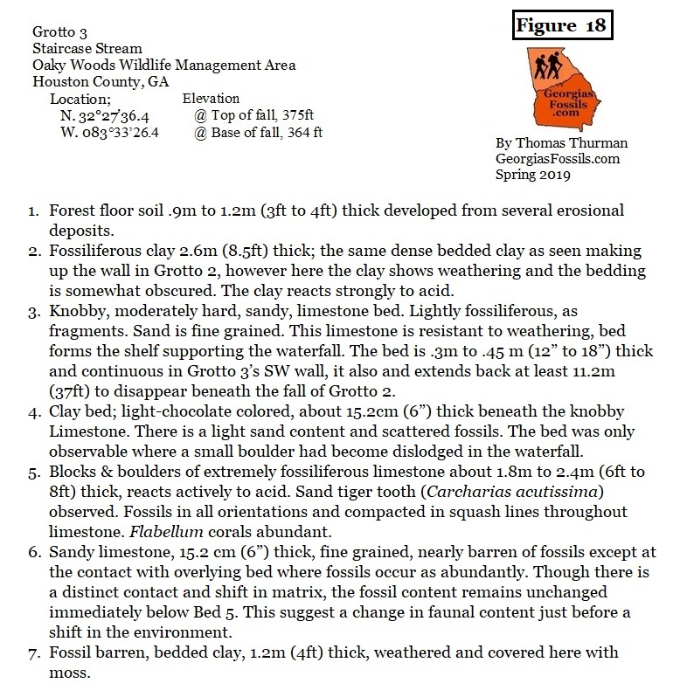
Grotto 3

Slide 26
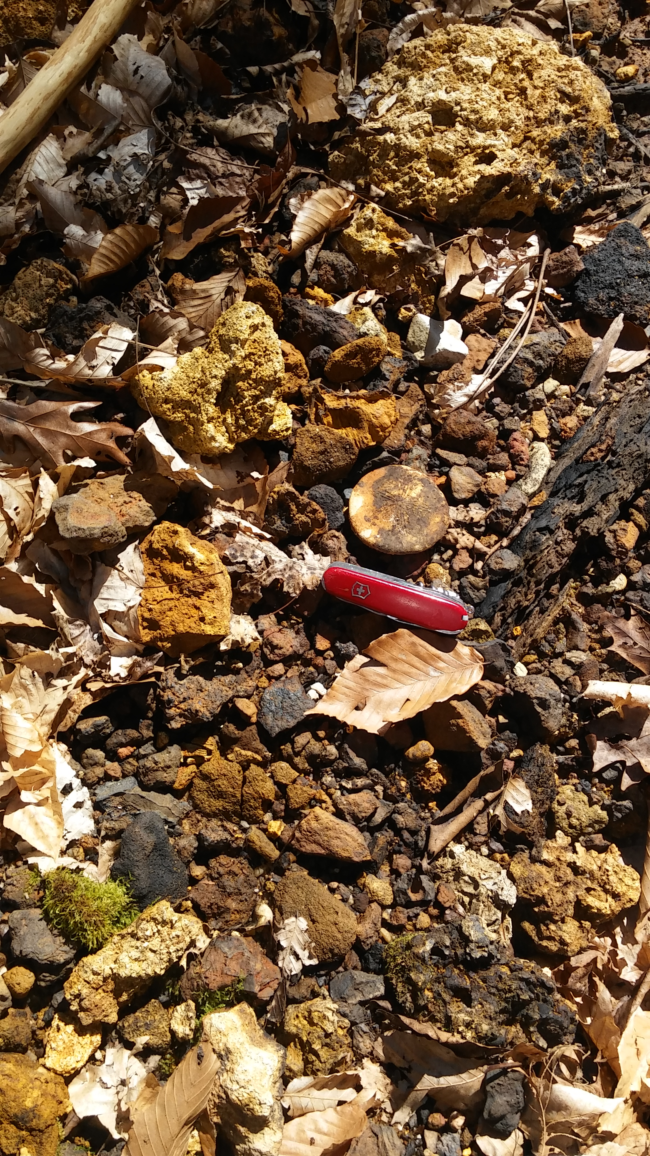
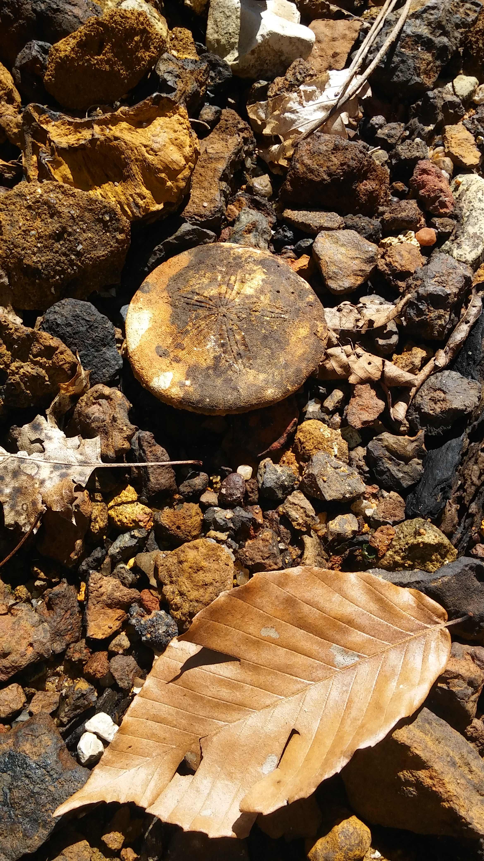
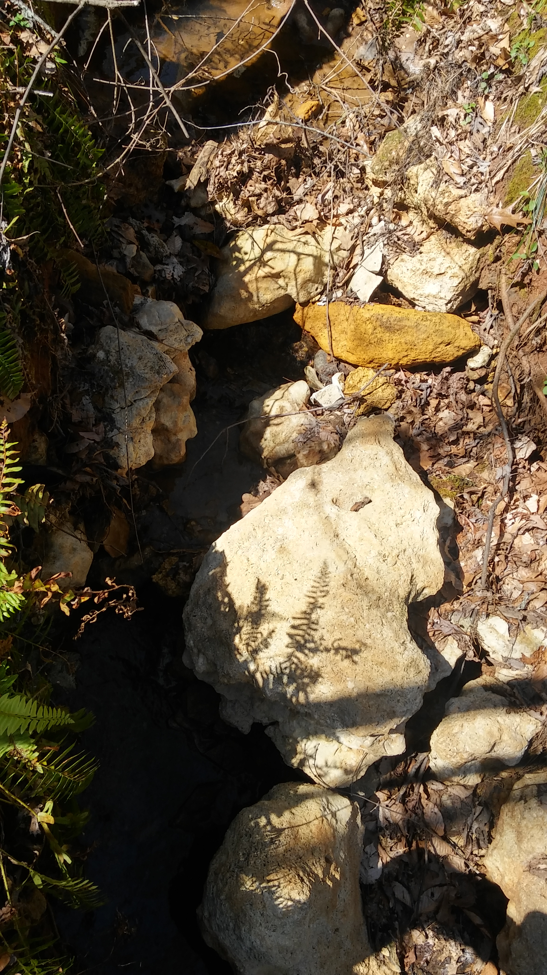
As you move downstream keep an eye on the streambed where beautiful fossils often weather out & make good photo opportunities.
It can be a strenuous hike which often involves scrambling up and down ravines.
In 2016 I stumbled onto this perfect, silicified, Periarchus quinquefarius, lying among the leaf litter and chert ruble.

Slide 27
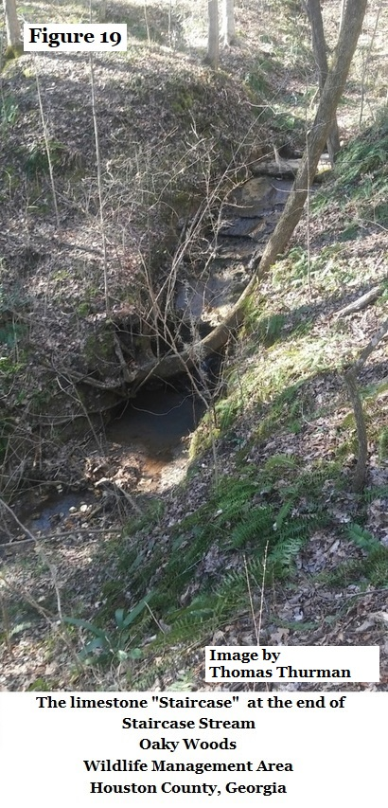
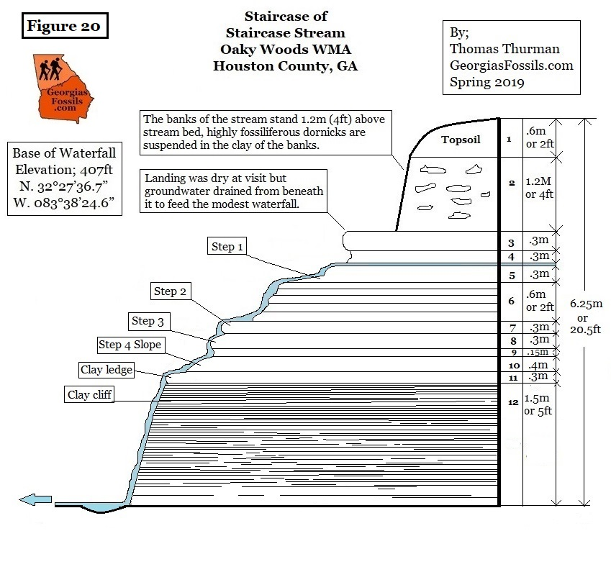
The Staircase

Slide 28
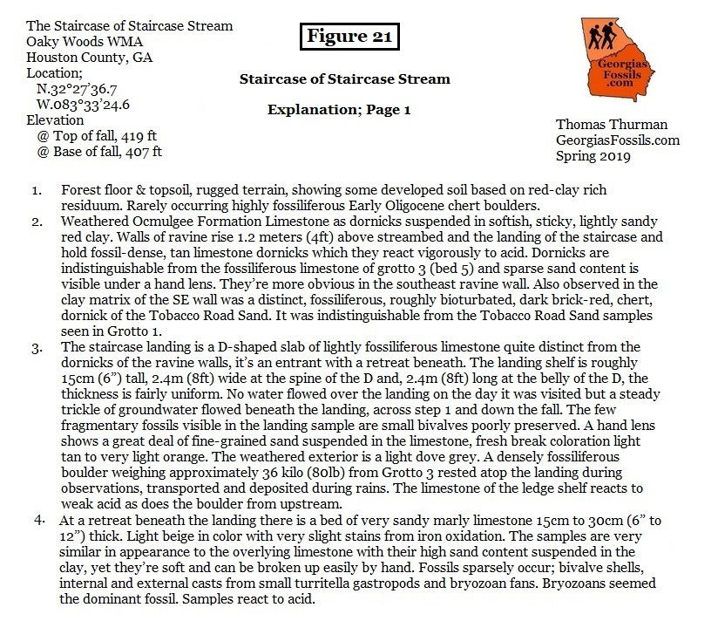
The Staircase
Page 1

Slide 29

The Staircase
Page 2

Slide 30


The Staircase
Page 3

Slide 31

Ocmulgee Formation Cliffs

Slide 32


Ocmulgee Formation Cliffs; Page 1

Slide 33

Ocmulgee Formation Cliffs; Page 2

Slide 34


At location 3 on the below map there’s a hilltop exposure of the uppermost Eocene Ocmulgee formation which produces these beautiful, colonial bryozoans.

Slide 35




Deep thanks to:
The Georgia Department of Natural Resources
& the Georgia DNR Wildlife Resource Division
Mark Williams; Commissioner, Georgia Department of Natural Resources.
Don McGowan, the Regional Manager of Game Management for the Wildlife Resource Division of the Georgia Department of Natural Resources.
Thanks to Dr. Don Thieme!
Thanks to
Dr. Burt Carter, Professor of Paleontology at Georgia Southwestern in Americus for the field help, stratigraphic advice and loan of
experience!
Thanks to Dr. Roger W. Portell,
Collections Director of Invertebrate Paleontology at
the Florida Museum of Natural History
which will house the collected fossils.

Slide 36


Deepest Thanks!
Dr. Paul F. Huddlestun, Phd; Retired Stratigrapher and Invertebrate Paleontologist for the Georgia Geologic Survey, I (we) appreciate his many conferrals and his willingness to travel from his home in New Mexico, repeatedly, to do field work with us in Oaky Woods.
Henry N. Josey, PharmD
amateur paleontologist and highly experience field researcher. Hank & I hiked miles in Oaky Woods and saw many very cool things. Still, we only scratched the surface and there is much in Oaky Woods and other WMAs which remain unexplored and unreported.
Paul F. Huddlestun
Henry (Hank) N. Josey

Slide 37
References;
Thuman, Thomas D., Basilosaurids, the First Modern Whales, Section 12, GeorgiasFossils.com
Cooke, Wythe; Cenozoic Echinoids of the Eastern United States, U.S. Department of Interior, US Geological Survey Professional Paper 321, USGS, 1959
Huddlestun, Paul F., Hetrick, John H; The Stratigraphy of the Tobacco Road Sand – A New Formation, Short Contributions to the Geology of Georgia, Georgia Geologic Survey, Bulletin 93, 1978
Huddlestun, Paul F., Hetrick John H.; Upper Eocene Stratigraphy of Central and Eastern Georgia, Georgia Geologic Survey, Bulletin 95, Pg.50, 1986
Huddlestun, Paul F.; The Oligocene, A Revision of the Lithostratigraphic Units of the Coastal Plain of Georgia, Georgia Geological Survey, Bulletin 105, pg24, 1993
Pickering, S.M.; Stratigraphy, Paleontology and Economic Geology of Portions of Perry and Cochran Quadrangles, Georgia; Georgia Geological Survey, Bulletin 81, 1970

