Slide 1
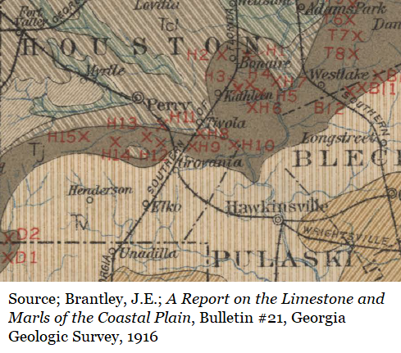
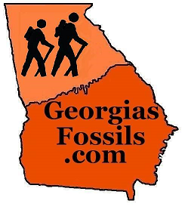
The Tivola Whales
By
Thomas Thurman
GeorgiasFossils.com

Slide 2
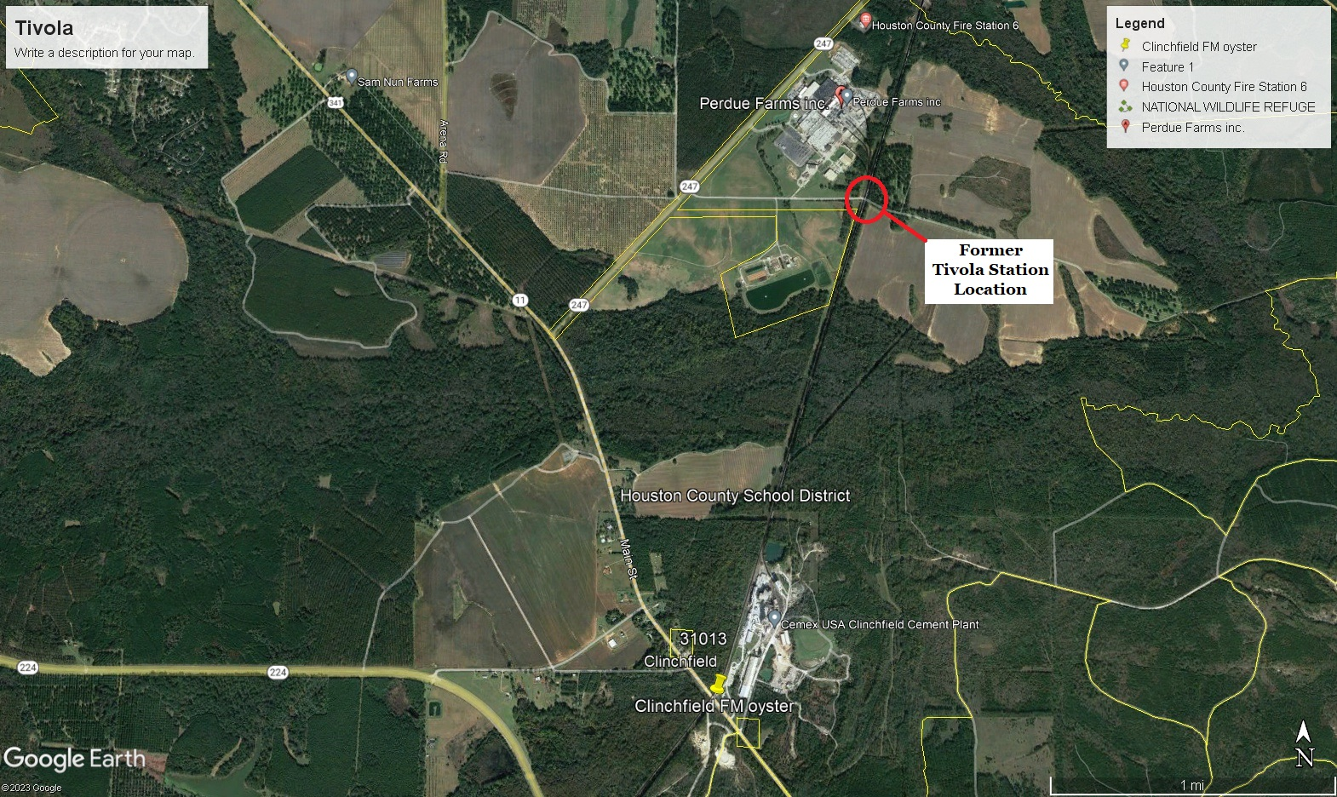
The village of Tivola is extinct.
The Tivola train station once stood behind the modern Perdue Farms plant

Slide 3
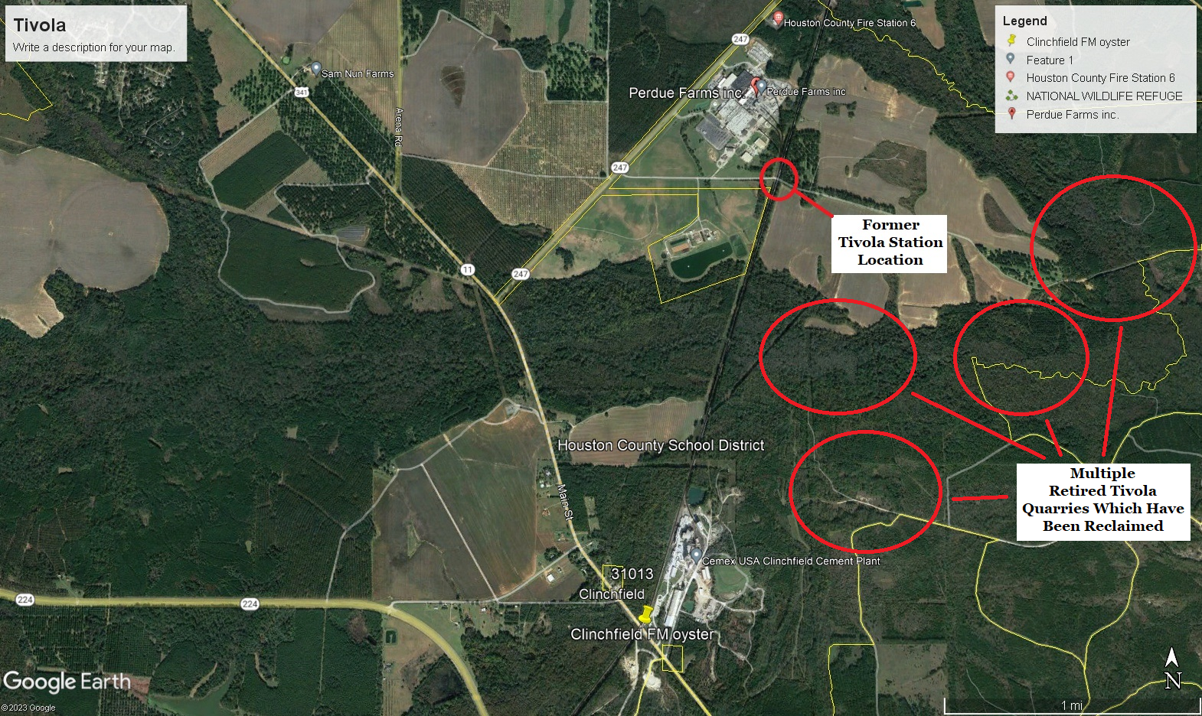
Tivola limestone deposits have been actively mined for more than a century.
Most quarries are retired & reclaimed.
The old quarries were cut near Tivola Station

Slide 4
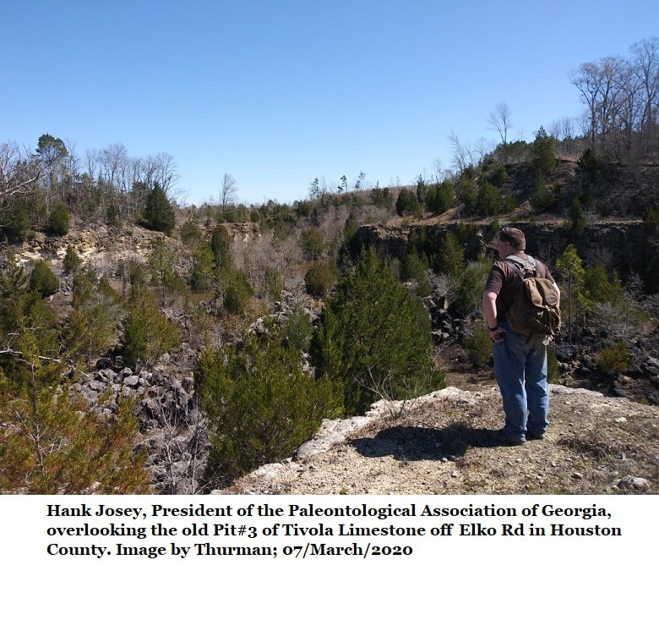
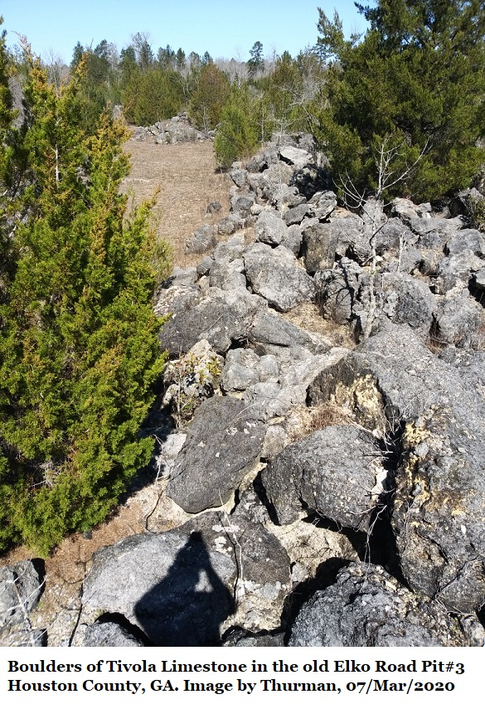
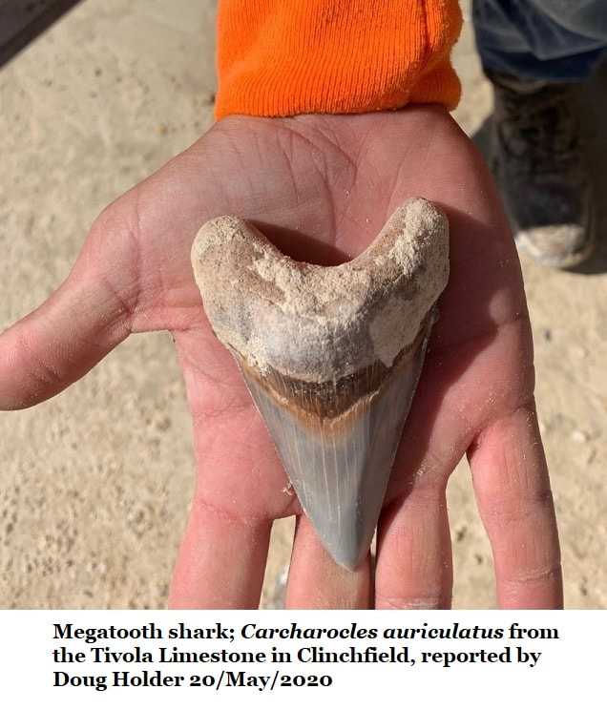
The
Tivola Limestone
Over the last 125 years least 3 whale fossils from different individuals have been reported from the Tivola Limestone.

Slide 5
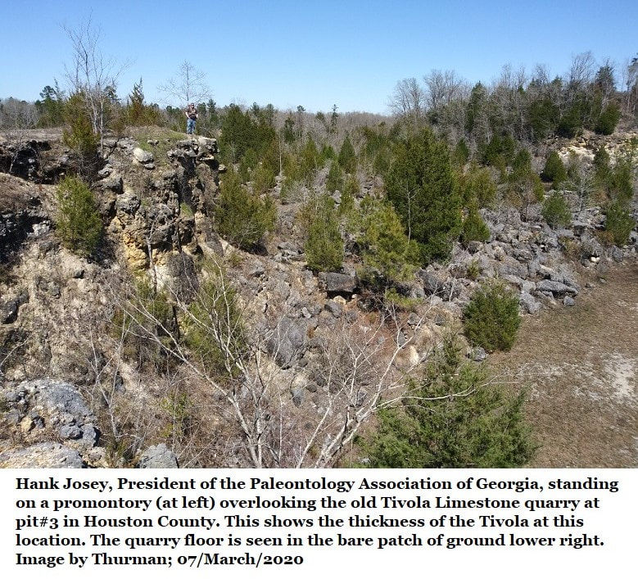
Barnwell to Ocala
Early on it was called the Barnwell Limestone and considered part of the limestone deposits in Barnwell County, South Carolina.
By the 1930s many called it the Ocala Limestone and associated to limestones in Florida and South, GA.

Slide 6
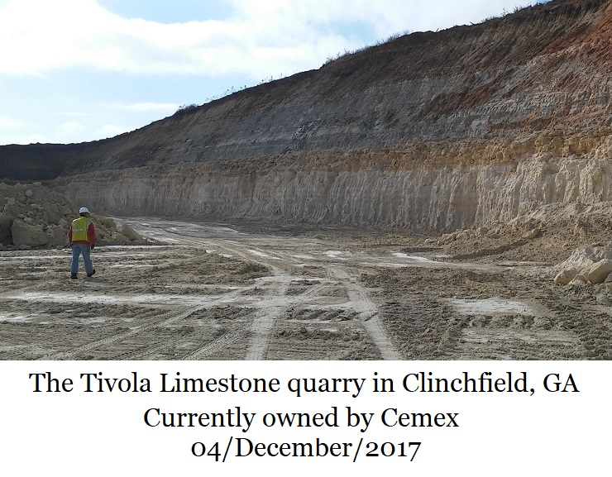
Separate & Distinct
In 1986 it was shown that the limestone was separate and distinct to Georgia, concentrated in Houston County but extending sporadically both east and west.
It had originally gone to market with Tivola Train Station labels.
So in 1986 researchers renamed it the Tivola Limestone

Slide 7
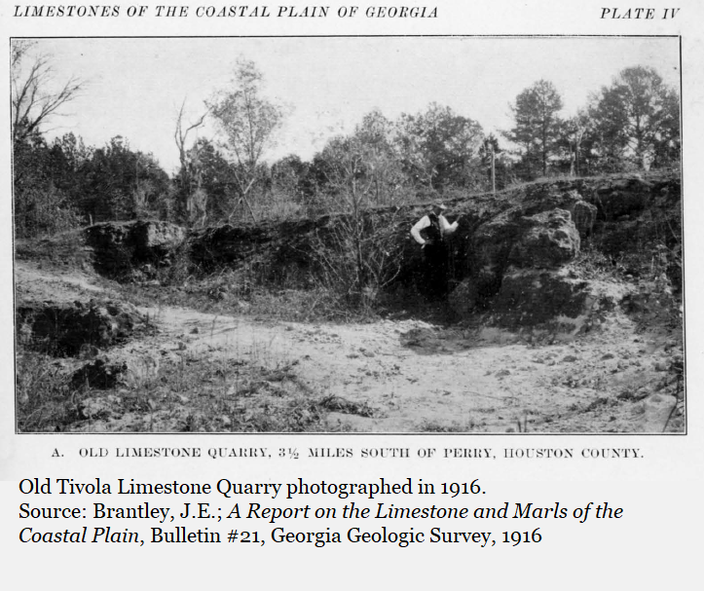
Old Tivola Quarry on Elko Road in 1916
Researchers from the USGS & Georgia Geological Survey called the quarry “Old” in 1911.

Slide 8
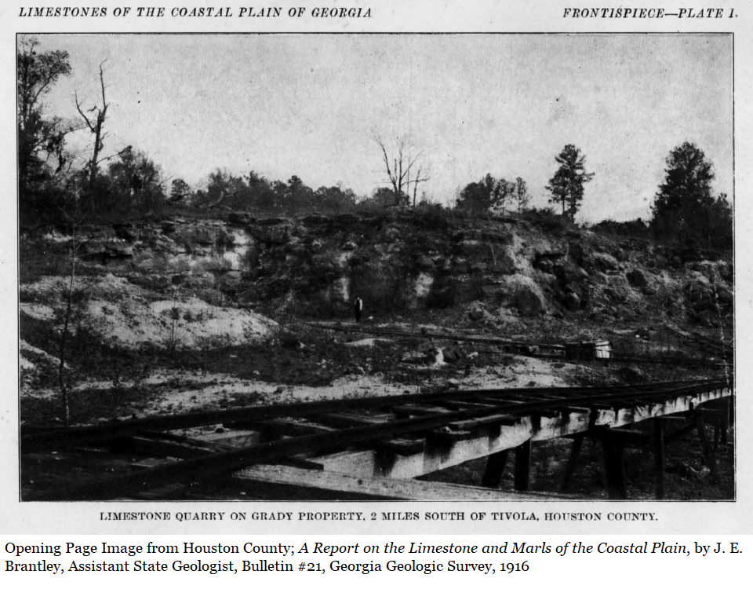
Another 1916 quarry two miles south of Tivola.
Near Clinchfield, it’s due south of the modern plant.
This quarry still exist though it is overgrown & inaccessible to the public.

Slide 9
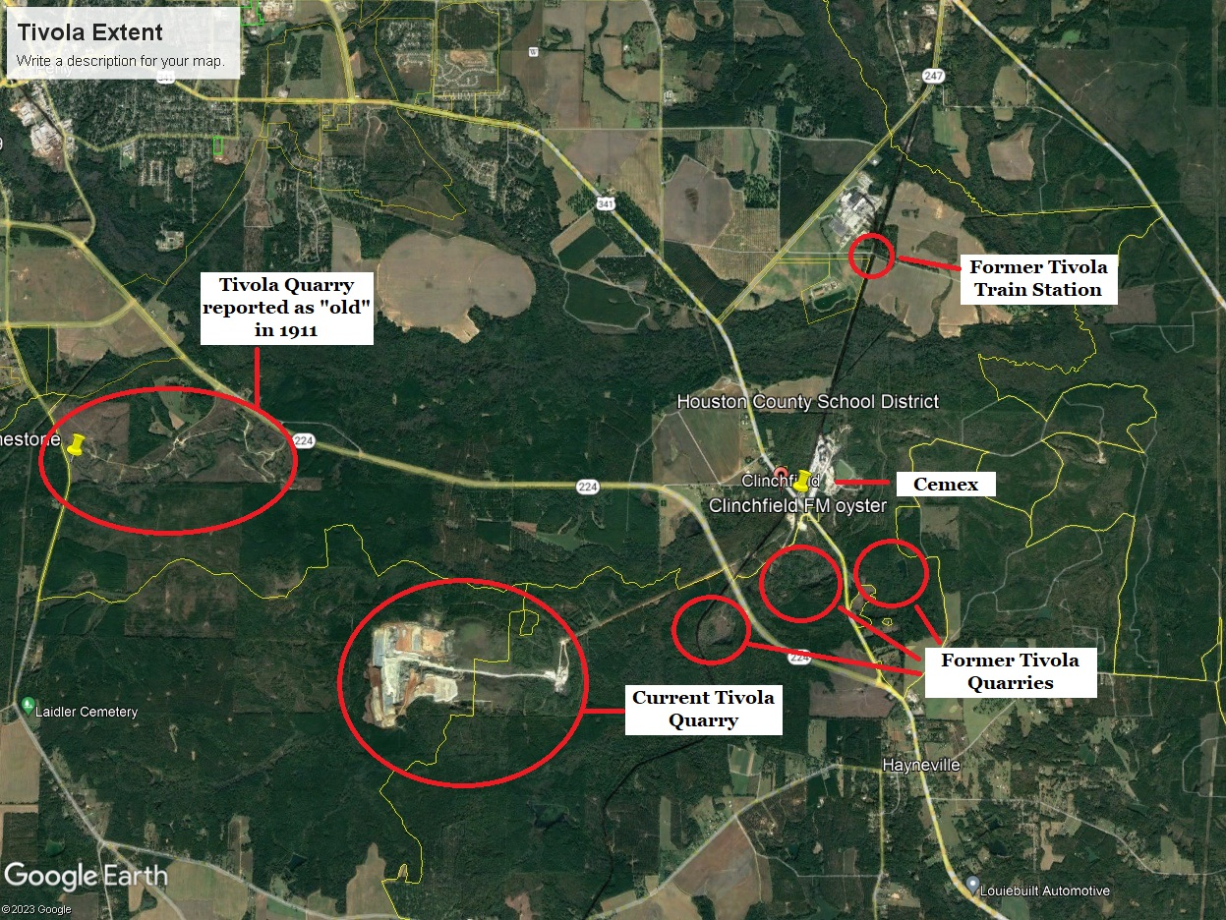
The Current quarry is owned and mined by Cemex.
Many of the old quarries haven’t been reclaimed but they aren’t accessible to the public.

Slide 10
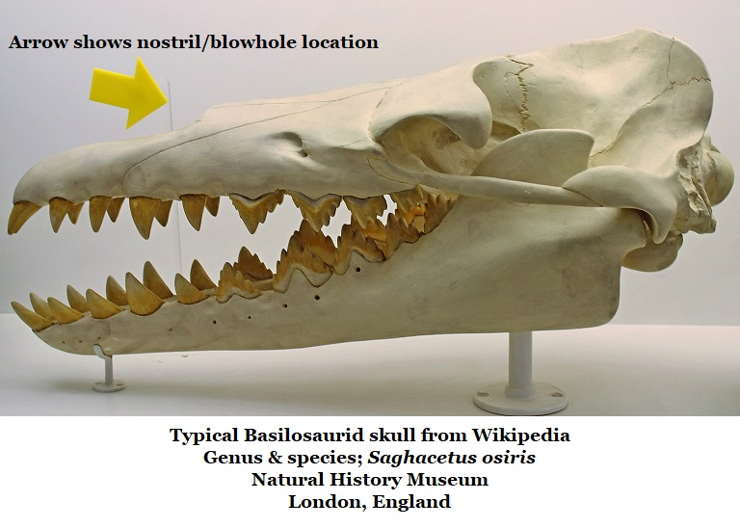

The large Basliosaurid family
Family Basilosauridae
Subfamily Basilosaurinae
  Genus Basilosaurus
  Genus Basiloterus
  Genus Basilotritus
  Genus Eocetus
Subfamily Dorudontinae
  Genus Ancalecetus
  Genus Chrysocetus
  Genus Cynthiacetus
  Genus Dorudon
  Genus Masracetus
  Genus Ocucajea
  Genus Saghacetus
  Genus Stromerius
  Genus Supayacetus
  Genus Zygorhiza
Subfamily Pachycetinae
  Genus Antaecetus
  Genus Platyosphys
(?)
Red star indicates species occurs in Georgia’s fossil record.

Slide 11
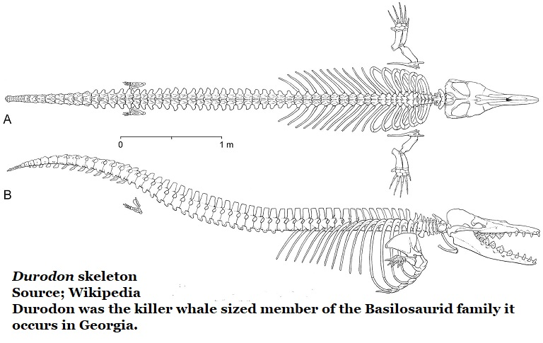
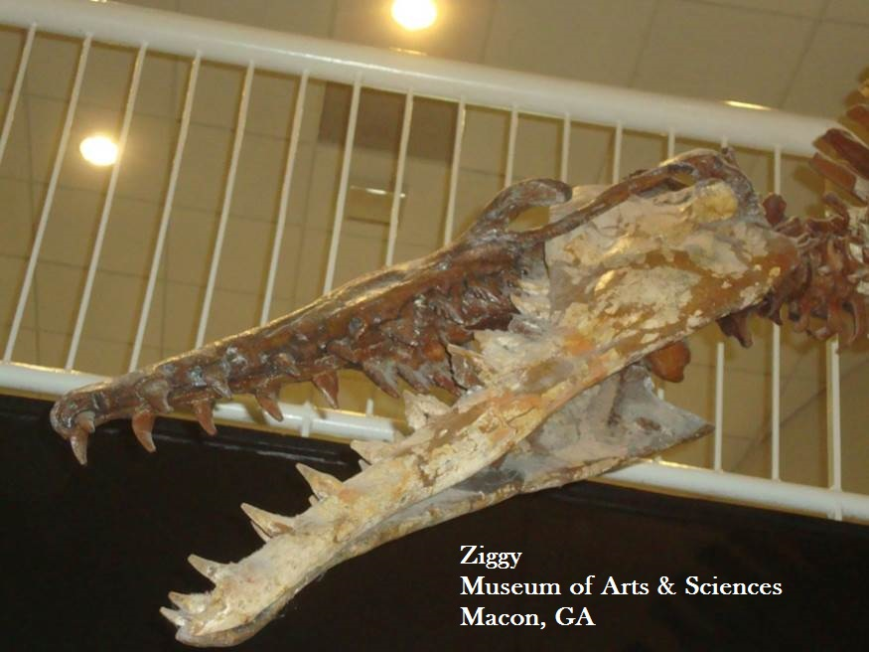
Ziggy, at the Museum of Arts & Sciences was reassigned as a Durodon serratus by Dr. Mark Uhen.
Durodon fossils also occur in Houston County
Uhen is a paleontologist specializing in whale evolution, he worked at the Smithsonian until a few years ago.
He has spoken here, at the Museum of Arts & Sciences.

Slide 12
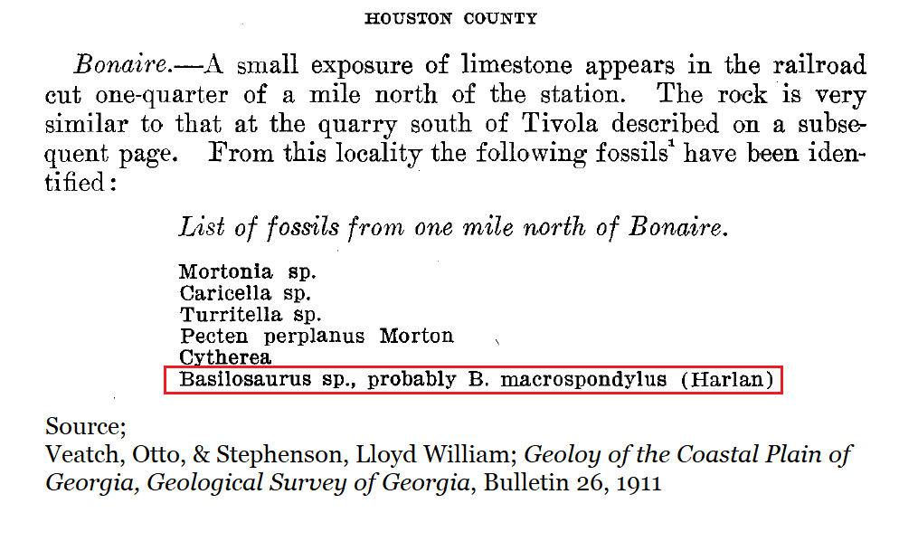
Earliest known Houston County Basilosaurid comes from 1911. (Which species is questionable)
This is not Georgia’s oldest whale fossil report.
There is another from around 1890.

Slide 13
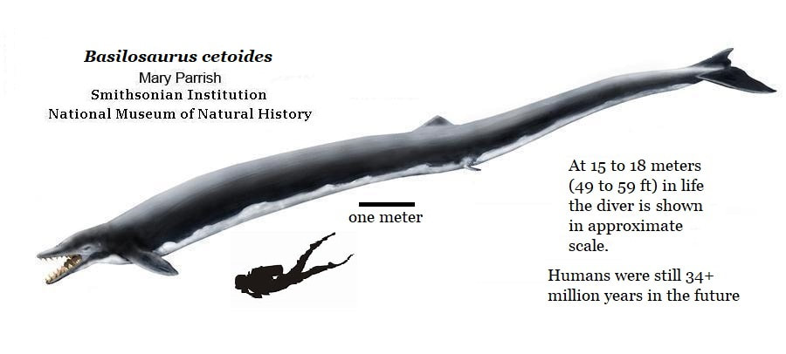
The 1932 Tivola Whale
In September of 1932 quarry workers in Perry discovered the bones of a Basilosaurus cetoides.
Dean Leon P. Smith of Wesleyan College was brought in to recover the fossils.

Slide 14
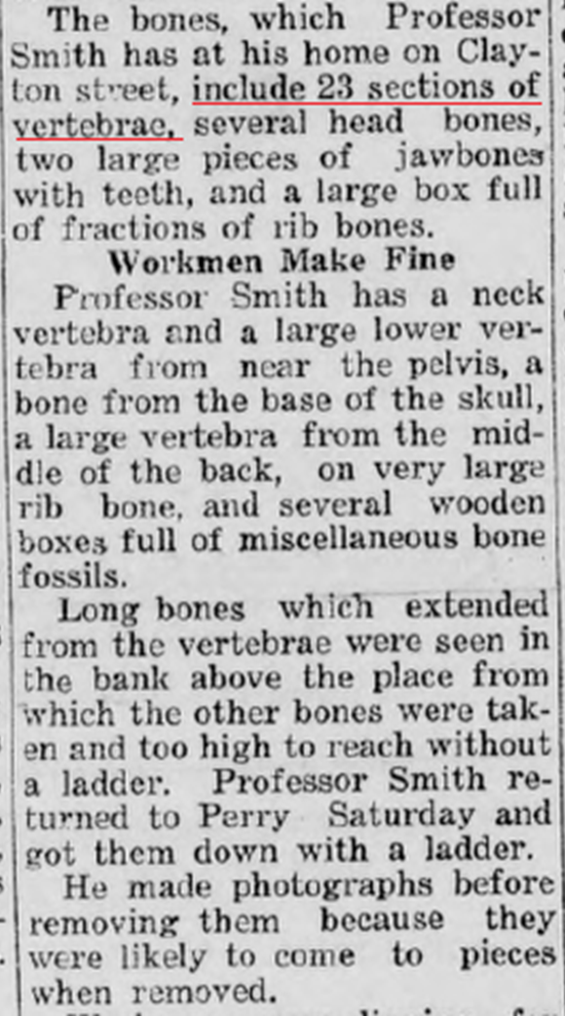
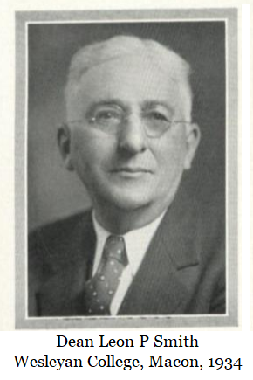
What Dean Smith recovered.
The newspapers reported
23 sections of vertebrae
  Neck
  Mid back
  Near pelvis
Skull fragments.
  Base of skull
  Partial snout
  Partial jaw with teeth
Ribs
Several additional boxes full of miscellaneous bones

Slide 15
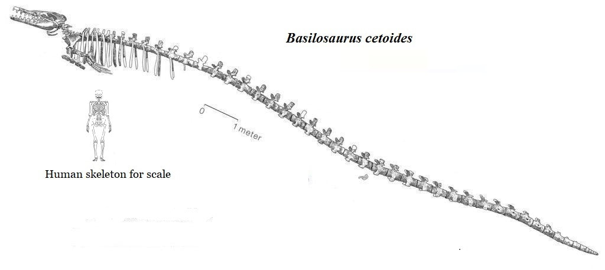
There are 58 vertebrae in the Smithsonian’s mounted Basilosurus cetoides.
The skeleton is 54 feet long.
Dean Smith recovered nearly half the whale.

Slide 16
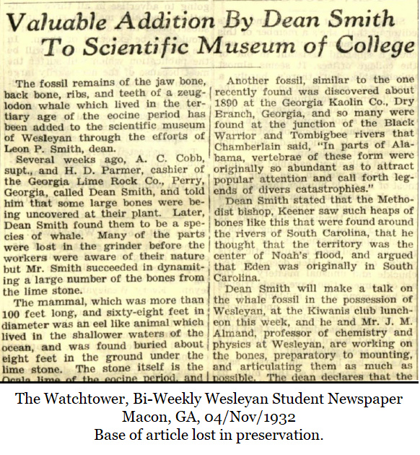
Confirmation
Confirmation of the find from the November 1932 Wesleyan student newspaper.
Much of the whale was lost to the grinder before the miners were aware of the fossils. So perhaps there had been a complete animal.
The paper mentions a similar whale was found in 1890 at the Georgia Kaolin Company in Dry Branch, Twiggs County, Georgia.

Slide 17
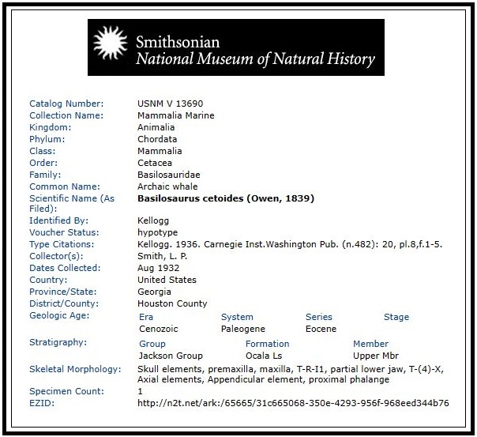
Dean Smith intended to reconstruct the whale for display at Wesleyan.
Instead, it was acquired by the Smithsonian before 1936. Their official record does not mention the 23 vertebrae or ribs.
I emailed an inquiry to the Smithsonian…
“I forwarded your inquiry on to our registrar and collections manager, who are better able to track down collections records. But in a word, the vertebrae and ribs are here, and covered by the general term ‘axial elements’ in the record you saw
Dave J. Bohaska
Smithsonian NMNH
This becomes an issue later.

Slide 18
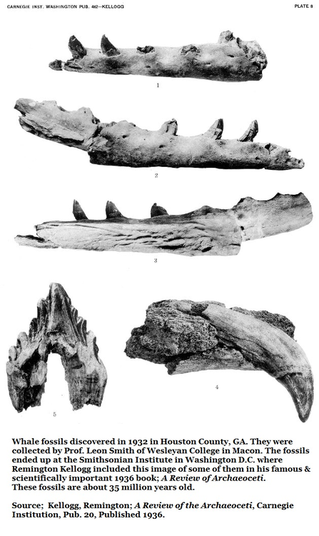
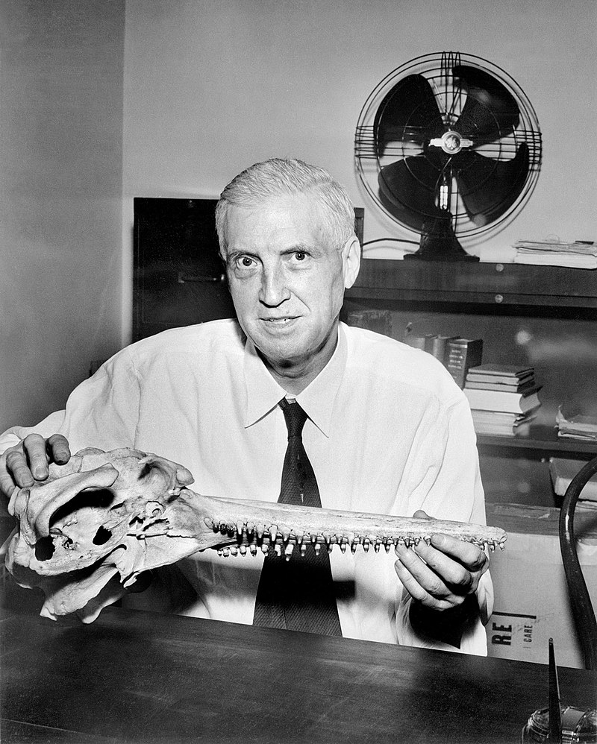
In 1936 Remington Kellogg was the Director of the Smithsonian and the world’s leading expert on whales. He published the below report establishing the natural history of whales.
Some of the Houston County material was included in his 1936 paper.

Slide 19
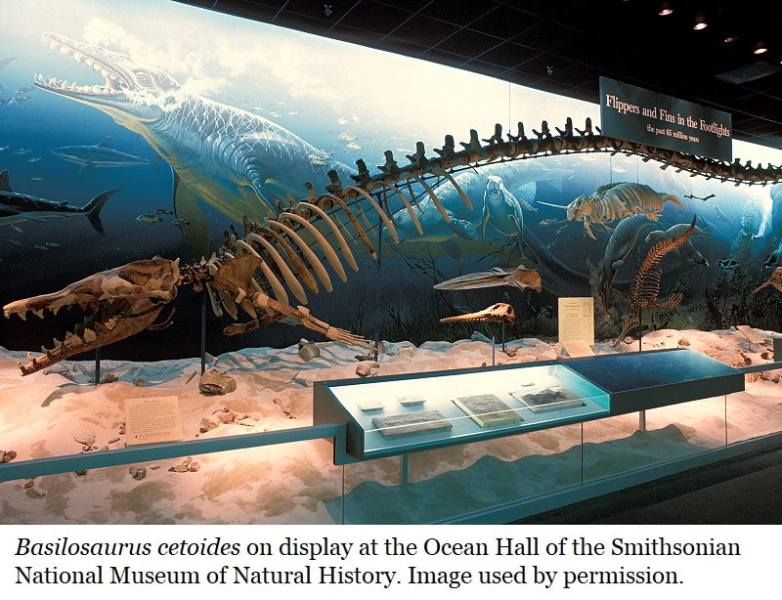
The Smithsonian reports that elements of the 1932 Tivola Whale are incorporated into the Basilosaurus cetoides reconstruction in the museum’s Sant Ocean Hall.

Slide 20
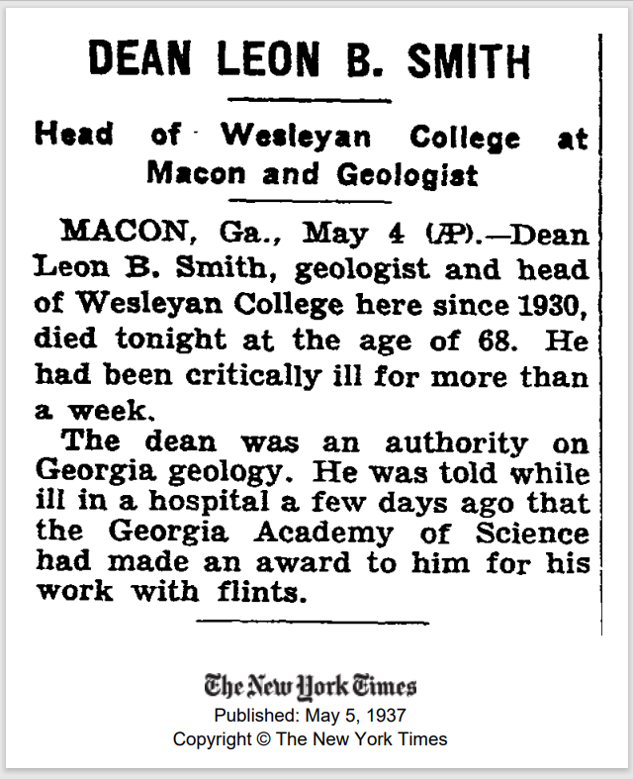
Dean Smith passed away in May, 1937
According to the New York Times, before passing he was given an award by the Georgia Academy of Sciences.
Clearly, he enjoyed a supportive relationship with the Academy.

Slide 21
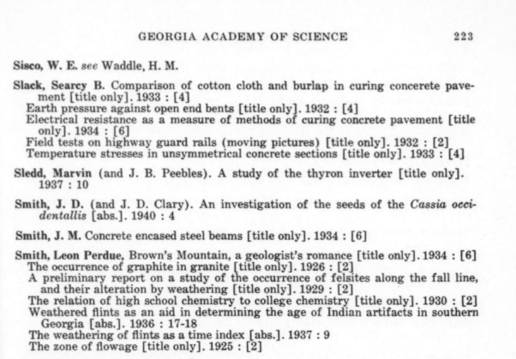
The Academy’s archives only go back to 1977.
A 1967 index of published Georgia Academy of Sciences articles dating back to 1927 show Smith’s contributions to the publication but nothing which seems Tivola Whale related.
Thanks to Bryan Briones, STEM Reference Librarian at the Robert W. Woodruff Library for finding this index.

Slide 22
In 2021 Dr. Kathlyn Smith of the Georgia Southern Museum published a report on 7 Basilosaurus cetoides vertebrae found along the riverbank in Albany Georgia.
The paper states…
“…the most complete specimen of the species from Georgia to date…”
Dr. Mark Uhen was a co-author.

Slide 23
Images of the vertebrae still entombed in limestone from the riverbank.
Before Georgia Southern could complete recovery, these fossils were removed from the riverbank and thus lost to science.
Clearly,
this isn’t the most complete Basilosaurus cetoides
Georgia has produced.

Slide 24
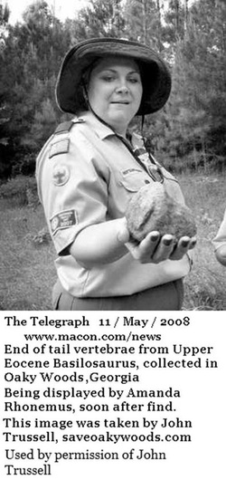
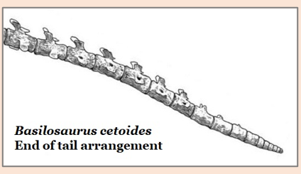
As late as 2008 whale material was still being recovered form Houston County.
In this case an end-of-tail vertebrae found in Oaky Woods.
This one would be a bit younger than the Tivola Whale.

Slide 25
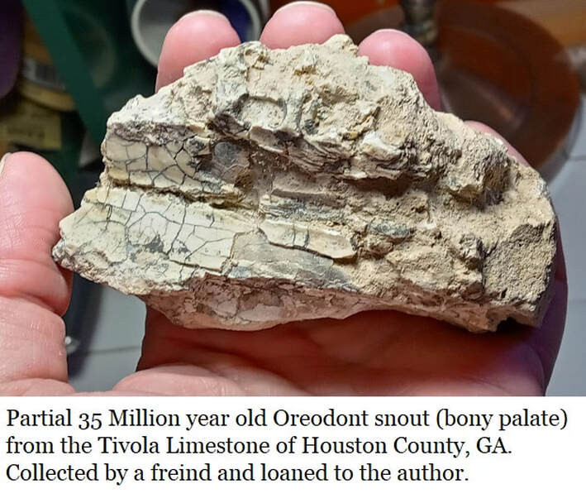
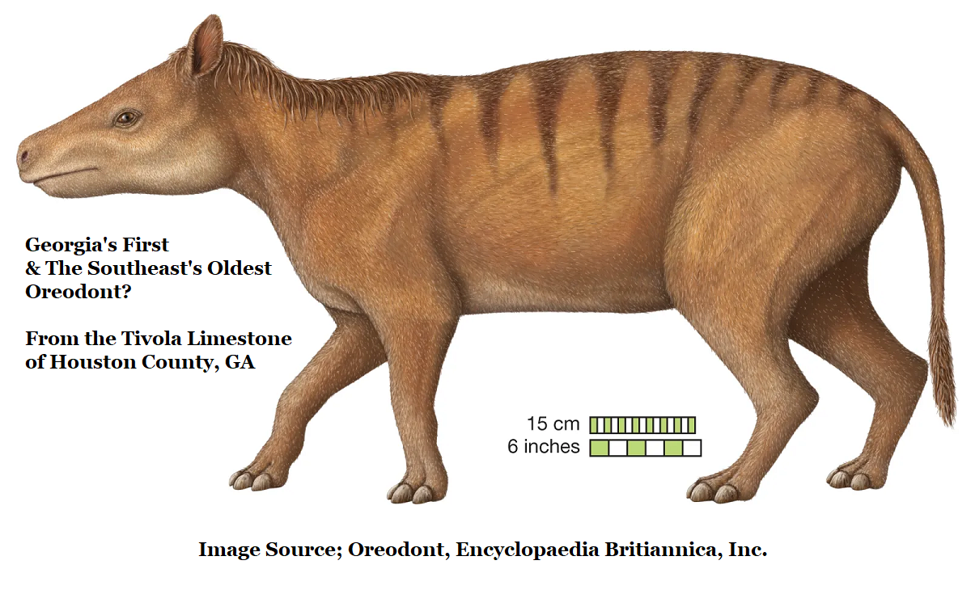
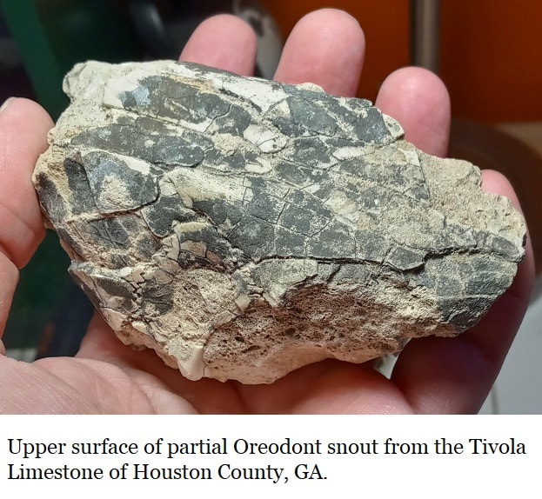
The Tivola Limestone continues to surprise.
A partial snout was found by an amateur in one of the many abandoned Tivola Limestone quarries. Two separate institutions have identified the fossil as belonging to a member of the oreodont family.
This would not only be Georgia's first oreodont, but it would also be the oldest oreodont yet reported from the southeast; the Tivola Limestone is a Late Eocene deposit.
All other southeastern oreodonts are Oliogocene or Miocene, so they are millions of years younger.
This find is due to be published later this year.

Slide 26
References
Pre-Historic Whale Bones Found In Mine Near Perry; Houston Home Journal, Perry, GA, Thursday, 8/Sept/1932, Reprint from The Macon Telegraph (No author credited)
Preliminary Report on the Geology of the Coastal Plain of Georgia, Otto Veatch & Lloyd Williams Stephenson, Bulletin 26 of the Georgia Geologic Survey, 1911.
Kellogg, Remington; A Review of the Archaeoceti, Carnegie Institution, Pub. 20, Published 1936.
Perry Whale Fossil Only One of Kind in N. America, Houston Home Journal, Perry, GA, Thursday, 3/November/1932 (No author credited)
Upper Eocene Stratigraphy of Central & Eastern Georgia, Paul F. Huddlestun & John H Hetrick, Bulletin 95, Page 24, Georgia Geologic Survey, 1986
“I Forwarded your inquiry on to our registrar and collections manager, who are better able to track down collections records. But in a word, the vertebrae and ribs are here, and covered by the general term ‘axial elements’ in the record you saw”; Dave J. Bohaska Smithsonian NMNH Museum Specialist, Email, 16/March/2023
Email over Leon Smith’s publications from the GA Journal of Science; “…Granted this is just an index of publications of the GAS, https://archive.org/details/sim_georgia-journal-of-science_1922-1967_1-25_cumulative-index. I do see a listing of articles written by a Leon Perdue Smith (see page 223), though not sure if these might be salient to your search.” Bryan Briones, STEM Refence Libraian, Atlanta University Center, Robert W. Woodruff Library
Oreodont publication; “they plan to focus on the GA oreodont once Rachel graduates (Spring 2023)” Personal email, Dr. Roger Portell, Florida Museum of Natural History. Email dated; Sun, Jul 10, 2022.

