Slide 1

Evolution
& Geologic Time in Georgia’s Fossil Record
Geologists have a saying…rock remembers.
Neil Armstrong

Slide 2
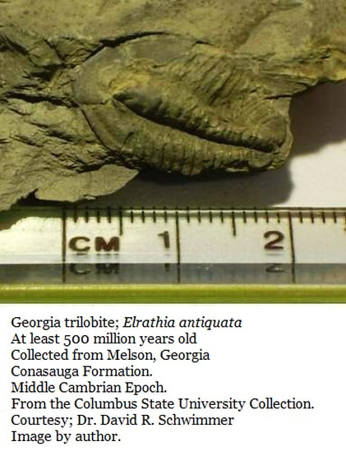
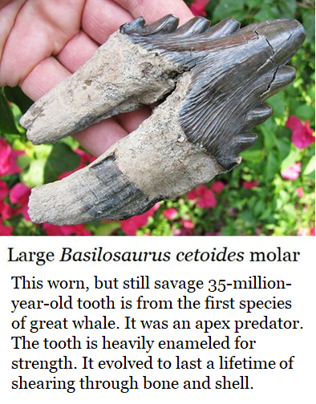
Teeth
Teeth are the most common vertebrate fossil.
Tooth enamel is the hardest substance the body produces so teeth are the most easily preserved.
Georgia’s fossil record shows that 500 million years ago Georgia was submerged beneath a fertile sea in the Southern Hemisphere.
Trilobites and other animals are well known from these Northwest Georgia sediments.
But these fossil beds hold no enameled teeth, such as ours. Enameled teeth had not yet emerged.
Neither were there vertebrates, anywhere on Earth.

Slide 3
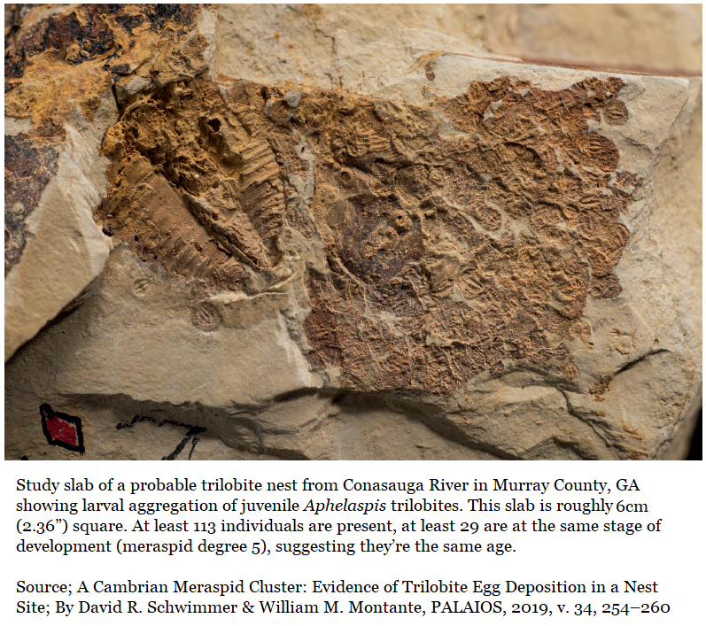

Teeth & bones didn’t exist, but nesting behavior had emerged.
Bill Montante of Tellus Science Museum discovered this small, 500-million-year-old trilobite slab. The larger individual to the left is the fossil of a shed shell, imagine something like a fossilized snakeskin. Trilobites indeed shed their shell as they grew. All the others on the small slab were living animals when they were buried. Of the 113 individuals present at least 29 are the same age.
Montante teamed up with David Schwimmer of Columbus State University in 2019 to publish a paper which showed, for the first time ever, that trilobites both nested and displayed homing behavior in a Georgia sea 500 million years ago.

Slide 4
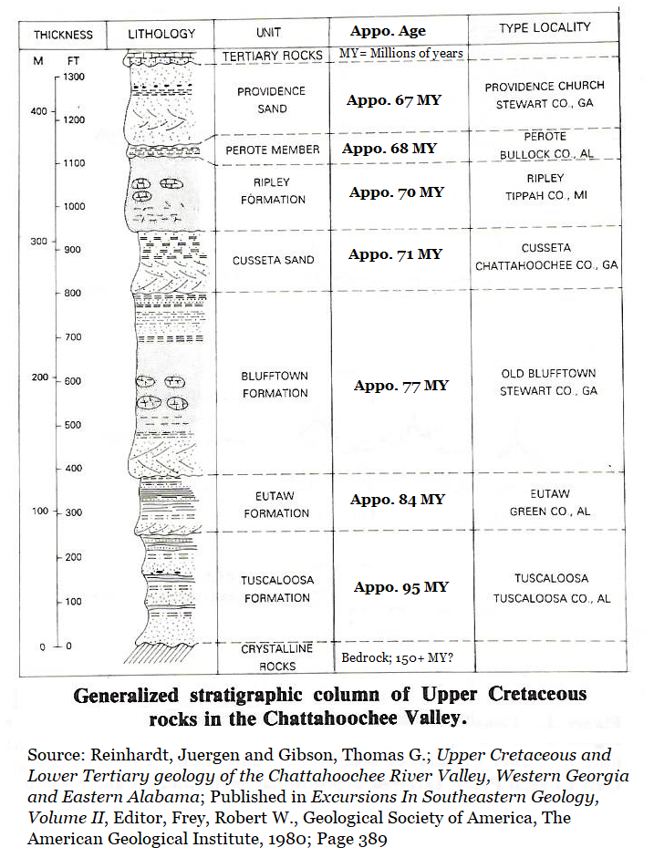

Stratigraphy
Earth’s Layers
Note: Fossils cannot be younger than the deposits holding them.
If enameled teeth hadn’t evolved when Georgia’s trilobites lived, then they cannot be present in the trilobite’s fossil bed.
The top pancake is freshest while the lowest pancake is the oldest.
Earth’s layered beds of sediments are generally the same, the top bed is the most recent & lowest bed is oldest.
The study of these layers is Stratigraphy.

Slide 5
A Species’ Path Through Evolution
A simplified explanation of a complex subject
Emergence
A new species emerges through an advantageous genetic mutation from their parent species.
Any mutation or variation which offers an advantage, no matter how small, will be preserved and amplified in successive generations. Mutated individuals must successfully mate and produce offspring within their parent species until sufficient mutated numbers exist to stabilize a new population.
Establishment
A new species becomes established when populations are self-sustaining, and individuals no longer seek mates from their parent species but prefer mates of their own species. However, in nature mating opportunities are rarely wasted.
Expansion
It is the nature of the individual to seek its own range; thus species tend to expand their range to the limits of their environmental tolerances or until they encounter natural obstacles they cannot overcome.
Diversification
Once a population and range is established, mutations or genetic drift within a species is tolerated and individuals with mutations can find opportunities to mate, thus establishing new species.
& Extinction
Typically a single species endures for less that 10 million years though this is highly variable. Extinction can occur for any number of reasons; disease, climate change, catastrophe, predation, or competition.

Slide 6
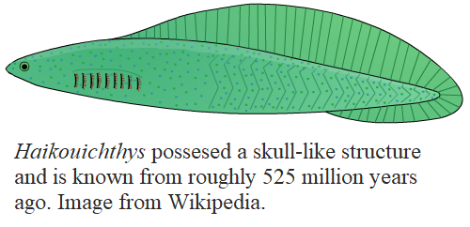
Rise of Bones & the Vertebrates
Those trilobite fossil beds lack teeth.
They also lack bones, trees, and insects.
None of this had yet emerged.
However; simple chordates like Haikouichthys were present & these would lead to vertebrates. They possessed a simple skull structure, though jawless, and a hollow tube of cartilage serving to protect their notochord.
That hollow tube and notochord would, in time, evolve into the vertebral column & spinal cord we share with all other vertebrate species.
Fish would emerge as the earliest vertebrates.
Teeth would take a bit longer.

Slide 7
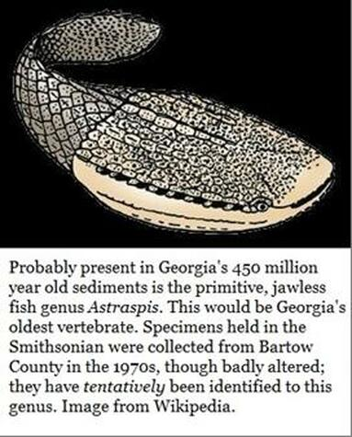
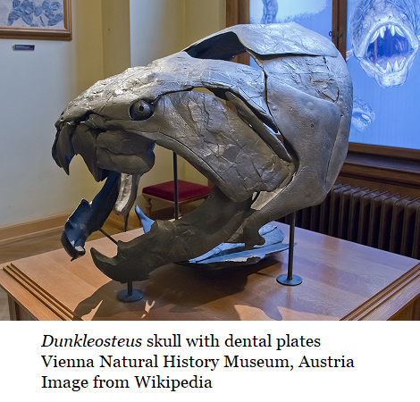
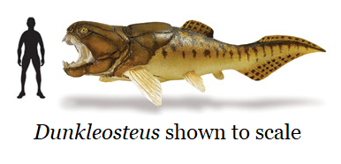
The Armored Fishes
Astraspis is a primitive armored fish about eight inches long fish which looked something like a tadpole but lived 443.7 to 488.3 million years ago, long before frogs or tadpoles emerged. It was a jawless fish which lived before evolution had produced the mandible, or lower jaw.
The global climate was hot due to high CO2 levels. Sea levels were very high. Ocean surface temperatures were around 113°F (45° C). By comparison, the 20th century global marine surface temperature average is 61°F (16°C) and climbing.
Bones, in a primitive form, are now present and seen as armor on fish, jawed fish are just beginning to establish themselves.
While not known from Georgia, at 390 million years ago the apex predator Dunkleosteus swims North America's seas.
It possessed a fully functional jaw but no teeth, rather the bones of the jaw itself were the self-sharpening cutting edge.

Slide 8
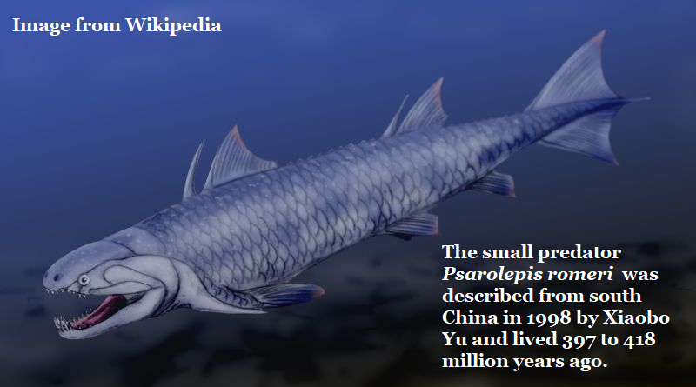
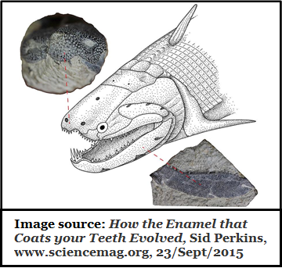
The Evolution of Teeth
At 400 million years ago jaws are present and the evolution of teeth is underway.
China has produced 400-million-year-old fossils of Psarolepis romeri which suggests enamel began as reinforcement for scales and bones.
It possessed enamel on its jaw and the roof of its skull, but not on its teeth.
Most living fish do not produce enamel, but there are exceptions.
Modern gar produce an enamel coating on their scales and
Modern shark teeth are enameled .
Note; Shark teeth are actually modified placoid scales that have the same structure as a tooth; an outer layer of enamel, dentine and a central pulp cavity.
Most modern four limbed animals have enameled teeth.

Slide 9
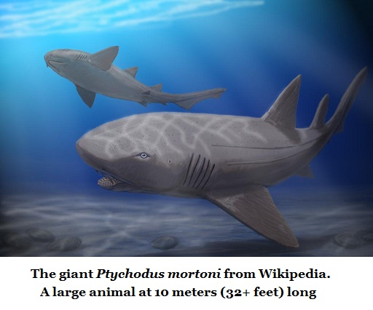
Georgia has a wealth of 83-million-year-old enameled shark teeth.
Diversification…
The class Chondrichthyes (or cartilaginous fishes) includes sharks, rays & everything in between. They generally have toothlike scales called dermal denticles or placoid scales. Denticles usually provide protection, and in most cases, streamlining. It is assumed that oral teeth evolved from dermal denticles.
West Georgia’s Ochilee Creek
83-Million-year-old, Eutaw Formation in Georgia
Scientific Name Common Name
Borodinopristis Sawfish
Columbusia Shark
Chiloscyllium Bamboo Shark
Cretodus borodini Mackerel Shark family
Cretolamna appendiculata Mackerel Shark family
Erguitaia Ray or Skate
Hybodus Hump Toothed Shark
Ischyrhiza Sawfish
Ischyrhiza mira Sawfish
Lissodus babulskii Sawfish
Microdontaspis Carpet Shark
Protoplatyrhina renae Skate
Pseudohypolophus Guitarfish
Ptychodus mortoni Extinct Shark
Ptychotrygon Sawfish
Ptychotrygon triangularis Sawfish
Scapanorhynchus rhaphiodon Goblin Shark
Squalicorax falcatus Mackerel Shark family
Squatina hassei Angel Shark
The ancestry of most modern sharks can be traced back 100 million years. Most fossils are of teeth, often in large numbers.
At left is a list of shark family teeth from west Georgia’s Eutaw Formation

Slide 10

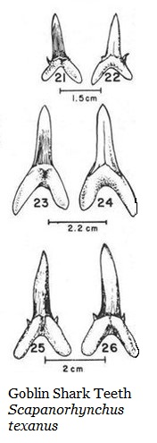
77 Million year old sharks from West Georgia’s Blufftown/Cussetta Formation.
In another joint project where David Schwimmer assisted Gerard (Jerry) Case we have sharks from the Blufftown/Cusseta Formation. In gratitude for Schwimmer's help, Case named a new sawfish species for him; Borodinopristis schwimmeri.
Blufftown/Cusseta Sand Formation sharks reported in 1987/1988 by Gerard Case & David Schwimmer.
Scientific Name Common Name Frequency
Hybodus (species?) Hump Tooth Tooth & claspers
Lissodus babulskii Thresher family 5 teeth
Squalicorax kaupi Crow Shark 100+ teeth
Pseudocorax affinis Crow Shark 2 teeth
Squatina (species?) Angel Shark 2 teeth
Ginglymostoma globidens Nurse Shark 5 teeth
Scapanorhynchus texanus Goblin Shark 1,000 + teeth
Synodontaspis holmdelensis Ragged Tooth 2 teeth
Cretolamna appendiculata Mackerel Shark 7 teeth
Cretodus borodini Mackerel Shark 3 teeth
Ischyrhiza mira Sawfish Oral & saw teeth
Ptychotrygon vermiculata Sawfish Oral & saw teeth
Brachyrhizodus romer Cow Nosed Ray Chevrons Pseudohypolophus Ray (Species?) Chevrons
Rhombodus laevis Guitarfish family 6 teeth
Borodinopristis schwimmeri Sawfish Saw Tooth
Originally attributed to the very top of the Blufftown Formation, recent microscopic fossil research by Schwimmer shows that the bed producing so many shark teeth seems to be reworked Cusseta Sand overlying the Blufftown Formation.
Notice the huge population of Goblin Sharks with their large teeth.

Slide 11
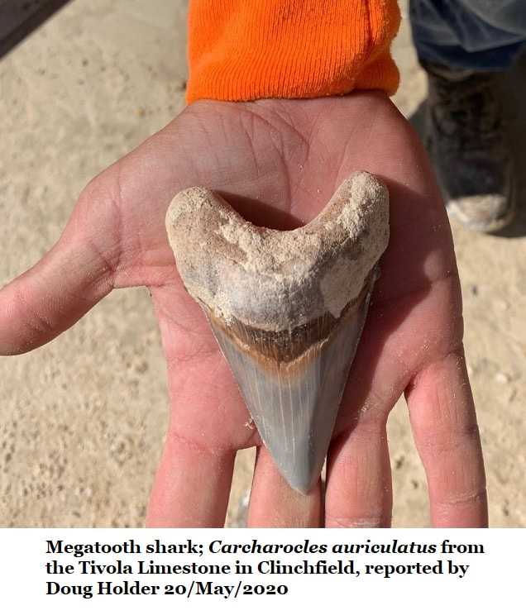
Georgia’s 34 to 35 million-year-old shark teeth.
Sharks reported from the Late Eocene Clinchfield Formation by multiple researchers.
Genus &/or Species Common name Frequency Reporting
Abdounia enniskilleni Extinct Gray Shark 492 teeth Westgate
Abdounia enniskilleni Extinct Gray Shark 589 Teeth Parmley
Carcharias acutissima Sand Tiger Shark 446 Teeth Parmley
Carcharias cuspidate Great White Shark Abundant Pickering*
Carcharias hopei Sand Tiger Shark 296 Teeth Parmley
Carcharias hopei Sand Tiger shark 922 teeth Westgate
Carcharias koerti Sand Tiger Shark 123 teeth Parmley
Carcharocles angustidens Megatooth Shark 2 Teeth Parmley
Carcharodon auriculatus Giant toothed shark 2 teeth Westgate
Dasyatis (sp) Stingray 53 teeth Westgate
Edaphodon (sp) 1st SE Chimaera Extremely Rare Parmley
Galeo latidens Tiger shark 219 teeth Westgate
Galeocerdo alabamensis Requiem Shark 351 Teeth Parmley
Galecerdo latidens Tiger Shark Abundant Pickering*
Ginglymostoma serra Nurse shark 13 teeth Westgate
Hemipristis curvatus Snaggletooth shark 170 teeth Westgate
Hemipristis curvatus Snaggletooth Shark 635 Teeth Parmley
Heterodontus (sp) Angel Shark 1 Tooth Parmley
Isurus (sp) Mako shark 4 teeth Westgate
Isurus praecursor Mako Shark 27 Teeth Parmley
Lamna (sp) Porteagle shark 124 teeth Westgate
Lamna Appendiculate Mackerel shark Common Pickering*
Mustelus vanderhoefti Smoothhound Shark 3 Teeth Parmley
Myliobatis (sp) Eagle Ray Abundant Pickering*
Myliobatis (sp) Eagle ray 8 dental batteries/284 teeth Westgate
Nebrius thielensis Nurse Shark 79 Teeth Parmley
Negaprion eurybathrodon Lemon Shark 2127 Teeth Parmley
Negaprion gibbesi Lemon shark 1538 teeth Westgate
Palaeorhincodon Whale Shark 1 tooth Parmley
Physogaleus (sp) Carchrhinid 19 teeth Westgate
Physogaleus secundus Sharpnosed Shark 70 Teeth Parmley
Pristis (sp) Sawfish Very rare Pickering*
Propristis schweinfurthi Sawfish 238 rostral teeth Westgate
Raja (sp) Skate 4 skutes Westgate
Rhinoptera (sp) Cownose ray 67 teeth Westgate
Scyliorhinus gilberti Catshark 53 Teeth Parmley
Sphyrna (sp) Hammerhead Rare Pickering*
Squatina (sp) Angel shark 1 tooth Westgate
Squatina prima Angel Shark 6 Teeth Parmley
Striatolamia macrota Sand Shark 1 Tooth Parmley​
Shark teeth reported in Central Georgia.
Georgia’s Clinchfield Formation has produced more than 9,700 scientifically reported vertebrate fossils scattered among about 50+ species of sharks, bony fish, reptiles, marine mammals, terrestrial mammals & one bird making it Georgia’s richest source of vertebrate material.
Late Eocene Georgia sharks reported by Gerard Case in 1981 including Pritis pickeringi which Case named for former Georgia State Geologist Sam Pickering.
Genus & Species Common Name Frequency
Pritis pickeringi Sawfish (New) 1 rost. tooth
Heterodontus pineti Bullhead shark 1 tooth
Procarchrodon auriculatus Megatooth (?) 3 teeth
Isurus oxyrhinchus Shortfin mako 3 teeth
Lamna twiggsensis Mackerel shark 5 teeth
Odontaspis acutissima Sand tiger shark 5 teeth
Odontaspis cuspzdata Sand tiger shark 1 tooth
Ginglymostoma obliquum Carpet shark 1 tooth
Scyliorhinus distans Catshark 2 teeth
Scyliorhinus enniskilleni Catshark 3 teeth
Hemipristis wyattdurhami Weasel shark 4 teeth
Galeocerdo clarkensis Tiger shark 3 teeth
Negaprion eurybathrodon Lemon shark 3 teeth
Scoliodon terraenovae Requiem shark 1 tooth
Rhizoprionodon (sp) Requiem shark 12 teeth
Galeorhinus galeus School shark 1 tooth
Galeorhinus huberensis School shark 5 teeth
Sphyrna zygaena Hammerhead 1 tooth
Squatina prima Angel shark 2 teeth
Rhinobatos casieri Guitarfish 1 tooth
Dasyatis borodini Stingray 1 tooth
Dasyatis charlisae Stingray 3 teeth
Pristis lathami Sawfish 1 rost. tooth
Propristis schweinfurthi Sawfish 3 Rost. teeth & frag
Rhinoptera daviesi Cownose ray 1 chevron
Myliobatis (sp) Eagle ray 1 chev. & jaw plate
Aetobatis (sp) Eagle ray 1 chevron

Slide 12
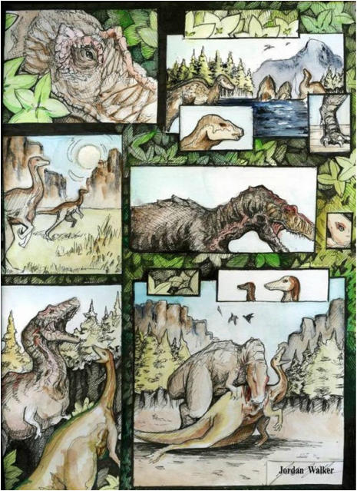
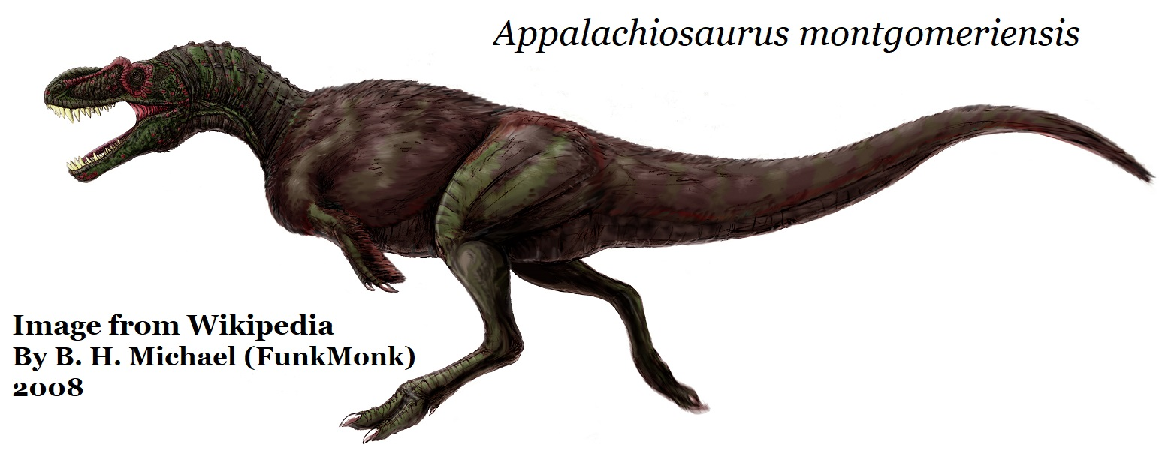
Appalachiosaurus montgomeriensis
Appalachiosaurus lived 77 million years ago and evolved from a branch of the tyrannosaur group, it is older than Tyrannosaurus rex.
Fossils for members of the tyrannosaur family are unusual in the eastern United States as conditions which favored the preservation of land animals were decided rarer than in the west.
Artwork by Jordan Walker

Slide 13
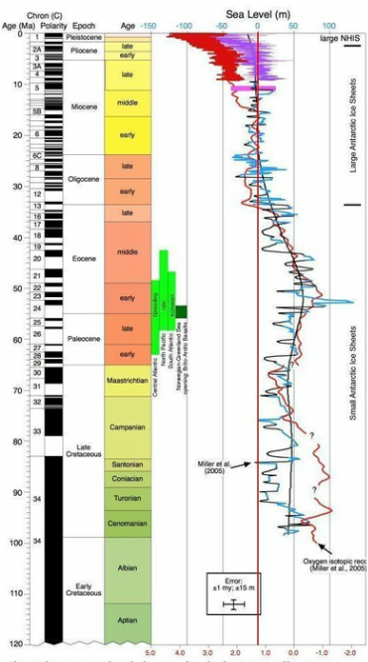
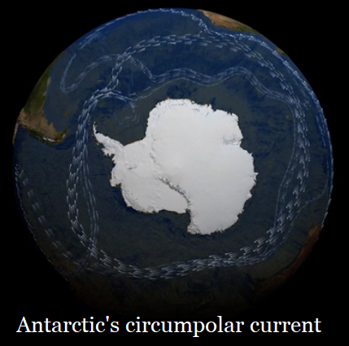
100 Million Years of Sea Level Change
Sea levels are driven by global temperatures.
Warm Earth, little water held as glacial ice = High sea levels.
Cool Earth, lots of water held in glacial ice = Low sea levels.
Over the last 100 million years sea levels have tended to be high.
About 40 million years ago Antarctica broke off from South America and slowly moved into its current position.
By 25 to 30 million years ago the cold Circumpolar Current became established around Antarctica trapping the cold and triggering large ice sheets & glaciers.
Zero at top & vertical red line shows modern sea levels.
To the right of the zero shows high stands above modern levels.
To the left of the red line is low stands, below modern levels. At top of graph shows the last 10 million years where levels fluctuated quickly & dramatically

Slide 14
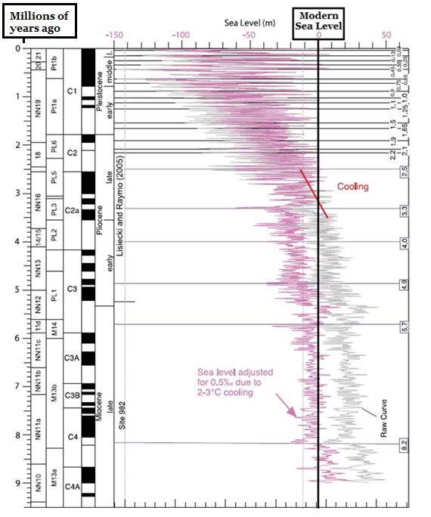
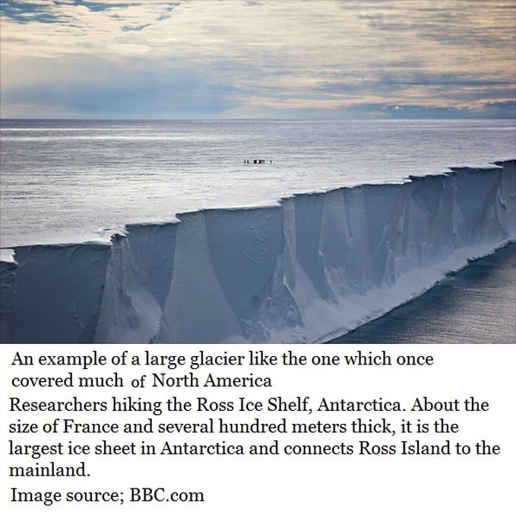
Sea level Change over the last 10 million years
By 10 million years ago the cold of Antarctica began to cool the globe.
North & South polar ice sheets increased.
Sea levels plummeted.
Glaciers began to grow & retreat in a repetitive cycle.
A cycle that continues today.

Slide 15
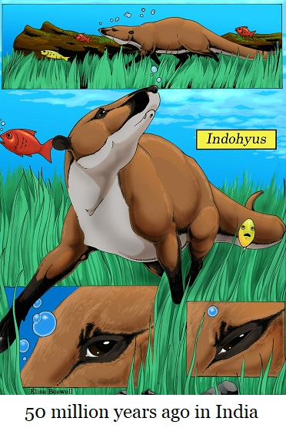
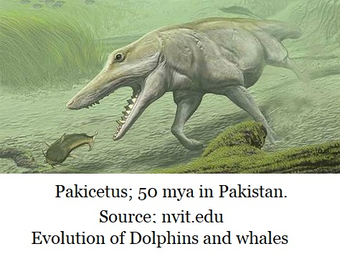

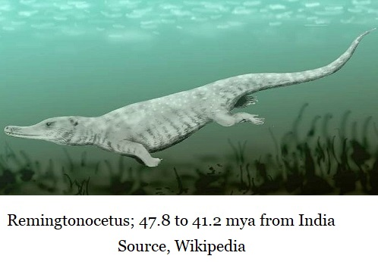
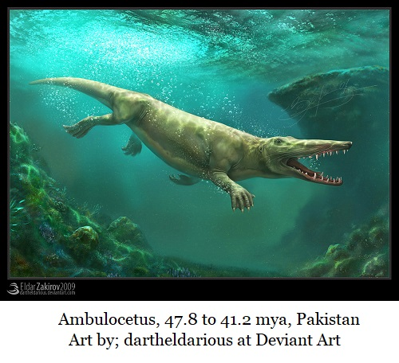
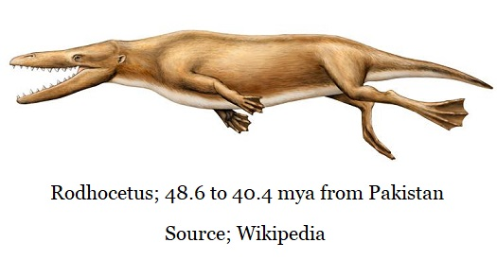
About 50 Million Years Ago
Whales Returned to the Sea & the Protowhales Emerged
The evolution of whales possibly began with Indohyus
which like modern hippos was a herbivore that fed on land but felt safest in the water. This raccoon sized animal that possessed the characteristic & distinct ear bone structure seen in all modern whales.
This return to the sea happened on the shores of the extinct Tethys Ocean. The protowhales, which were whales which swam with their legs, were diverse, but they were all carnivores. However, they too possessed that same distinct ear bone structure see in Indohyus & modern whales.

Slide 16
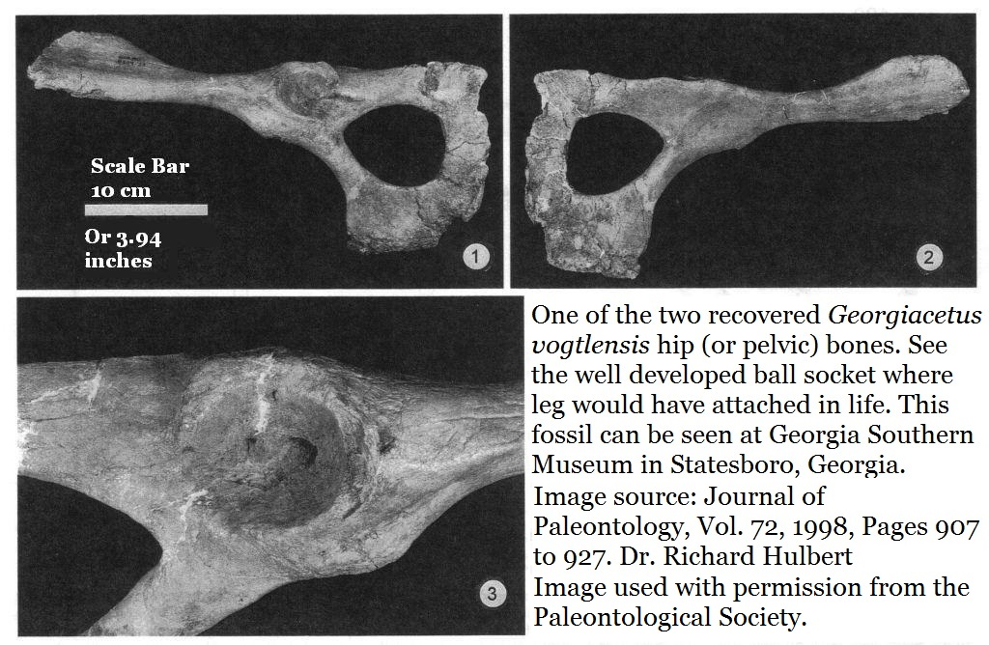
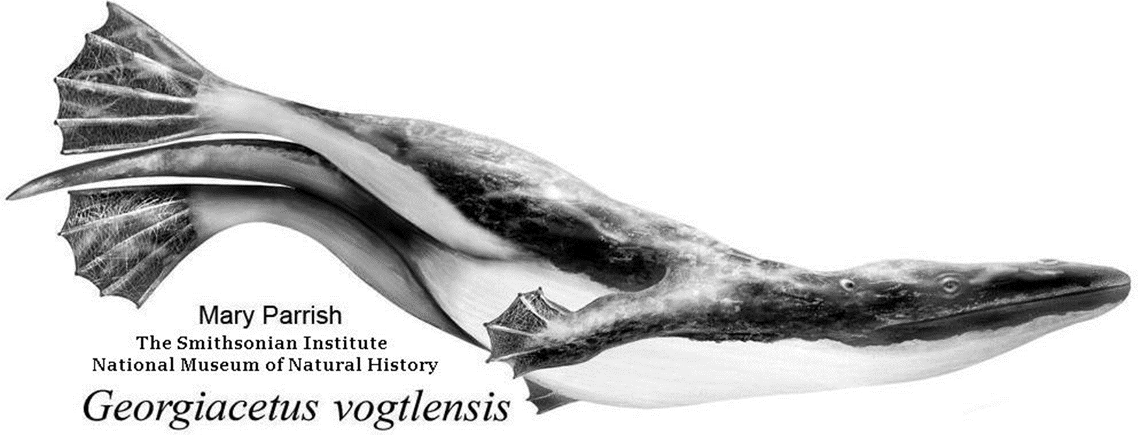
Southeastern Protowhales
For 10 million years the protowhales (Protoicetids) diversified and expanded their range from the Tethys Ocean to North America.
There were several very similar protowhales in the sea which covered much of the Southeast. They all apparently swam with their hind legs and lacked flukes.
Natchitochia jonesi; 39.5-39.9 million years ago (Louisiana)
Carolinacetus gingerichi; 39.7 - 42.4 million years ago (S. Carolina)
Georgiacetus vogtlensis; 39.8-42.4 million years ago (Georgia)
At 39.9 million year ago they may have all hunted in the same sea.
Nachitochia was the larger animal, but we have no skull material for reference. Georgiacetus is the smallest at 3 to 4 meters long.
Georgiacetus is also the most well known and the most advanced.
All three possessed large pelvis bones, suggesting they swam with hind legs. However, with Georgiacetus the pelvis is not attached to the spine. It could not support its own weight out of water.
The skull of Georgiacetus also shows more efficient teeth than any other known protocetid.

Slide 17
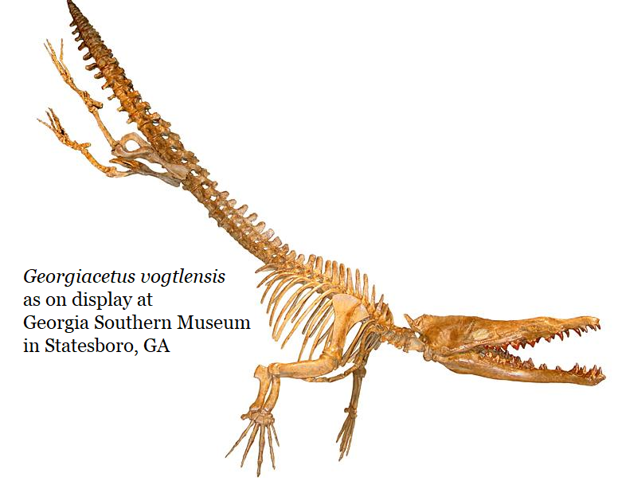
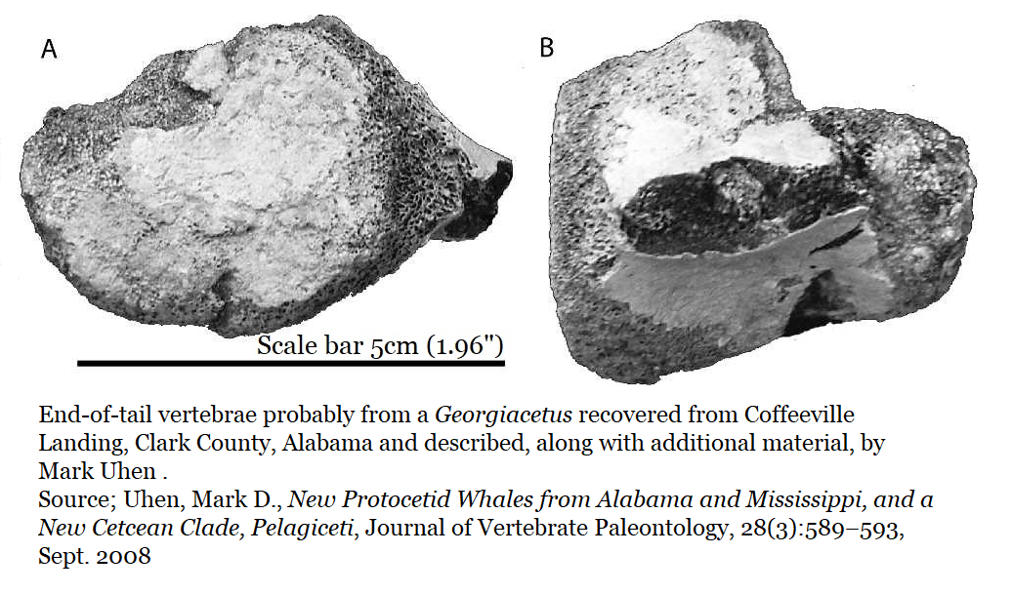
Georgiacetus vogtlensis; end-of-tail arrangement
For a decade no one was sure how Georgiacetus swam, no leg or end of tail material had ever been recovered and reviewed by science.
Then in 2008 Dr. Mark Uhen, currently at George Mason University, published a paper on new material from Alabama & Mississippi.
Included in that report was a single, damaged end-of-tail vertebra from a protowhale, the dimensions were appropriate for Georgiacetus. In spite of the damage, flanges were obvious. Flanges are anchors for muscles.
Whales with flukes have no flanges on their final vertebra.
This showed that Georgiacetus likely lacked flukes.

Slide 18
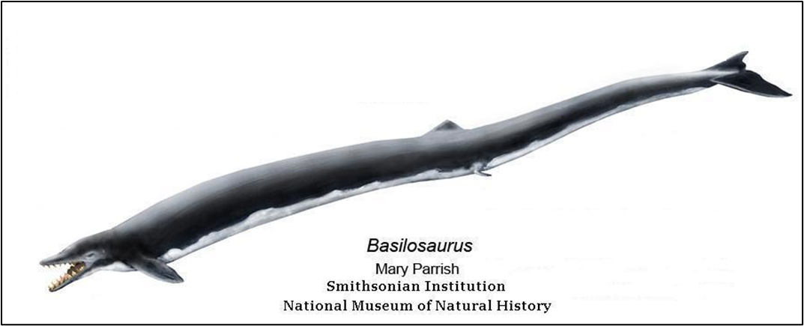
3 to 4 meters long (9 to 13 feet long)
Lived 39.8-42.4 million years ago
Georgiacetus vogtlensis likely had well developed hind legs. It was discovered in Burke County, GA. The original 1998 paper described remains from three individuals from the Plant Vogtle construction site; two very partial individuals and one 70 to 75% complete individual. It probably swam by moving its hind legs together in an up & down undulating motion like a modern otter or beaver.
Basilosaurus cetoides
emerged about a million years later, possessed tiny hind legs and a fluke.
It was described in 1839.
Basilosaurus is a fairly common Southeastern fossil. In Georgia it’s known from Houston, Twiggs, Dougherty Wilkinson, Washington, & several others.
15 to 20 meters long (49 feet to 65 feet long)
lived 41.3 to 33.9 million years ago
There are multiple species in the Basilosaurus genus, and several genre in the basilosaurid family.
They range in size from the great whale Basilosaurus cetoides to the killer whale sized Durodon serratus.

Slide 19
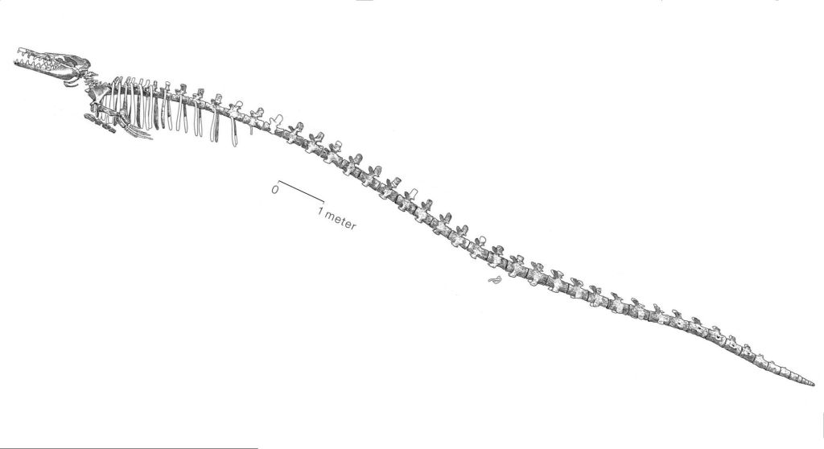
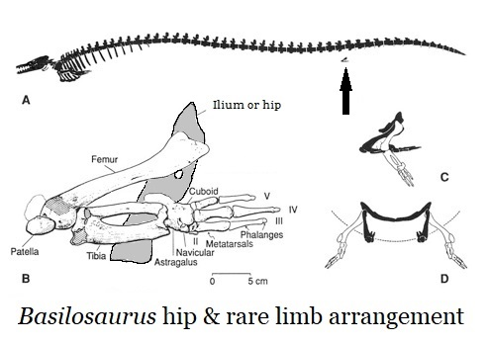
Basilosaurus cetoides
Diver shown only for scale.
This animal lived 41 million years before we existed.
While they were efficient warm water predators with a fearsome set of teeth, the basilosaurids did not possess the large brains of modern whales.
All the basilosaurids found extinction 33.9 million years ago during the Eocene/Oligocene global cooling and extinction event.
Held as the first great whale, Basilosaurus cetoides, and all the basilosaurids, possessed the free-floating vestigial hip and simplified end-of-tail, fluke supporting, vertebrae arrangement found in modern whales.

Slide 20
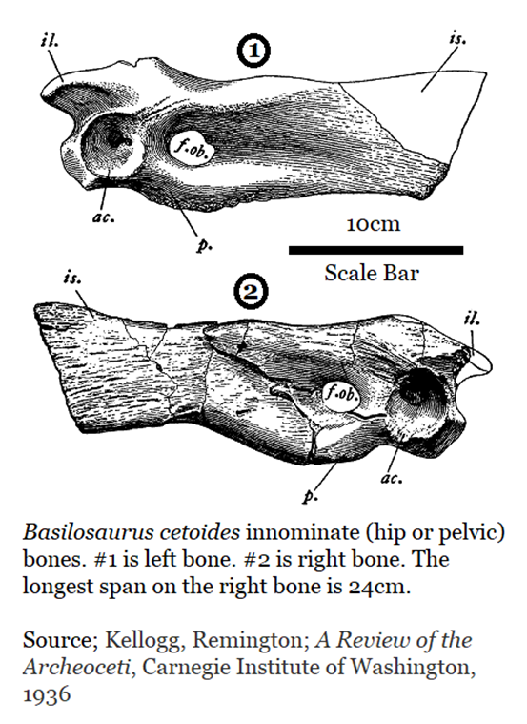
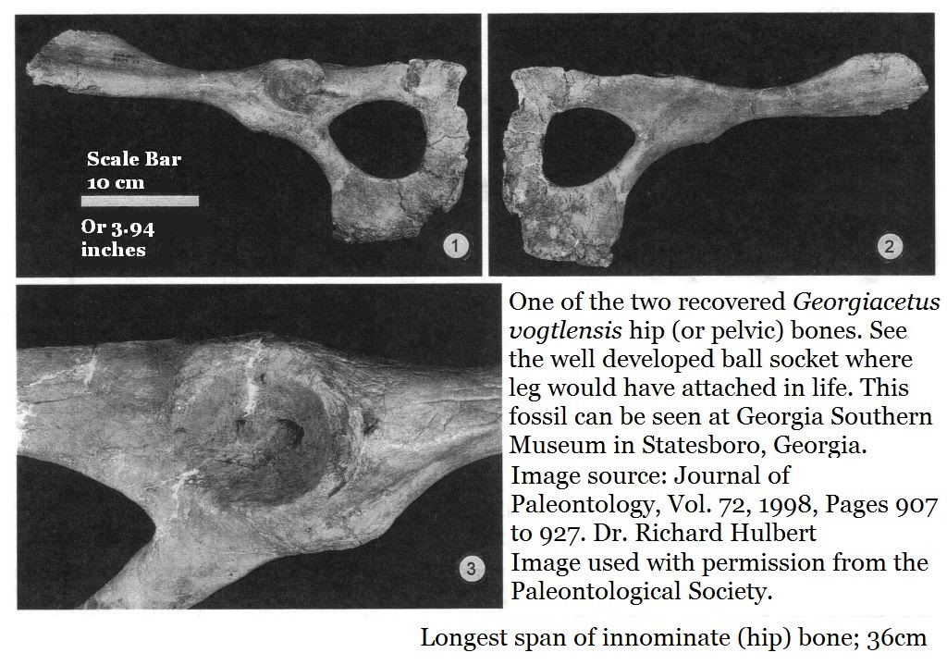
A Comparison of Hips
The Georgiacetus hip bones are 36cm (14”) long.
The living animal was 3 to 4 meters long (9 to 13 feet long)
The Basilosaurus cetoides hips bones are 24cm (9.4”) long for a living animal of 15 to 20 meters long (49 feet to 65 feet long)

Slide 21
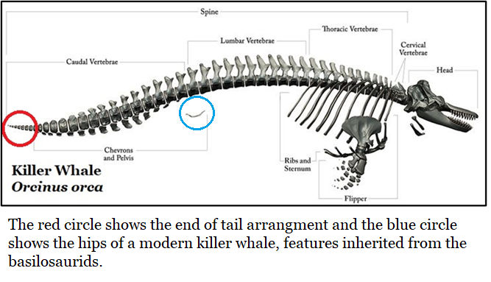
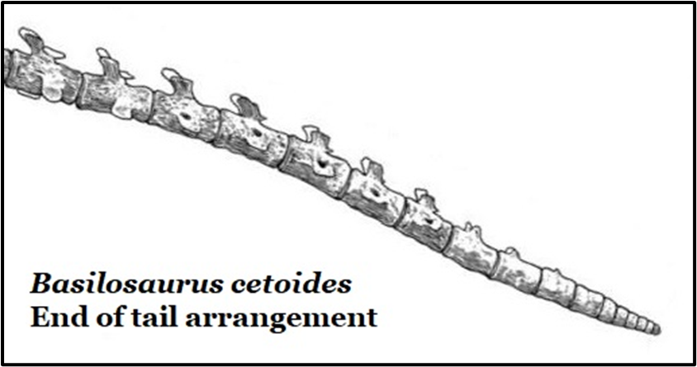
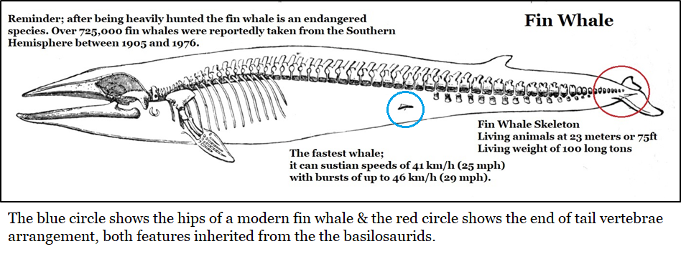
The Vestigial Hips & Tails of Modern Whales
All of the modern whales, from dolphins to the mighty rorquals; still share two traits inherited from Basilosaurus.
A vestigial hip, free-floating and unattached to the spine.
Simplified and compact end of tail vertebrae, wrapped in fibrous tissue to support the flukes.

Slide 22
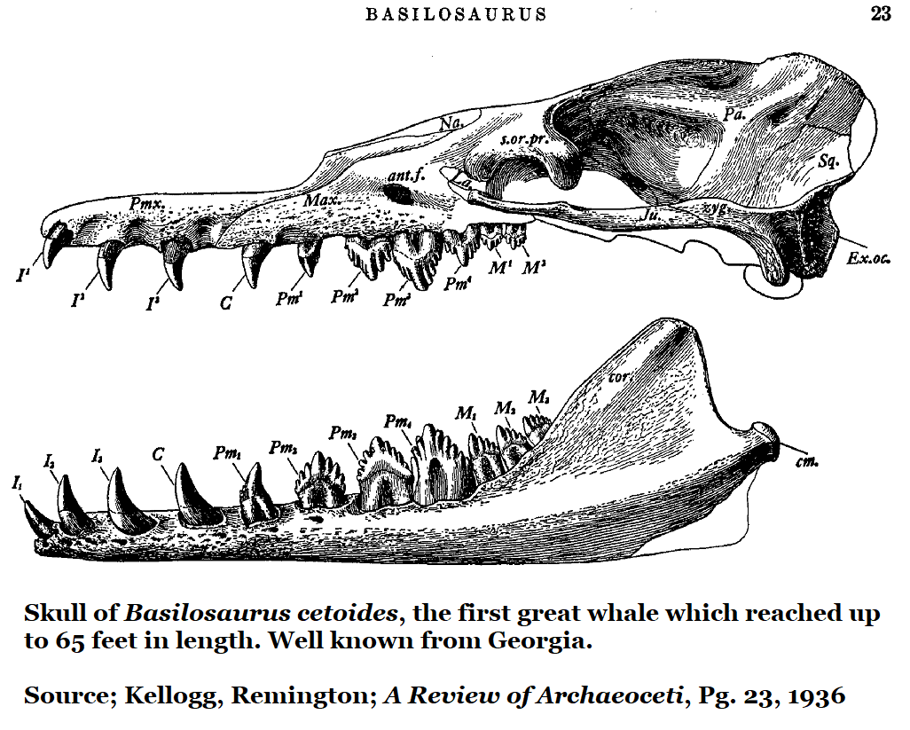
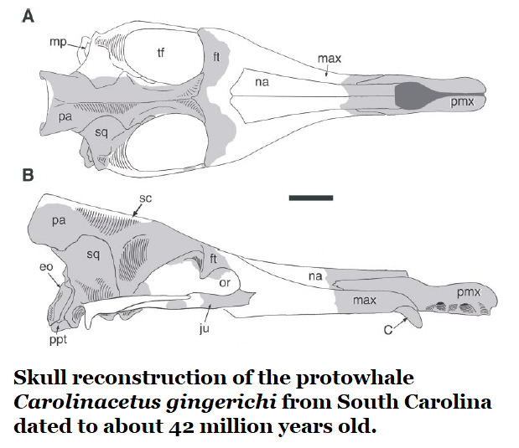
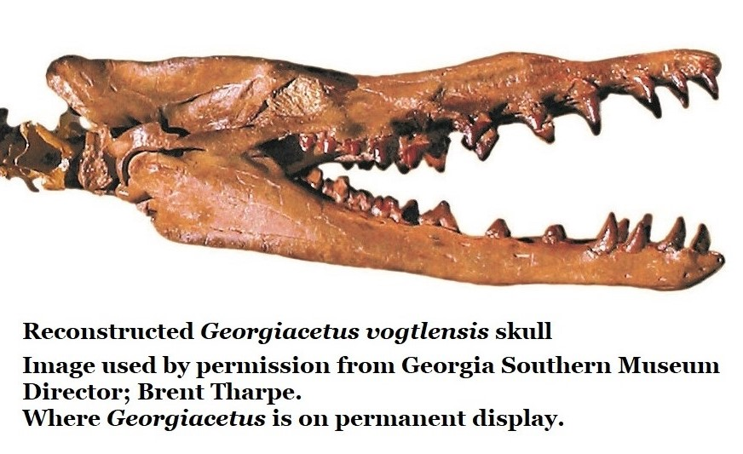
The Tooth of the Whale
#3
#1
#1; Protowhale;
Carolinacetus gingerichi, approximately 39.7-42.4 million years ago. Probably 3 to 4 meters in length. Described in 2005 from a South Carolina specimen.
#3; First great whale; Basilosaurus cetoides
Powerful muscles driving savage teeth.
#2; Protowhale; Georgiacetus vogtlensis
All three of these related species share a similar, very efficient tooth arrangement; forward peg-like teeth for seizing prey and rear shearing teeth for dispatching prey and processing it into manageable portions.
#2

Slide 23
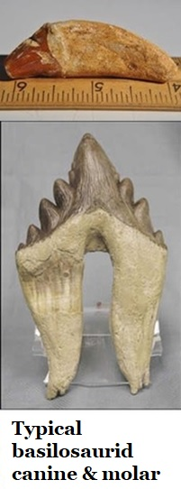
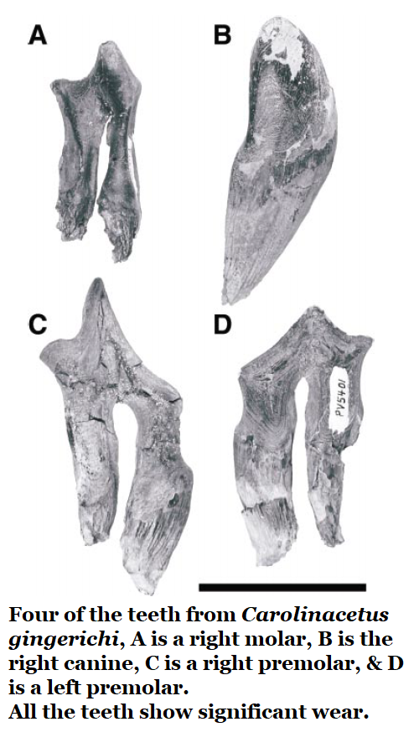
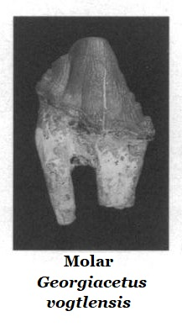
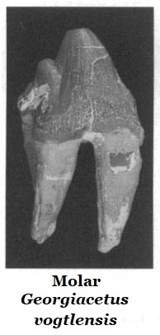
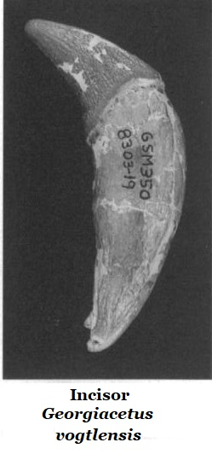
Evolution In Whale Teeth
Evolution doesn’t necessarily progress towards efficiency but the theory that “any mutation or variation which offers an advantage, no matter how small, will be preserved and amplified in successive generations” seems to apply in the progression of early whale teeth.
While Carolinacetus had efficient teeth (#1), clearly Georgiacetus is an improvement (#2), but Basilosaurus shows even greater efficiency with one of the most complex carnivore molars nature ever produced.
A tooth which occurs in Georgia.
#1
#3
#2

Slide 24
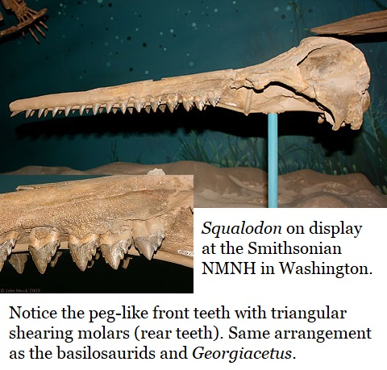
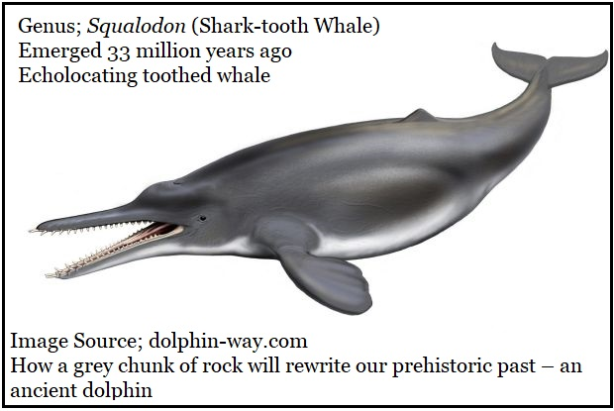
Modern Toothed Whales are Descendants of the Basilosaurids
Just after the extinction of the basilosaurids, about 33 million years ago the genus Squalodon emerged to a global presence including specimens from the Southeastern USA, but sadly no Georgia specimens have yet been reported.
The tooth arrangement of Squalodon clearly shows ancestry through the basilosaurids.
The deeply inclined skull above the eye sockets reveals the presence of the melon, and shows that Squalodon used echolocation, the same feature can be seen in modern dolphin and killer whale skulls.
Squalodon links the basilosaurids and modern toothed whales (Odontoceti).

Slide 25
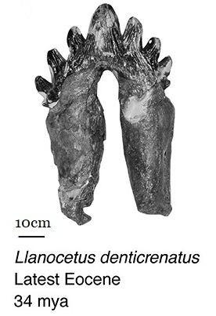
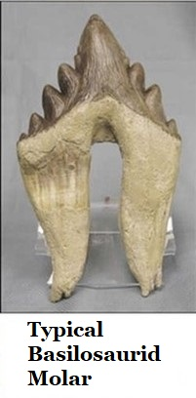
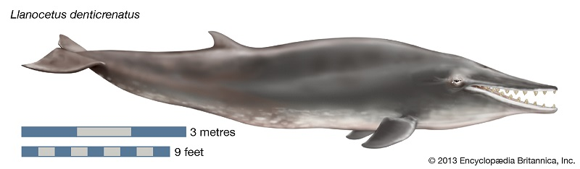
Modern Baleen Whales are Descendants of the Basilosaurids
Most of the earliest baleen whales (Mysticeti) occur in the Southern hemisphere where their greatest diversity persists to this day. Its likely they emerged there. Llanocetus denticrenatus is known from the 37.2 to 33.9-million-year-old sediments of Seymour Island, Antarctica.
Though unknown from Georgia, current research puts it as one of the oldest baleen whales.
It fed by filtering plankton through highly specialized basilosaurid-type teeth.
This was a large animal with a 2 meter (6.5 foot) long head and a body length of perhaps 30 feet (9.1 meters).
It was excavated in the mid-1970s and described by E. D. Mitchell in 1989. The skull is in on display at Smithsonian National Museum of Natural History in Washington.

Slide 26
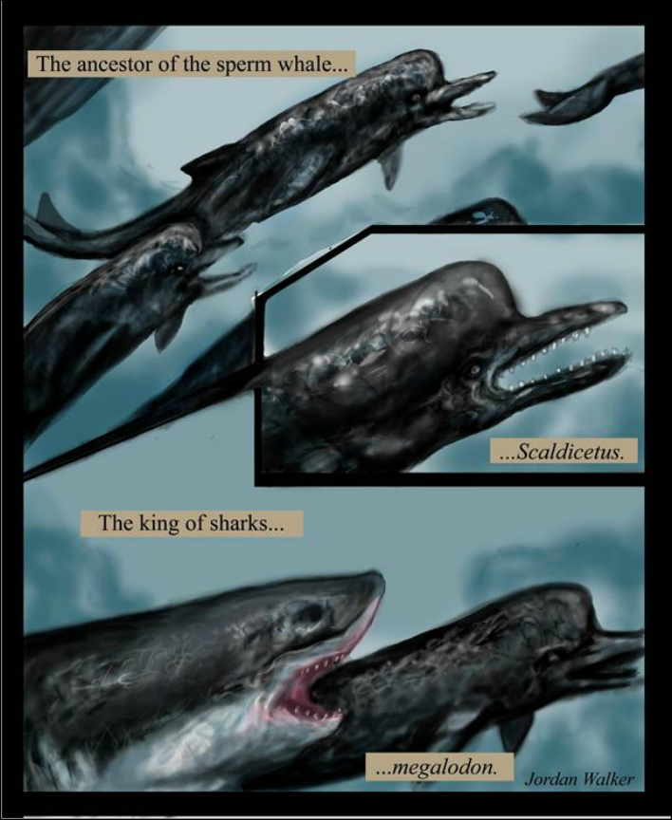


Scaldicetus; Killer Sperm Whale
At roughly 20 million years ago, & occurring in Georgia’s fossil record, is the killer sperm whale Scaldicetus. It is not closely related to either sperm whales or killer whales.
By this time whales have become far more efficient swimmers and teeth had become less complex with the incisor-like grappling tooth throughout the mouth.
This suggests a diet which required little to no processing.

Slide 27


Georgia’s Pleistocene Whales
Our Pleistocene sediments also hosted the extinct beaked whale Anoplonassa forcipata. The Georgia specimen founded the species and is currently the only known example. It’s a 7.5 inch long portion of a jaw bone housed in the collection of the Harvard Museum of Comparative Zoology in Cambridge, Massachusetts. It was collected and described by the famous American paleontologist Edward Drinker Cope in 1869.
A baleen whale completes the spectrum of whale types in Georgia’s fossil record. The modern gray whale, Eschrichtius robustus once swam on Georgia’s coast. The gray whale emerges into the fossil record during the Pleistocene.
It eats crustaceans which it scoops up from the bottom. Averaging 52 feet in length it no longer occurs in the Atlantic but is only known from the northern Pacific. Whalers called it the devil fish for its tendency to fight ferociously.

Slide 28



Both The Teeth & Baleen of Modern Whales
are a Departure from the Basilosaurids
Evolution doesn’t always advance towards complexity. While the basilosaurids possessed truly savage, complex teeth and powerful jaws; their brains were small.
Yet from the basilosaurids we have both the toothed whales and baleen whales. The complex teeth are long gone; replaced by simple baleen filters made of keratin (the same material as your fingernails) or the simple peg-like spikes of most toothed whales.
Yet, the brains have grown; especially in toothed whales. Dolphins and killer whales (the largest member of the dolphin family) are held as some of the most intelligent animals on Earth, perhaps on par with humans but with a very different type intelligence.
Whales & dolphins do not modify their environment, they have little use of tools and no use for fire.
Theirs would be an alien intelligence.

Slide 29



Flukes; the Lasting Evolutionary Gift of the Basilosaurids
“Any mutation which offers an advantage, no matter how small, will be preserved and amplified in successive generations.”
Basilosaurids possessed flukes and today there are at least 80 species of whales, dolphins & porpoises across the Earth which swim with that evolutionary gift from the basilosaurids.
But not all flukes are the same; some have evolved for efficient and sustained speed, some for agility, some for quick acceleration...
It is a mutation which has been preserved and amplified through successive generations.

Slide 30

There is a single light in science,
and to brighten it anywhere is to brighten it everywhere.
Isaac Asimov
Thank you,
Science Teachers,
for raising that single light
& guiding our children.

Slide 31
References
Thurman, Thomas D., GeorgiasFossils.com, Section 2: Trilobites, 500 million years ago, & the Conasauga Formation
Perkins, Sid; How the Enamel that Coats your Teeth Evolved, www.sciencemag.org, 23/Sept/2015
G. R. Case & D. R. Schwimmer. A New Selachian Fauna From the Eutaw Formation (Upper Cretaceous/Early to Middle Santonian) of Chattahoochee County, Georgia. Palaeontographica Abteilung A 261(Lfg. 4-6):83-102, 2001.
G. R. Case & David R. Schwimmer; Late Cretaceous Fish From The Blufftown Formation (Campanian) in Western Georgia, Journal of Paleontology Vol.62 No. 2, The Paleontological Society, 1988
Carr, Thomas; Williamson, Thomas; & Schwimmer, David; A New Genus and Species of Tyrannosauroid From The Late Cretaceous (Middle Campanian) Demopolis Formation of Alabama. Journal of Vertebrate Paleontology, Vol.25, No.1, pgs119-143, Society of Vertebrate Paleontology. March 2005
Miller, Kenneth G., Kominz, Michelle A., Browning, James B., Wright James D., Mountain, Gregory S., Miriam E. Katz, Sugarman, Peter J., Cramer Benjamin S., Christie-Blick, Nicholas, Pekar, Stephen F., The Phanerozoic Record of Global Sea-Level Change; . Science, Vol. 310, 25 Nov 2005
Westgate, James W; Paleoecology and biostratigraphy of marginal marine Gulf Coast Eocene vertebrate localities, Gunnell, G.F., eds., Eocene biodiversity, unusual occurrences and rarely sampled habitats: New York, Kluwer Academic/Plenum, p. 263–297., 2001
Parmley, Dennis and Cicimurri, David J.; Late Eocene Sharks of the Hardie Mine Local Fauna of Wilkinson County, Georgia; Georgia Journal of Science, Vol 61: (3) pgs153-179, 2003
Kellogg, Remington; A Review of the Archeoceti, Carnegie Institute of Washington, 1936
Thewissen J.G.M.; Cooper, Lisa Noelle; Clementz, Mark T.; Bajpai, Sunil; Tiwari, B.N.; Whales originated from aquatic artiodactyls in the Eocene Epoch of India. Nature, Nature Publishing Group, Vol. 450, vol. 20, 27/December/2007
Hulbert, Richard C. Jr.; Petkewich, Richard A.; Bishop, Gale A.; Bukry, David; Aleshire, David P.; A New Middle Eocene Protocetid Whale (Mammalia: Cetacea: Archeoceti) and associated Biota From Georgia. Journal of Paleontology, Vol.72, No.5. The Paleontological Society, 1998.
Geisler, Jonathan, H., Sanders, Albert E., Luo, Zhe-Xi; A New Protocetid Whale (Cetacea: Archaeoceti) From the Late Middle Eocene of South Carolina; American Museum Novitates, #3480, 25/July/2005
Uhen, Mark D., New Protocetid Whales from Alabama and Mississippi, and a New Cetacean Clade, Pelagiceti, Journal of Vertebrate Paleontology, 28(3):589–593, Sept. 2008
Mitchell, E.D.; A New Cetacean from the Late Eocene La Meseta Formation, Seymour Island, Antarctic Peninsula, published in the Canadian Journal of Fisheries and Aquatic Science, 1989

